Slide 1
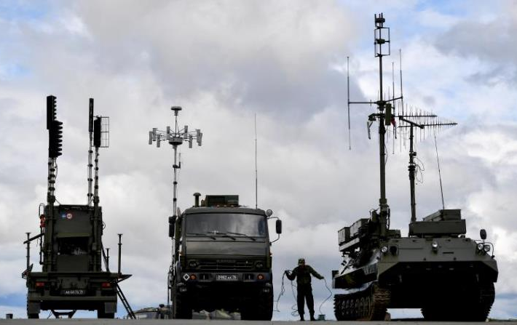
Rapid Analysis in a Congested Environment
ISMOR 40
Adam Beckett – Defence Consultant

Slide 2
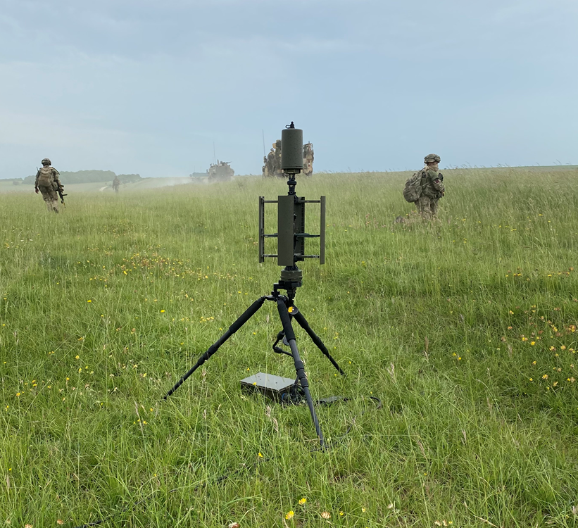
Contents
The Peer EW Threat
Data Capture & Analysis
Example Analysis Loops
Summary
Questions

Slide 3
Abstract
Roke is currently supplying Electronic Warfare capabilities as part of a suite to Collective Training Group (CTG) to capture, assess and manage UK Army visual, thermal, and electronic signatures. These capabilities assess the physical and electronic appearance of Force Elements from the perspective of peer/peer+ adversaries to provide a more realistic training experience. This presentation will show how data from EW sensors reveals identifiable patterns in the emissions generated by tactical land radios, and how our resulting short-loop analysis fed to the exercise’s Training Audience and Opposing Force allows near real-time actioning and exploitation of this data. The presentation will also highlight (within classification limits) insights derived from a growing collection of experimentally validated recommendations to enhance the survivability of Command Posts.

Slide 4
The Peer EW Threat

Slide 5
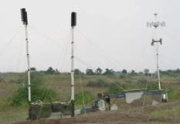
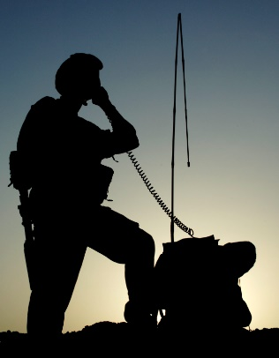

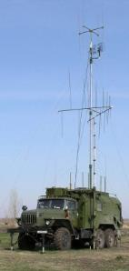
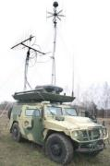
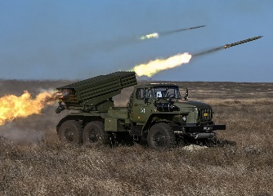
The Peer EW Threat
Forward Line
In the last 10+ years, peer(+) adversaries have invested heavily in Electronic Warfare (EW) capability designed to counter US & NATO information superiority.
They can use their layered EW assets to DRILE:
Detect presence of Radio Frequency (RF) emissions of interest.
Recognise radio systems that generate detected emissions.
Identify the Force Element (FE) that operates these radios.
Locate these FEs in tactically relevant times and with sufficient accuracy.
Exploit: By cueing other Intelligence, Surveillance, and Reconnaissance (ISR) assets, jamming, or Fires.
Command & Control (C2), ISR
Blue radio emissions
Detect, Recognise, Identify, Locate
Exploit
Electronic
Sensing (ES)
Electronic Attack (EA) / Fires
C2

Slide 6
Data Capture & Analysis

Slide 7
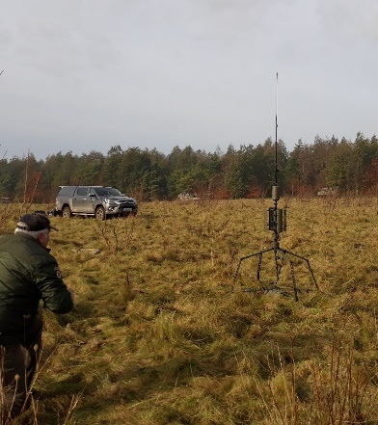
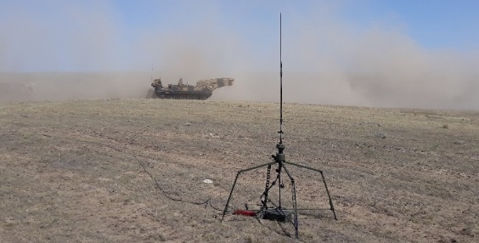
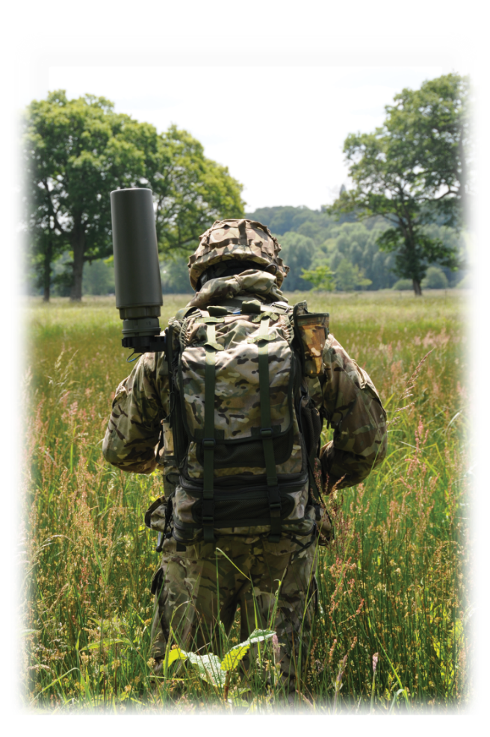

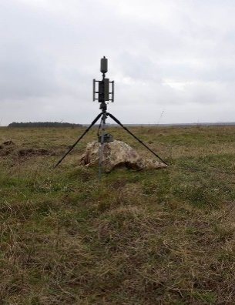
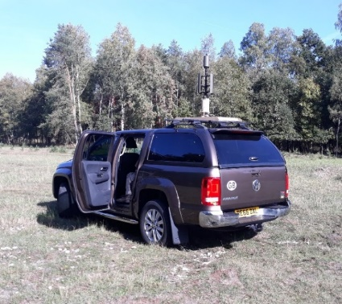
Experimentation Programme
Over the last few years, Roke, in support to Land Warfare Centre (LWC) Field Army Operational Research Branch (FAORB), has been conducting an experimental campaign to measure the RF signatures of Army Command Posts (CPs) and other FEs during training Exercises.
We have collected a wealth of data on the RF signatures of CPs, using Roke’s Resolve sensors, while representing a live ES threat.
Through our short-, medium-, and long-loop analysis of this data, we have generated insights on:
  Factors influencing the ability of a peer enemy to DRILE Blue RF signatures;
  Measures that can be applied which may reduce the ability of a peer(+) opponent to DRILE.

Slide 8
Planning for Success
By devising a Data Collection & Management Plan (DCMP), all relevant data can be properly recorded and organised for maximum effectiveness.
A strict DCMP can be created when the goals of a collection are clearly defined, i.e., when there are defined questions to be answered.
However, as there is a requirement to develop new insights and experiment with new scenarios, dynamic analysis must be conducted. As a result, the DCMP must account for any potentially useful data.
LONG-LOOP
MEDIUM-LOOP
MEDIUM-LOOP
MEDIUM-LOOP
SHORT-LOOP
SHORT-LOOP
SHORT-LOOP
Day 1
Day 2
Day 3
Day 4

Slide 9
Short-Loop Analysis (Rapid)
Each Exercise day ends with an After-Action Review (AAR), a key time for Observer-Mentors (OMs) to convey insights to the Training Audience (TA).
To provide material for the AAR, the Roke team must conduct rapid analysis in the field during the data collection.
This short-loop analysis comprises first-look insights from the day, providing initial answers to any OM questions.
Templates produced from previous Exercises are used to quickly analyse large amounts of data.
SHORT-LOOP
SHORT-LOOP
SHORT-LOOP
Day 1
Day 2
Day 3
Day 4

Slide 10
Medium-Loop Analysis (Dynamic)
Following the completion of a daily data collect, dynamic analysis takes place.
To find new insights, the analyst must dive deeper than templates allow, using each of the tools at their disposal.
These products are provided the following morning and provide further evidence to the rapid analysis product alongside new insights.
These dynamically-generated insights may not answer existing questions and may prompt further investigation.
MEDIUM-LOOP
MEDIUM-LOOP
MEDIUM-LOOP
Day 1
Day 2
Day 3
Day 4

Slide 11
Validation of Insights
Rapidly-delivered insights can be acted upon within the daily rhythm of the Exercise.
  This allows collection of further data for validation purposes.
Through constant communication with OMs, relationships between behaviour and observed emissions can be quickly ascertained and validated.
  This also provides the TA with opportunities to improve through the exercise.
CONTINUALLY-GATHERED FEEDBACK
Day 1
Day 2
Day 3
Day 4

Slide 12
Long-Loop Analysis (Trends & Reporting)
By the end of an Exercise, data from each daily collect, potentially across multiple weeks, will be available to the analyst.
Trend analysis from this aggregated data is extremely valuable for the end-of-exercise AAR, as it can be used to track the progress of the TA.
LONG-LOOP
Day 1
Day 2
Day 3
Day 4

Slide 13
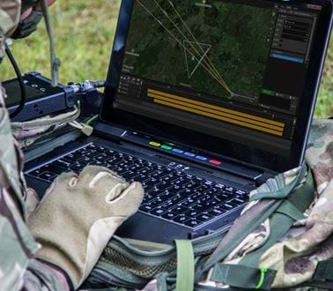
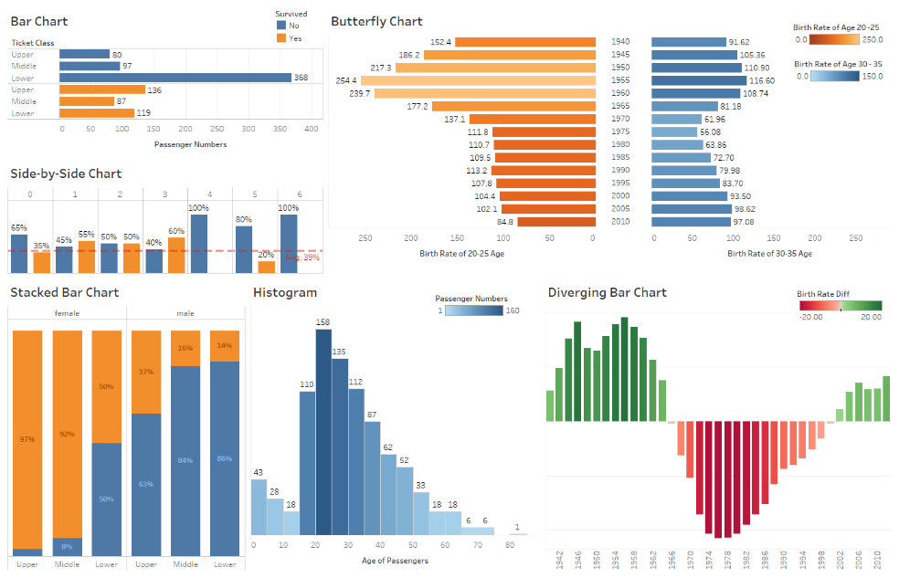
Analysis Tools
Application of Tools to Each Loop
 | Short-Loop | Medium-Loop | Long-Loop
Viper | Essential | Highly useful | Useful
Python | Too slow | Useful | Useful
Excel | Useful | Essential | Essential
Tableau | Essential | Essential | Essential
Roke Viper
  Initial & immediate views to aid rapid analysis.
Python
  Extraction and manipulation of raw data.
Excel
  Filtering and experimenting with processed data.
Tableau
  Visualisation and comparison of datasets.
  Can produce templates essential to rapid analysis.

Slide 14
Examples of Effective Rapid Analysis

Slide 15
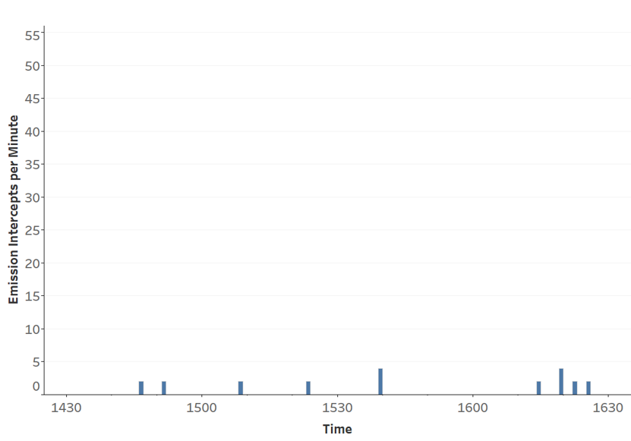
Automated Systems
BEFORE
Blue: X Net
Orange: All other nets
Regular spikes in emissions, in this case occurring every 8 minutes on X net, are indicative of automated transmissions.
  These automated emissions make up most detected emissions from this location – X net’s automation is betraying the location of the CP.
Once this was isolated to a specific CP, the feedback was delivered, and the following day, emissions stopped – a quick and impactful win for the TA.
  This also validates our identification of the signals as an automated system.
AFTER
Fewer emissions = Better survivability

Slide 16
Deception – How many resources are required?
Deception is a key tactic to gain the upper hand against a peer threat.
The TA sent vehicles to Crossing 1 to generate a visual signal, but in the RF view, Crossing 2 is clearly under heavier use.
By delivering a visual representation of RF information, the TA were alerted to the importance of resourcing a deception beyond the visual spectrum.
In future attempts, increased radio usage made deceptions far more convincing from an RF perspective.
  This validates our advice that resourcing a deception with radios allows for a greater deception effect.
Heat indicates intercepted RF emissions

Slide 17
Summary

Slide 18
Summary
Our Rapid Analysis loops allow for validation and improvement throughout a single exercise.
Relying on appropriate tools allows rapid analysis without hindering experimental or dynamic analysis.
Currently, the team have progressed to dynamically reporting and investigating on behalf of the Exercise’s Red team, providing constant insights and augmenting Exercise realism.
  In the future, the team’s capability could be increased with greater presence, allowing a constant watch of the entire Area of Operations.
LONG-LOOP
MEDIUM-LOOP
MEDIUM-LOOP
MEDIUM-LOOP
SHORT-LOOP
SHORT-LOOP
SHORT-LOOP
Day 1
Day 2
Day 3
Day 4

Slide 19
Questions

Slide 20

Contact Details
Adam Beckett MSc
Senior Consultant
­­
Phone +44 (0)1794 833677 Mobile +44 (0)7511 050274
Official Email: adam.beckett@roke.co.uk
O-S Email: adam.beckett@roke.r.mil.uk

