Slide 1
Welcome to the first event of the year from the
Analytics Network

Slide 2
Agenda
Intro from John Hopes the President of the OR Society
Nadine Keane: CAP Journey and its benefits
Anna Kobylinska: EY Cash Analytics
Upcoming events

Slide 3

Certified Analytics Professional

Slide 4
The OR Society and Analytics
The OR Society is the professional home for the operational research and analytics community in the UK.
The Analytics Network is a special interest group that hosts events throughout the year for those with a particular interest in analytics.
The OR Society has partnered with INFORMS in the USA to offer the Certified Analytics Professional (CAP) accreditation in the UK.

Slide 5
What is CAP?
CAP is the premier global professional certification for analytics practitioners administered by INFORMS in the USA.
Those who meet CAP’s high standards and pass the rigorous exam distinguish themselves and create greater opportunities for career enhancement.
For organisations seeking to enhance their ability to transform complex data into valuable insights and actions, CAP provides a trusted means to identify, recruit, and retain the very best analytics talent.
Notes:
Certified Analytics Professional, an exam-based analytics qualification established by INFORMS, the US equivalent of the OR Society.

Slide 6
Do I qualify?
Earning the CAP credential includes meeting eligibility requirements for experience and education:
Earning the CAP credential also requires effective mastering of soft skills, committing to the CAP Code of Ethics, and passing the CAP exam.
DEGREE LEVEL | DEGREE AREA | EXPERIENCE
MSc/MA or Higher | Related Area | 3 Years
BSc/BA | Related Area | 5 Years
BSc/BA | Non- Related Area | 7 Years

Slide 7

Is it right for me?
CAP may be right for you if:
You want a certification that is specifically related to analytics or
You want a designation recognised by people unfamiliar with operational research or
You want an exam-based qualification.

Slide 8
Programme at a Glance
Globally recognised credential based on practice of analytics professional
Vendor and software neutral
Created by teams of subject matter experts from practice, academia, and government
Focused on seven domains of analytics process:
I. Business Problem Framing
II. Analytics Problem Framing
III. Data
IV. Methodology Selection
V. Model Building
VI. Deployment
VII. Lifecycle Management
Computer-based exam administered through the CAP test vendor network

Slide 9
CAP Benefits
Building Capability: CAP-accredited employees and professionals provide the unique capability to leverage the power and promise of analytics.
Driving Credibility: Having CAP professionals on your team demonstrates you have the top talent in place and are committed to the highest ethical standards of analytics practice.
Creating Opportunity: Encouraging employees and professionals to pursue CAP certification creates new opportunities for long-term career success and provides new avenues for an organisation’s analytics-based growth.

Slide 10
What support do you provide?
Resources available via The OR Society website at www.theorsociety.com/CAP include:
  CAP handbook
  Links to INFORMS webinars
  FAQ page
Support from The OR Society staff
  Call the office or email felicity.mcleister@theorsociety for further information.
For further information, to register and apply visit: https://www.certifiedanalytics.org
Notes:
Webinars – series of webinars that cover everything you need to apply, prepare, and benefit from your CAP® Certification
Handbook – The handbook supplements the webinars and provides you with complete information about the CAP® Program, How to Apply, Preparing for the Exam, Taking the Exam, and the Code of Ethics.

Slide 11
What else do I need to know?
Cost
  ORS Member rate: $495
  Non–members: $695
Ease
  The INFORMS dashboard is easy to navigate, provides all the necessary resources and application is quick and easy.
Recertification
  Certifications lasts three years. To renew you must demonstrate CPD.
CPD
  CAP requires commitment to CPD and record-keeping of CPD for inspection.
Notes:
John FYI: All CAP® certificants will be required to achieve a total of 30 Professional Development Units over the initial and subsequent three-year renewal period. The PDUs may be achieved in several different categories including: formal professional education courses, self-directed learning, creating new analytics knowledge or content, volunteer service, and analytics professional work experience. In general one hour of activity equals one PDU. There are various thresholds and limits for PDUs in the various categories. See the Candidate Handbook for more information.

Slide 12
Other Accreditations
The OR Society offers three pathways for professional certification – the OR Society Accreditation, Chartered Scientist and Certified Analytics Professional.
OR Society Accreditation – this staged accreditation scheme is ideal for anyone with a relevant degree and a desire for professional development.
Chartered Scientist – CSci is ideal for anyone who wants a widely recognised accreditation, demonstrating their scientific competence.
To find out more please visit: http://www.theorsociety.com/Pages/csci/orschemes.aspx

Slide 13
Analytics Network
@AnalyticNetwork
For those with an interest in analytics, in topics such as data science, optimisation, visualisation, big data, regression, data mining, predictive modelling or forecasting.
A community of more than 1,300 people across the UK, run by volunteers.
Regular events, seminars and discussions with content prescribed by members.
Eduardo Contreras Cortes - Interim Chair of Analytics Network.
If you're interested in helping to develop and run the Analytics Network, please email Hope Meadows on hope.meadows@theorsociety.com

Slide 14


The CAP Experience
Nadine Keane
Feb 2018

Slide 15
agenda
Why CAP®
Professional & Personal Learnings
Tips for Preparing
Q&A

Slide 16

why
‘Craft a Sustainable Career’ Monica Valour HBR 2013
actively practice career crafting
know how you add value
link accomplishments to career goals
stay up to date with professional and industry developments
seek opportunities to work or network with inspiring people

Slide 17

INFORMS CAP®
Certified Analytics Professional credential awarded by Institute for Operations Research and the Management Sciences (INFORMS)
extensively experienced certification board
must meet academic and experience thresholds
fair, valid and reliable examination
demonstrates commitment to ethics in the profession
needs certification renewal through lifelong learning

Slide 18
learnings
Examination Domains follow Analytics Solution Process:
Business Problem Framing (12-18%)
Analytics Problem Framing (14-20%)
Data (18-26%)
Methodology (Approach) Selection (12-18%)
Model Building (13-19%)
Deployment (7-11%)
Model Lifecycle Management (4-8%)

Slide 19
learnings
Practical Knowledge
Professional Development
Networking
Value Add
Accomplishment
Team Management
Industry Development
Career Challenge
Academic Knowledge
Being Inspired by Analytics Professionals

Slide 20
learnings
Try, try harder…
Business
Problem
Framing
Analytics
Problem
Framing
Data
Methodology
Selection
Model
Building
Deployment
Model
Lifecycle
Management

Slide 21
tips for preparing
visit certifiedanalytics.org
CAP® Handbook
Study Guide
JTA: Job Task Analysis, Tasks per Domain
Webinars per Domain
Sample Test

Slide 22
Thank You
Questions?

Slide 23
Predicting invoice lateness
Analytics Network Event from the OR Society
  February 2018

Slide 24

29%
Share of invoices in UK not paid on time
1. Can we use analytics to predict which ones?
2. And if so, what to do about them?

Slide 25



Company A
Company B
Company C
Transport
Publishing
Property

Slide 26





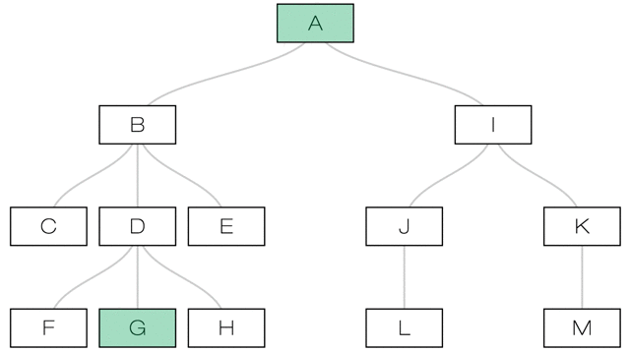



Step 1:
Data extraction/ data model
Data fetch
Transactional payments data
Narrative commentary
Automated extraction process
Vendor deduplication
Family tree
Cleansing
Master Data Layer

Slide 27
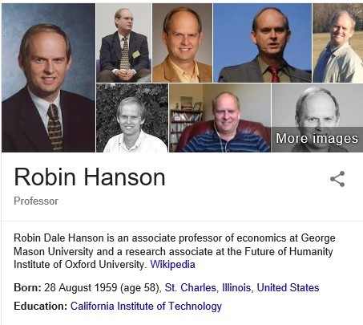
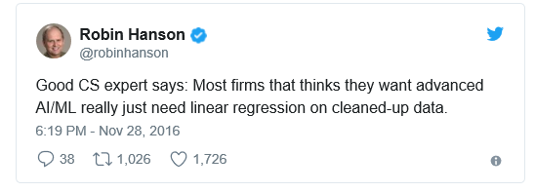
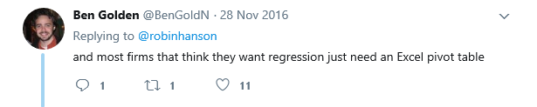
Notes:
Real cash out of the improved situation

Slide 28
Step 2:
Simple
New invoice
Did the customer paid you on time in the past?
60%
no
yes
1 hour
Model build effort
Model accuracy
LATE
ON TIME

Slide 29
Step 3:
Logistic regression on past timeliness
Past late payments
75%
1 day
Model build effort
Model accuracy
Risk of late payment
Company C

Slide 30
Step 4:
Adding more variables
+ 100
signals considered
80%
2 weeks
Model build effort
Model accuracy

Slide 31
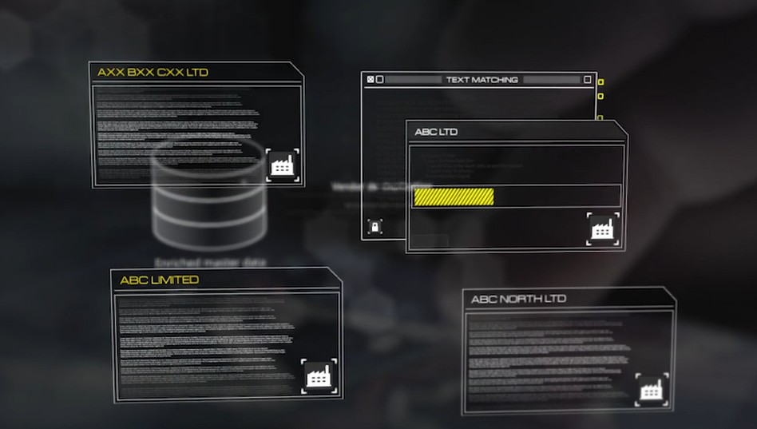
Step 5:
Even more variables– through external data matching
4 weeks
85%
Model build effort
Model accuracy

Slide 32
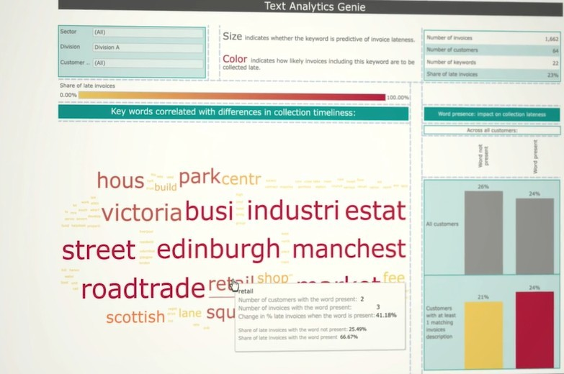
Step 6:
Adding unstructured data
6 weeks
88%
Model build effort
Model accuracy

Slide 33
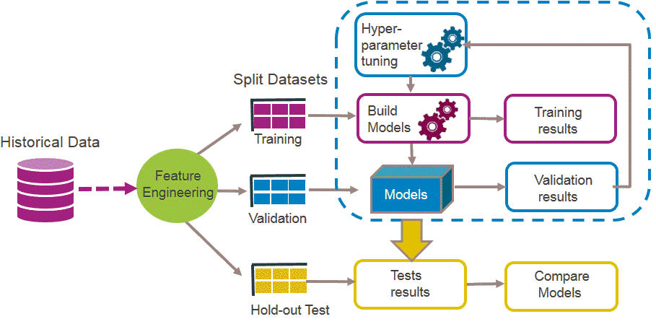
Step 7:
Different ML methods
2 months
90%
Decision Trees
Support Vector Machine (SVM)
Random Forest
Ranger Random Forest
Gradient Boosting Machine
Extreme Gradient Boosting
Model build effort
Model accuracy

Slide 34

30% uplift in model accuracy
Company B
£2.5M more high risk invoices identified

Slide 35
29%
Share of invoices in UK not paid on time
Can we use analytics to predict which ones?
And if so, what to do about them?

Slide 36
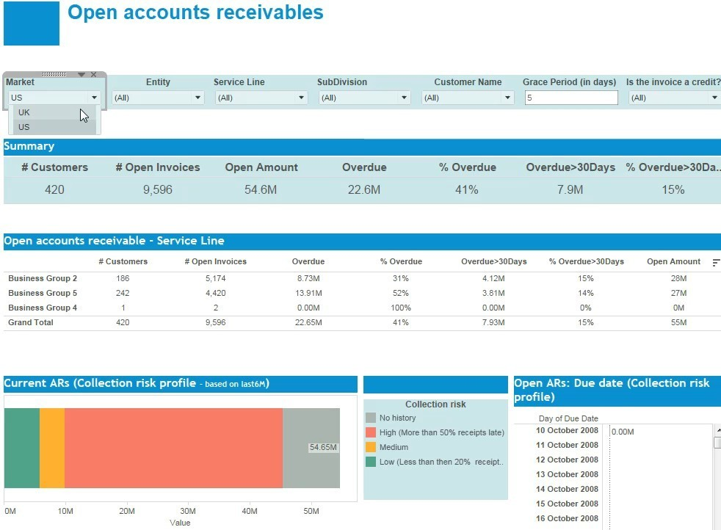
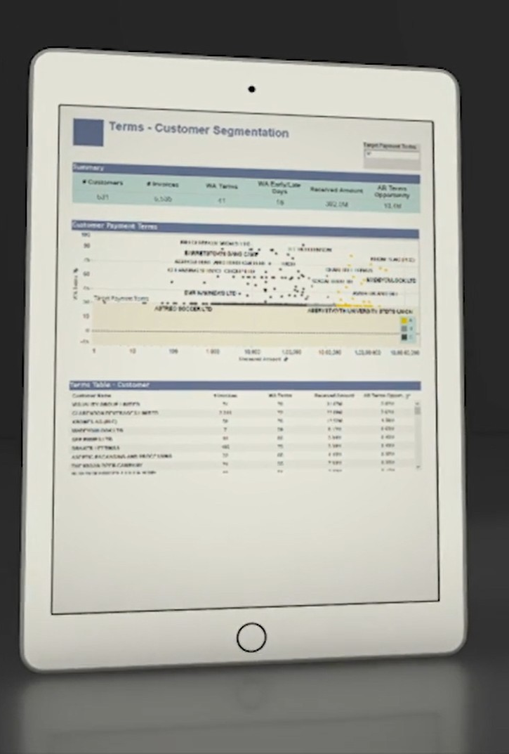

Slide 37

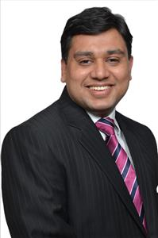
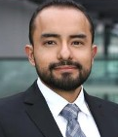
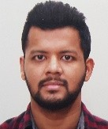
Anna Kobylinska
Senior Manager
Neeraj Gupta
Manager
Eduardo Contreras Cortes
Executive
Arpit Gupta
Executive

Slide 38
Upcoming events

Slide 39
We are looking for you!
If you are interested to talk or if you like to host an event please let us know! Contact us at:
Hope Meadows on hope.meadows@theorsociety.com
Eduardo Contreras OR@eduardoc.co.uk

Slide 40
Next Events
Data Science Speakers Club, next session 12th February
www.meetup.com/datasciencespeakers/
Beale Lecture 2018 at the Royal Society, 22nd February
www.theorsciety.com/beale
People Analytics Spring Meeting, 17th April
bit.ly/ORPeopleAnalytics
Annual Analytics Summit 2018, 12th June,
www.analytics-events.co.uk
Annual Conference OR60, 11th-13th September, www.theorsociety.com/OR60
More details on www.meetup.com/AnalyticsNetwork
Notes:
Certified Analytics Professional, an exam-based analytics qualification established by INFORMS, the US equivalent of the OR Society.

