Slide 1
@SanjitAtwal @Squawka
Stats Worth Sharing
Warnford Court
Throgmorton St, London
EC2N 2AT
Private & Confidential
© Squawka 2013

Slide 2
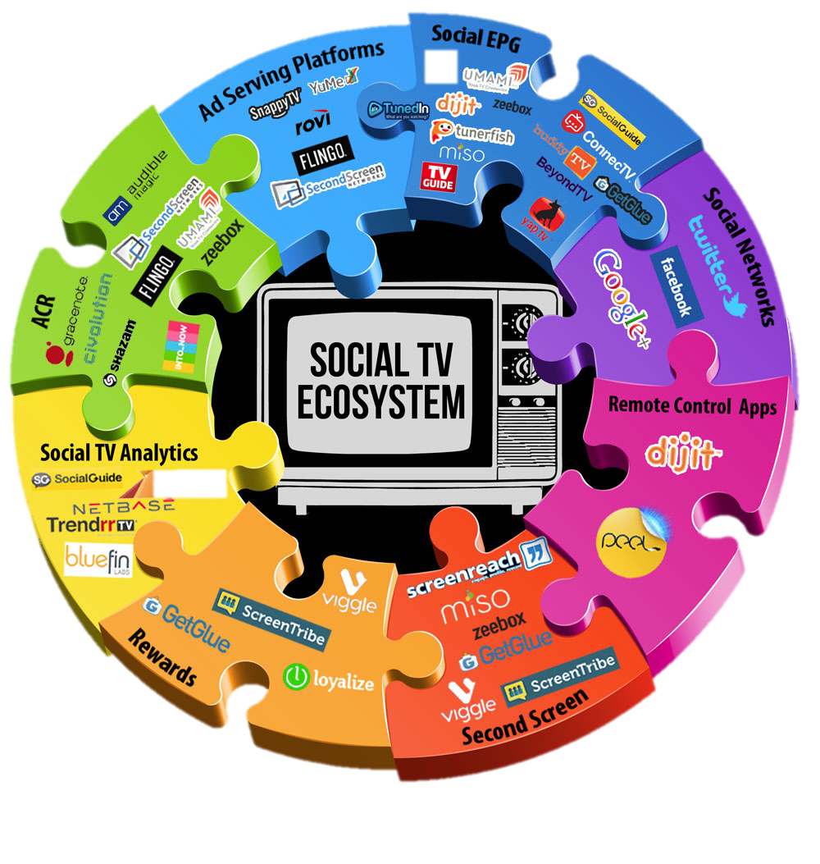
Everybody is talking about Second Screens
@SanjitAtwal @Squawka
We believe second screens must offer unique utility

Slide 3
@SanjitAtwal @Squawka
What is the potential?
32% (7.4m) of football fans have used a second screen whilst watching football
45% (10.4m) of football fans felt there aren’t enough in game football statistics available during a match
45% (10.4m) of football fans declared an interest in using a football second screen powered by data
67% (6.5m) of football fans aged 18 – 34 declared an interest in using a football second screen powered by data
36% (8.4m) football fans bet on football at least once a month
- 67% (5.6m) of those who bet on football declared an interest in using a football second screen powered by data
In order to assess the possible reach and appeal of Squawka amongst UK based football fans, Zag conducted an omnibus survey through Vision Critical, an independent global market research and technology firm.

Slide 4
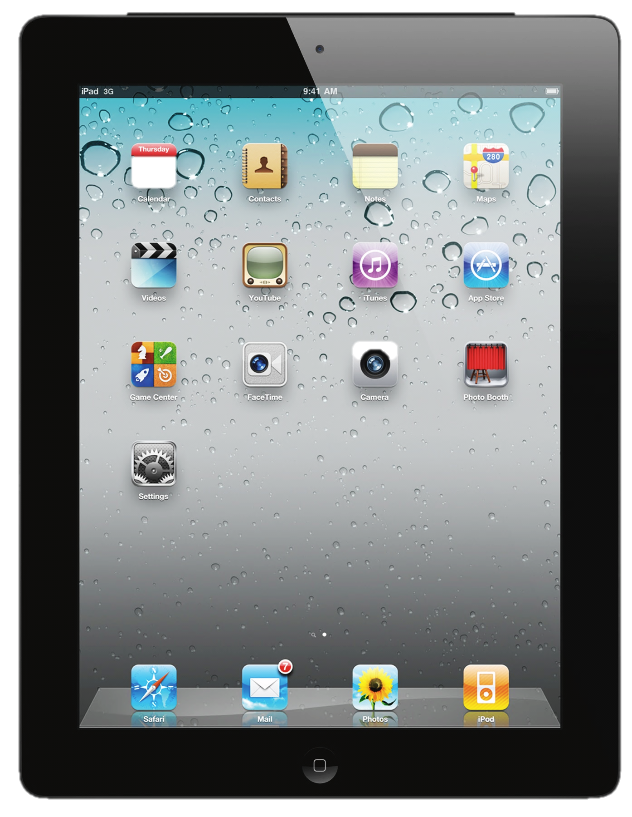
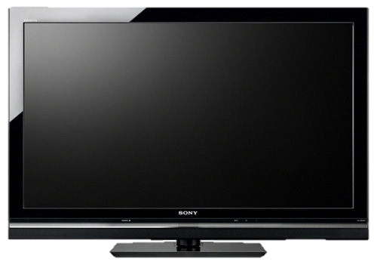
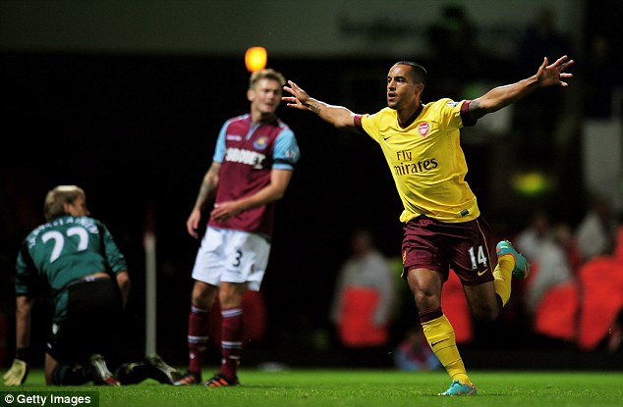
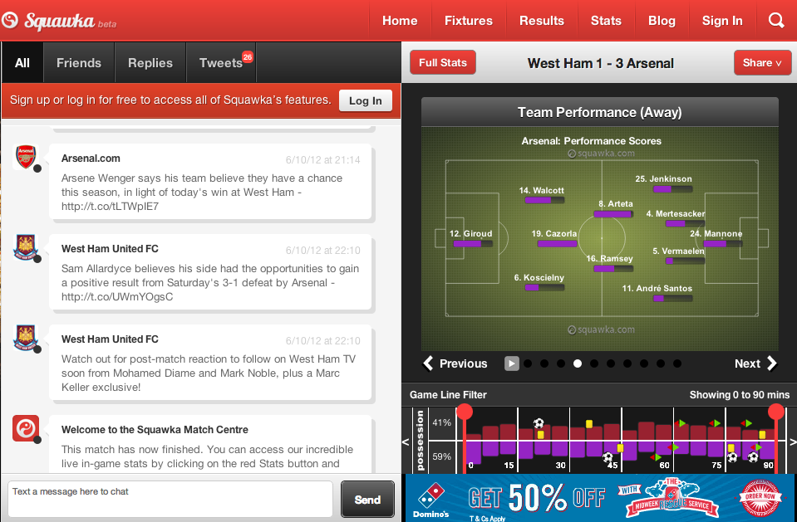
@SanjitAtwal @Squawka
Squawka delivers football fans stats worth sharing…
…comprehensive match statistics, visualised and shareable at the click of a button

Slide 5
“A simply awesome web app.”
“It’s fantastic! Fans will be glued to their laptops….”
“A revolutionary new way to follow football…”

Slide 6
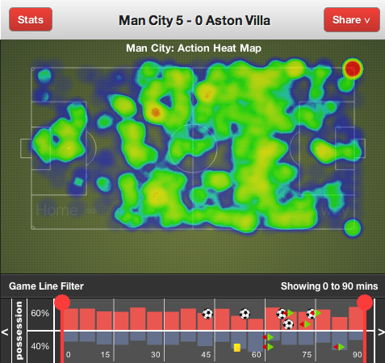
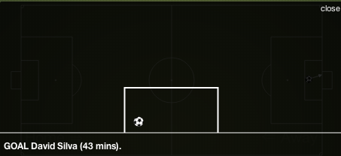
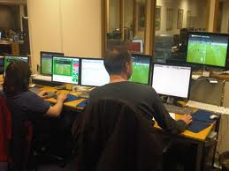
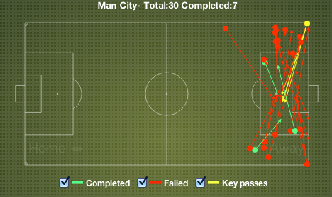
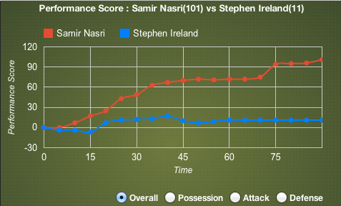
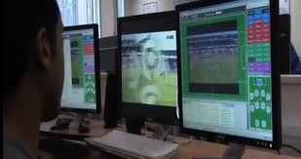
Squawka process XML feeds from to drive our real time data panel
@SanjitAtwal @Squawka

Slide 7
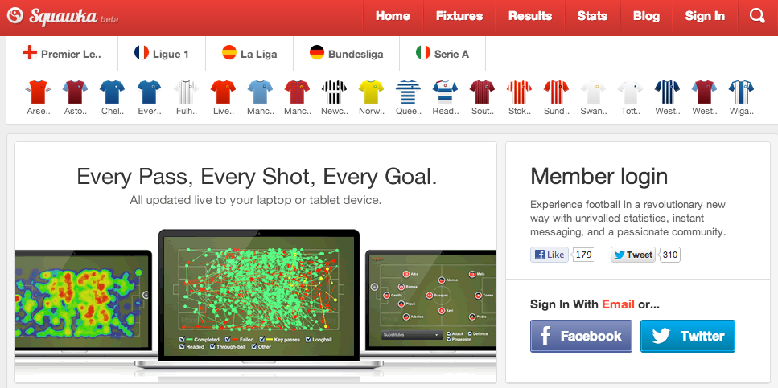
A clean and intuitive design covering Europe’s top five leagues
@SanjitAtwal @Squawka
Who we are…

Slide 8
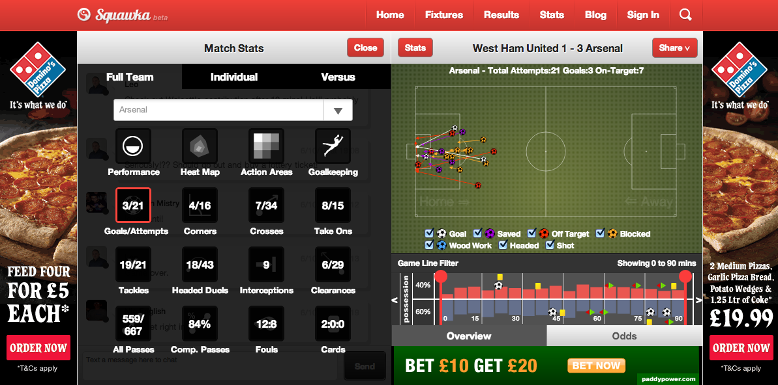
@SanjitAtwal @Squawka
The stats panel - Team, individual and head to head statistics are updated in near live time

Slide 9
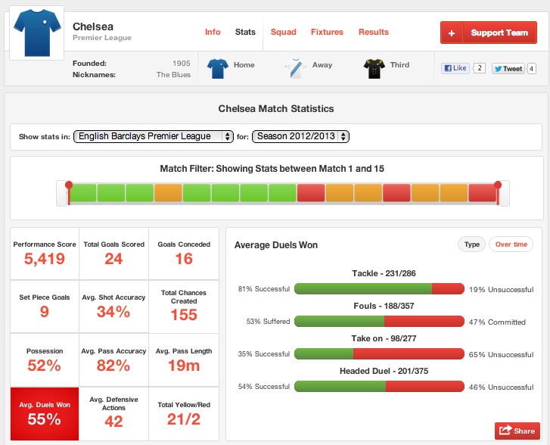
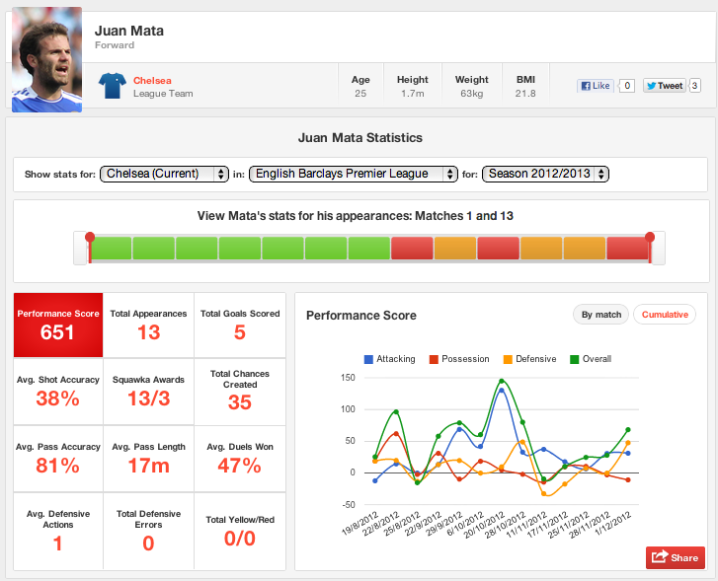
Stats Worth Sharing – every team and player has their own page with sharable stats
@SanjitAtwal @Squawka

Slide 10
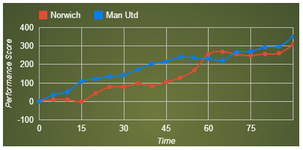
The Squawka performance score
@SanjitAtwal @Squawka
a comprehensive player rating algorithm built on the back of extensive analysis of over 400 Premier League matches
[ Action Event x Deployment x Outcome x Player Position x Pitch Area ]
=14,000,000 data points
… The most comprehensive and statistically
accurate representation of the impact one player has over a game
Potential use for Fantasy Football & Betting
Used by leading sports sites
“One of the most interesting and innovative ways of objectively ranking players that we have seen. Squawka are certainly leading the way in providing free cutting-edge analysis to fans of all types.” – Simon Banoub, Director of Marketing, Opta

Slide 11
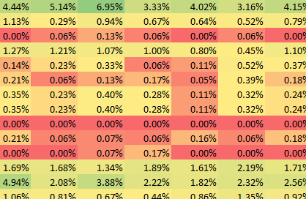
@SanjitAtwal @Squawka
We have analysed hundreds and hundreds of Premier League games.
All the different events are grouped according to:
Possession
Attack
Defence

Slide 12
@SanjitAtwal @Squawka
Each player position is scored differently for every single event
Goalkeeper
Defender
Midfielder
Forward
Frequency Analysis
Scoring players fairly for each action according to their position

Slide 13
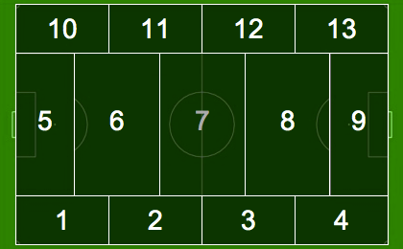
@SanjitAtwal @Squawka
We have split the pitch up into 13 different areas. Each area gives a different score for each action.
These are the actions areas we are used to, a quick snapshot of the game.
20%
50%
30%

Slide 14
@SanjitAtwal @Squawka
The Results
Every scenario has its own score

Slide 15
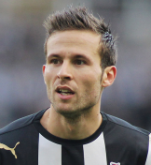
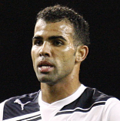
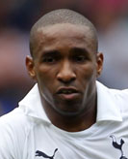
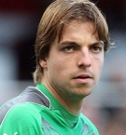
@SanjitAtwal @Squawka
Failed Pass
Shot
Interception
Save
Keypass

Slide 16
@SanjitAtwal @Squawka
Failed Pass
Shot (saved)
Interception
Save
Keypass

Slide 17
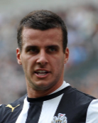
@SanjitAtwal @Squawka
Failed Pass
Interception
Missed tackle
Take-on
Crossbar
Keypass

Slide 18
@SanjitAtwal @Squawka
Failed Pass
Interception
Missed tackle
Take-on
Crossbar
Keypass

Slide 19
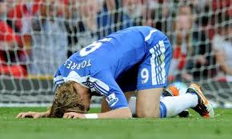
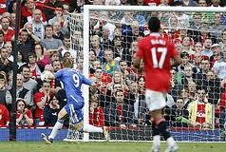
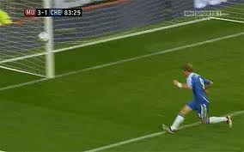
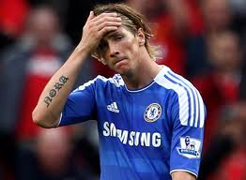
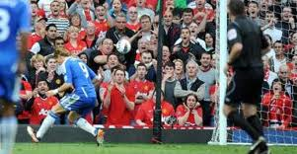
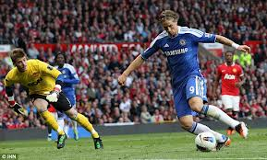
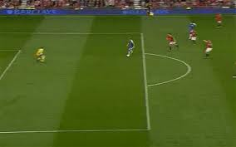
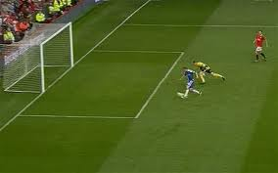
How can we determine the VALUE of a player?
@SanjitAtwal @Squawka

Slide 20
@SanjitAtwal @Squawka
Total Cost of Player (Wages & Transfer)
Performance Score
= Cost Per Point

Slide 21
@SanjitAtwal @Squawka
High cost and “not value for money”
Medium cost and “not value for money”
Low cost and “not value for money”
These players would be considered as high cost but worth the investment due to high score.
These players would be considered as “value for money” at low cost.
Total Cost

Slide 22
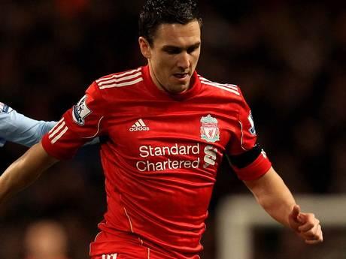
@SanjitAtwal @Squawka
“I pay you to get on first, not get thrown out at second…”
A Stewart Downing Story

Slide 23
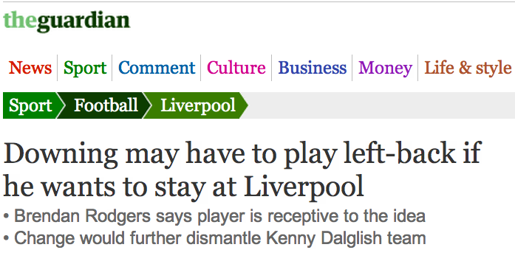
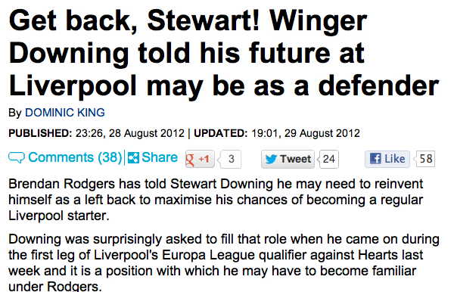
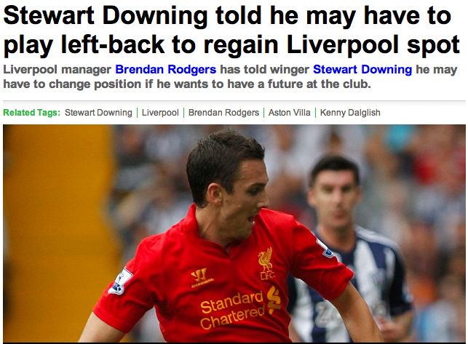
@SanjitAtwal @Squawka

Slide 24
Midfielders Attacking Scores
@SanjitAtwal @Squawka
Cost per score
Total Cost

Slide 25
Midfielders Defensive Scores
@SanjitAtwal @Squawka
Cost per score
Total Cost

Slide 26
Midfielders Possession Scores
@SanjitAtwal @Squawka
Cost per score
Total Cost

Slide 27
@SanjitAtwal @Squawka
What else can we do with this framework…?

Slide 28
@SanjitAtwal @Squawka
What age group were the most reliable purchases?

Slide 29
@SanjitAtwal @Squawka
What height group were the most reliable purchases?

Slide 30
Are Clubs Getting Value For Money?
@SanjitAtwal @Squawka

Slide 31
@SanjitAtwal @Squawka

Slide 32
Are Fans Getting Value For Money?
@SanjitAtwal @Squawka

Slide 33
@SanjitAtwal @Squawka

Slide 34
@SanjitAtwal @Squawka

Slide 35
@SanjitAtwal @Squawka

Slide 36
@SanjitAtwal @Squawka

Slide 37
And finally…the BIGGEST big data study of football….ever…
@SanjitAtwal @Squawka
Over 42 million data points...
….In real time

Slide 38
@SanjitAtwal @Squawka
David Luiz Own Goal
RVP Goal
Hazard just misses
Mata Goal
Ramieres Goal
Torres Sent off
Full Time
Rooney Booked
Torres Booked
Ivanovic sent off
Hernandez Goal

Slide 39
The (Twitter) Trials And Tribulations of Torres
Performance Score
Sentiment
Three successful passes but loses important aerial duel
Two failed passes and twice dispossessed. One failed take-on.
Wins foul but is also dispossessed and fails pass. Wins aerial duel and has shot on target.
Yellow Card
Half Time
Two failed take-ons and failed aerial duel, a bad touch and poor pass. One completed pass. Loses two aerial challenges but win tackle.
Red Card
Notes:
Starts with a few good touches but digital crowd start getting on his back after losing an important aerial duel.
They quickly turn around and start backing Torres despite a series of failed passes, almost as if they are trying to will him on despite poor play.
When he fails with a take-on the sentiment quickly return to negative
Again there is a positive swing after the negative uproar suggesting perhaps more loyal fans coming to Torres aid in the face of more vitriolic supporters.
Torres starts to come into the game more and wins a foul, an aerial duel and has a header on target. This sends his positive sentiment soaring. This is amplified by the Chelsea goal with fans crediting Torres with helping the Blues fight back.
Is booked but still hold massive favour with the digital crowd into the half. Interestingly, you can see on the graph how the positive sentiment starts to fade away as half time drags on. Football fans evidently have short memories.
Starts the second half poorly as Chelsea look to build on their first half momentum. This time fans stay on his side despite a variety of poor touches and failed take ons but then loses aerial challenges and fans are back on his case. Enjoys a brief respite when he makes a successful tackle.
Predictably, the red card sends him plummeting with huge negative sentiment.
Interestingly, although he is then being lambasted by the digital crowd until the end of the game, once the match ends Torres swings back into positive. This is likely due to replays and studio analysis of his sending off showing he was slightly unlucky to be dismissed.

Slide 40
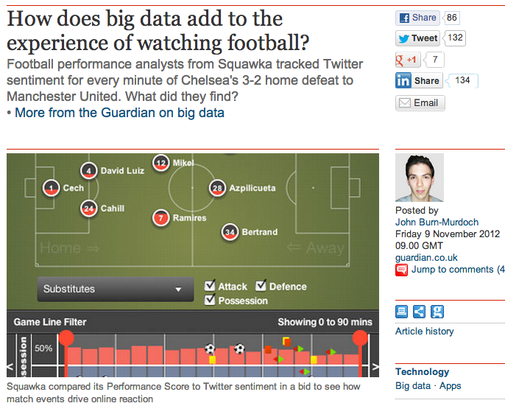
@SanjitAtwal @Squawka

Slide 41
Stats Worth Sharing

