Slide 1
Taking account of staff well-being in rostering shift workers
Jane Parkin
janeparkinch@gmail.com
http://www.jigsaw-consultants.co.uk/

Slide 2
Staff rostering
Many approaches: manual or automated
Generally have an objective e.g.
to minimise operating costs
There will be constraints which can be
hard (must be satisfied)
or soft (desirable but not essential)
Current rostering methods ignore staff well-being

Slide 3
Why should we care about well-being?
An ultimate/universal goal of human existence
People high in well-being:
function more effectively than people low in well-being
are likely to have more successful relationships
to be more productive at work
to have higher incomes
to have better physical and mental health

Slide 4
Well-being: a history
Bhutan 1972
GNH
building an economy based on Buddhist spiritual values
not western material development represented by GNP
UN 2011
passed a resolution placing “happiness” on global development agenda
World Happiness Report
OECD 2011
Better life initiative
http://www.oecdbetterlifeindex.org/#/11111111111
UK Coalition government 2010
Measuring National Well-being programme
led by ONS
Even HMT (Green Book) interested
Notes:
Valuing non-market impacts
Value, utility, Welfare and Well-Being
A newer, ‘subjective well-being approach’ has been gaining currency in recent years. The ‘life satisfaction approach’ looks at people’s reported life satisfaction in surveys such as the ONS’s Integrated Household Survey, which began including questions on respondents’ subjective well-being in April 2011. The life satisfaction approach uses econometrics to estimate the life satisfaction provided by certain non-market goods, and coverts this into a monetary figure by combining it with an estimate of the effect of income on life satisfaction.
At the moment, subjective well-being measurement remains an evolving methodology and existing valuations are not sufficiently accepted as robust enough for direct use in Social Cost Benefit Analysis. The technique is under development, however, and may soon be developed to the point where it can provide a reliable and accepted complement to the market based approaches outlined above. In the meantime, the technique will be important in ensuring that the full range of impacts of proposed policies are considered, and may provide added information about the relative value of non-market goods compared with each other, if not yet with market goods.

Slide 5
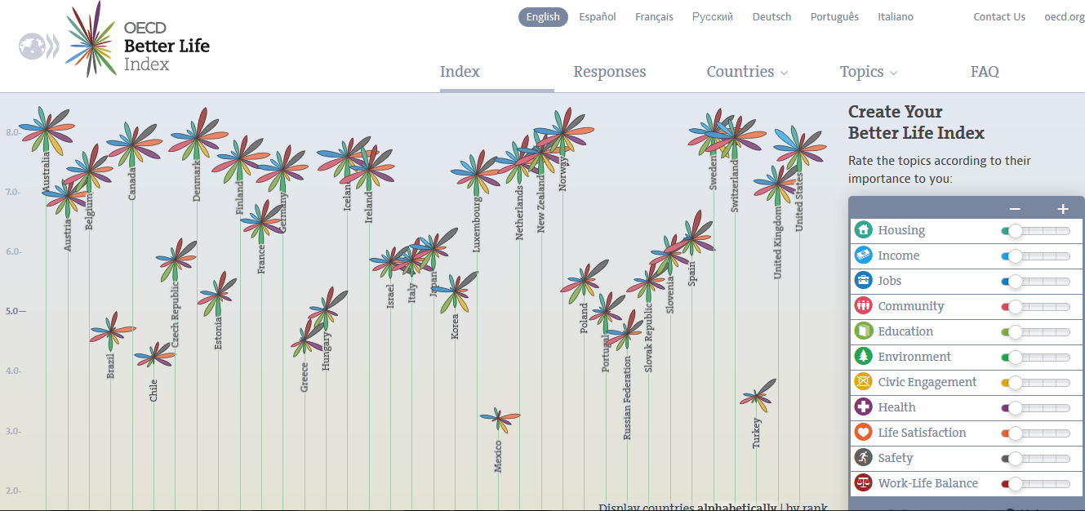
OECD Better Life Index

Slide 6
How to measure well-being?
Office of National Statistics (ONS) uses:
Objective measures
focus on satisfaction of basic human needs/rights
well-being is increased if preferences are satisfied
GDP often used as a proxy
increased income can bring about increased choice
Subjective measures
cognitive evaluations of one’s life
happiness, satisfaction
positive emotions e.g. joy and pride
negative emotions e.g pain and worry

Slide 7
ONS measures of subjective well-being
On a 0 (not at all) to 10 (completely) scale:
Overall, how satisfied are you with your life nowadays?
Overall, to what extent do you feel the things you do in your life are worthwhile?
Overall, how happy did you feel yesterday?
Overall, how anxious did you feel yesterday?
Notes:
• the ‘evaluative’ approach in which people are asked to reflect on their life and make a cognitive assessment of how their life is going overall or of how specific aspects of their life are going
• the ‘eudemonic’ approach (sometimes referred to as the psychological or functioning/flourishing approach), which measures people’s sense of meaning and purpose in life, connections with family and friends, a sense of control and whether they feel part of something bigger than themselves
• the ‘experience’ approach which measures people’s positive and negative experiences over a short timeframe to capture people’s personal well-being on a day-to-day basis.

Slide 8
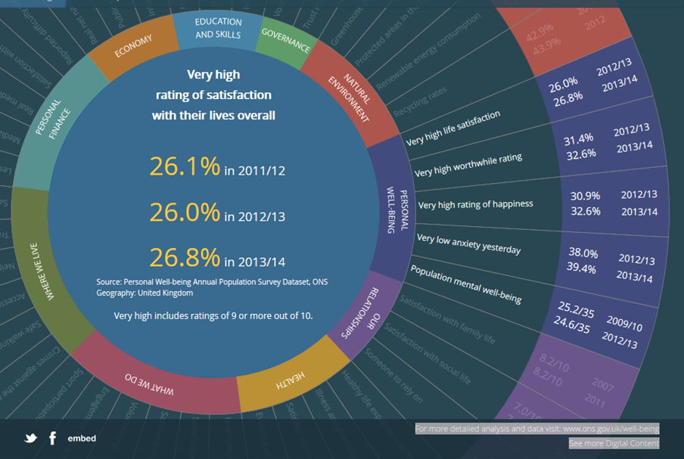
ONS national well-being March 2015

Slide 9
Well-being and work
“People who achieve good standards of well-being at work are likely to be more creative, more loyal, more productive, and provide better customer satisfaction than individuals with poor standards of well-being at work” NEF
The annual Civil Service people survey includes subjective wellbeing Qs
DWP survey (2011) of 2,000 staff across all industry sectors showed:
association between high employee engagement & high employee retention/low sickness absence
low levels of sickness absence associated with:
higher than average well-being
a positive view on personal work-life balance
higher than average employee engagement.
higher than average retention associated with:
positive views about work life balance
high scores on the employee engagement index.
defined an ‘optimal’ employee experience as a combination of:
high well-being
high employee engagement
higher than average retention and
low sickness absence

Slide 10
Well-being and shift work
Health & Safety Executive states that reducing problems associated with shift work may financially benefit an organisation by:
lowering sickness absence and absenteeism
decreasing lost-time incidents
reducing risk of fatigue-related accidents
reducing likelihood of compensation claims
increasing work efficiency
improving product quality
reducing staff turnover

Slide 11
Problems associated with shift work
HSE states that shift work can result in:
disruption of the internal body clock
fatigue
sleeping difficulties
disturbed appetite and digestion
reliance on sedatives and/or stimulants
social and domestic problems (social de-synchronisation)
chronic ill-health

Slide 12
HSE recommendations for comparing old/new shift patterns
Indicator | Possible criteria
Fatigue | HSE’s Fatigue and Risk Index to see if new pattern has reduced fatigue
Sleepiness at work | ‘Epworth sleepiness scale’ to determine sleepiness
Accidents, near misses, safety-critical events | Do records show a reduction in accidents, near misses and safety-critical events?
Absenteeism | Do records show a decrease in absenteeism?
Staff turnover | Do records show a decrease in staff turnover?
Employee welfare | Discuss with workers
Performance and productivity | Do records show increase in performance and/or productivity?

Slide 13
Rostering: aims of well-being measures
To measure performance of a roster
To enable comparison of different rosters
To measure the merits of a single roster for:
whole organisation and
individual employees
To include in objective function in rostering algorithm and
test effect of different weightings for well-being

Slide 14
What measures can be used?
Well-being aspect | Rostering algorithm
General health | Not feasible
Fatigue/sleepiness | HSE fatigue index
Risk of accidents etc | HSE risk index
Work-life balance | Subjective; compare quality free time with 'standard' working week
Subjective well-being/life satisfaction | Not feasible
Overall | HSE guidelines
Notes:
HSE Good practice guidelines for shift-work schedule design
1 Avoid placing workers on permanent night shifts.
2 If possible, offer workers a choice between permanent and rotating shift schedules.
3 Where possible, adopt a forward-rotating schedule for rotating shifts rather than a backward-rotating schedule
4 Either rotate shifts very quickly, e.g. every 2-3 days or slowly, e.g. every 3-4 weeks and avoid weekly/fortnightly rotating shift schedules.
5 Limit shifts to a maximum of 12 hours (including overtime)
6 Limit night shift or shifts where work is demanding, monotonous, dangerous and/or safety critical to 8 hours
7 Consider if shifts of a variable length or flexible start/end times could offer a suitable compromise
8 Avoid split shifts unless absolutely necessary to meet business needs
9 In general, limit consecutive working days to a maximum of 5-7 days and make sure there is adequate rest time between successive shifts.
10Where shifts are long (> 8 hours), for night shifts and for shifts with early morning starts, it may be better to set a limit of 2-3 consecutive shifts.
11When switching from day to night shifts or vice versa, allow workers a minimum of 2 nights’ full sleep.
12Build regular free weekends into the shift schedule.

Slide 15
HSE Fatigue Index
relates to probability of high levels of sleepiness
[0, 100]
extremely alert
extremely sleepy
HSE Fatigue Index values | Traditional working week | HSE standard shifts DDNNRRRR
average | 2.9 | 26
max | 3.7 | 49
Standard HSE shift pattern of 12 hour shifts commencing at 08:00 and 20:00
HSE standard shifts: (D-day, N-night, R-rest)

Slide 16
HSE Risk indicator
Based on occupational injury data;
gives relative risk of an accident/incident occurring
HSE Risk Index values | Traditional working week | HSE standard shifts DDNNRRRR
average | 0.74 | 1.04
max | 0.81 | 1.25

Slide 17
Work-life balance
Work-life balance (WLB) measures count the number of | Subjective weights
2 day free weekends | 35%
free weekend days | 15%
free evenings | 10%
free blocks of at least 2 days | 25%
free days | 15%
Compare with ‘Traditional’ working pattern (Monday-Friday, 9am-5pm)
Single well-being score for each employee:
the average of the weighted sum of deviations of all proposed WLB measures.
The higher value the better work-life balance measure for the given employee

Slide 18
HSE guidelines
HSE has a list of recommendations for shift-work schedule design e.g.
Avoid permanent night shifts
Limit consecutive working days to a max of 5-7; ensure adequate rest time
Where shifts are > 8 hours/nights/early starts; set a limit of 2-3 consecutive shifts
When switching from day to night or vice versa, allow a min of 2 nights full sleep
HSE (2006), Managing shiftwork, Health and safety guidance

Slide 19
Project for a major government department
Terms of reference:
Review effectiveness of staff rostering focussing on
staff well-being and
efficient deployment of resources
Design improvements to current rostering method
Investigated 3 sites
Site A: staff complained about:
fatigue, disrupted sleep patterns, eating disorders
uncivilised start and end times
lack of life outside of work
Sickness absence & staff turnover levels high
Staff survey results significantly lower than other sites for
work-life balance
general well-being
Site B: staff felt WLB skewed to work
Site C: staff generally accepted trade-off between WLB & pay

Slide 20
Major government department well-being measures at 3 sites
 |  | Site A | Site B | Site C
WLB |  | 57% | 62% | 72%
HSE guidelines |  | 54% | 63% | 73%
Fatigue | average | 23.9 | 13.8 | 7.5
 | max | 53.5 | 43.6 | 20.3
Risk | average | 1.07 | 0.89 | 0.87
 | max | 1.31 | 1.24 | 1.06

Slide 21
Comparison withWest Yorkshire Police 3 rosters compared
 |  | R 1 | R 3 | R 4
WLB |  | 52% | 66% | 61%
HSE guidelines |  | 67% | 67% | 67%
Fatigue | average | 16.0 | 19.9 | 17.4
 | max | 37.0 | 44.0 | 44.5
Risk | average | 1.0 | 1.0 | 1.0
 | max | 1.4 | 1.2 | 1.3

Slide 22
Fatigue comparisons

Slide 23
Outcomes of project
Clients accepted report; asked for software trial
Trial included some well-being measures
Results showed that efficiency, effectiveness and staff well-being could all be improved over current rosters
No previous attempts to incorporate well-being into rostering so
presentation at EURO 2015 and
paper submitted to JORS

Slide 24
Any questions?

