Slide 1
Supporting the development of
strategy with operational research
James Moon
Lead Advisory Manager, Philanthropy Division

Slide 2
Charity advisory at caf
Strategic planning
We can help transform your ideas into strategies that will produce results over the long-term. We'll work with you to identify your options, deliver the agreed course of action and articulate the impact.
Diversifying your income
We can help you draw up a plan to strengthen cash flow, decide which untapped sources of funding offer the best potential and support you in developing a fundraising strategy to capitalise on these opportunities.
Board Development
We can advise you on structuring and recruiting your board, make sure you're working together as a team, and review how well your organisation's governance meets its obligations.

Slide 3
Examples of Operational Research
CAF has used in our advisory
SWOT
Used a SWOT as part of a strategy review with all staff at a CIC.
Identified key areas of improvement and opportunities.
THEORY OF CHANGE
Used a Theory of Change to help a small charity ensure that their activities aligned with the outcomes they wished to achieve.
BENCHMARKING
Undertook financial benchmarking of comparator charities to help a medium size organisation understand appropriate return on investment for a new
income stream.

Slide 4
SWOT
Strengths Skills of staff team Use of the social model Passion/drive/commitment/work ethic of staff Range of services External services Consistent support team (staff retention more broadly) Staff have ideas for development and are innovative Invest in staff Reputation of staff Students Supportive team | Weaknesses Poor networking, need to use our networks more Internal communication Not transparent internally Lack of training opportunities for the support team Building/space/environment Resources, particularly marketing material Brand awareness Not aware of wider ecosystem in which we operate Time/capacity Staff security (vulnerable e.g. redundancies) Limited buy in from some members of the team Some don’t take on ownership Reactive rather than proactive
Previous strategy was owned only at the top, through this exercise all staff felt engaged in the new strategy and new views and experiences were shared.
Opportunities Monetise training and development through earned income (delivery and staff development)- sell globally? Secondments for staff Tech could be used more Social media currently untapped More pathways could be developed Private sector service Strengthen multi-service approach SLA’s in schools Could provide family led conferences Become more consistent | Threats Competition Environment- high area of deprivation Government policy IAPT No contracts/spot purchases Certain contracts prohibit self marketing/promotion ASF finishing in 2020
Notes:
New strategy has been devised collaboratively with staff and is owned by all levels of the organisation
Outside of the strategy the organisation has put into place new communication structures.
became apparent from that the CIC had a weak culture of communication

Slide 5
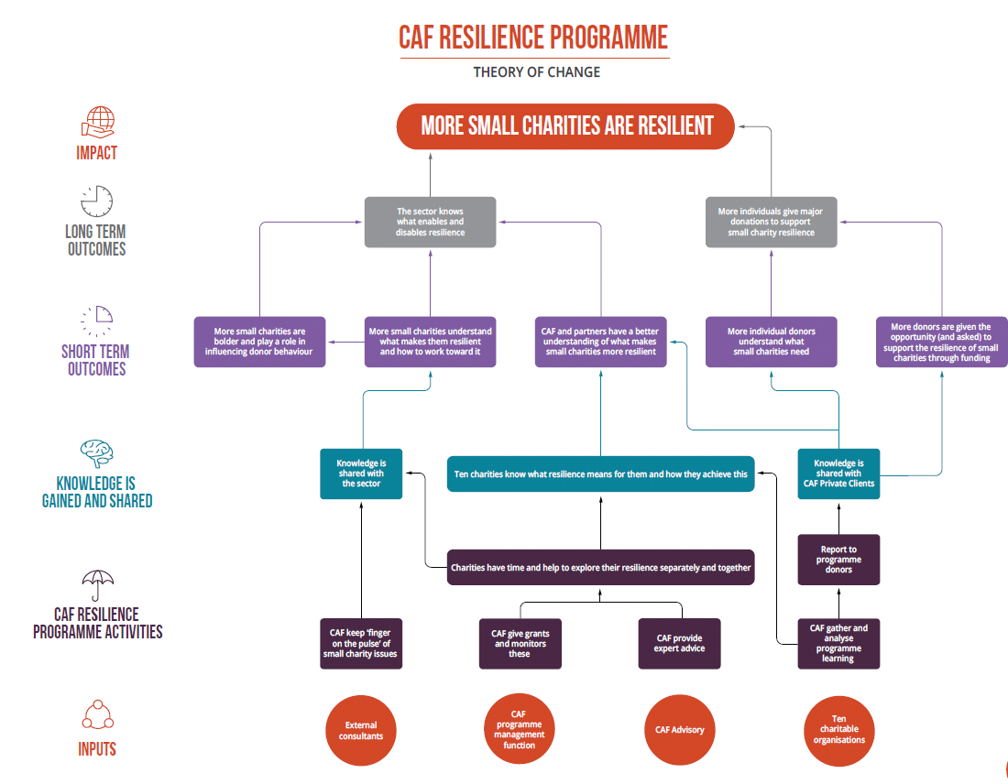
Theory of Change
Working with a community centre that had changed quite a lot in recent years. Wanted to ensure that the activities it undertook still had the desired outcomes.

Slide 6
Benchmarking
Supported a medium size charity to understand their comparators ROI and therefore forecast appropriate income and resources required for an new income stream
Organisation | Gov / Public funding | Traded income | Corporate Income | Donations & Legacies | Events | Trust and Foundations | Total Income | Total Expenditure | Cost of fundraising staff
XXX | 4,200,000 | - | 705,000 | 685,000 | 220,000 | 240,000 | 6,100,000 | 6,100,000 | 228,000
XXX | 4,472,111 | 148,513 I | 152,000 | 71,055 | 22,730 | 96,044 | 5,688,818 | 5,568,768 | 194,271 II
XXX | 1,304,000 | - | - | 5,322,905 III | 1,044,701 IIII | - | 7,305,682 | 4,607,000 | 265,187
XXX | - | 323,342 V | - | 1,945,000 | 3,476,000 | 52,000 | 6,300,000 | 4,424,973 | 666,635
XXX | 4,294,761 |  | 524,399 VI | 501,949 | 263,000 | - | 6,032,000 | 5,970,000 | 300,000
XXX | - | 237,700 | - | 26,527 | _ | 771,900 | 1,036,329 | 1,058,030 | 148,840
XXX | 2,650,000 | 7,693,000 | - | 1,448,000 | _ | - | 11,258,000 | 12,514,000 | 754,000

Slide 7
Overall experiences and Reflections
Benchmarking can be quite powerful but the data alone can at times be misleading. Contextualising and appropriate application is essential.
Organisations can struggle if they are trying to retro fit activities and outcomes into a theory of change. They need to be fully bought into the potential outcomes and implications of the activity to see the most benefit.
Staff engagement in SWOTs and PESTLEs are valuable but it is important that such engagement isn't one off or tokenistic. Closing feedback loops is essential when taking a truly collaborative approach to designing strategy.

