Slide 1
IMPOSTER SYNDROME Welcome!
Please introduce yourself in the chat, while you’re waiting for the event to start
Introduced by Frances O’Brien, Chair, WORAN

Slide 2
Programme
13.00 Welcome
13.10 Introduction: What is imposter syndrome? Who else has it? Why does it matter?
13.20 Workshop 1: What circumstances trigger your ‘imposter syndrome’? Do you think anything you do ever triggers ‘imposter syndrome’ in others?
13.40 Plenary and feedback (one point in turn from each group)
13.55 Workshop 2: What tactics do you use, or can you think of, to stop ‘imposter syndrome’ causing you problems? Are there any WORAN activities you’d like us to run, to help? What (if any) action will you take now?
14.15 Plenary and feedback 14.30 Close
AFTER YOU LEAVE, PLEASE PROVIDE FEEDBACK https://forms.gle/UK6qz6inQ3cFkCZ78

Slide 4
WORAN on-line events
Notes:
Purpose of events: discuss interesting topics; share and learn from each other; build network of people you know; have fun

Slide 5
Forthcoming programme
Early career Lightning talks
Wikithon
Single speaker
This Photo by Unknown Author is licensed under CC BY
March 17th
1pm
April 26th
2pm-5pm
May
tbc

Slide 6
LIVING WITH IMPOSTER SYNDROME
Ruth Kaufman, Rosemary Byde
18 February 2021

Slide 7
Imposter syndrome and you
Do you experience imposter syndrome?
Yes
Sometimes
No
Don’t know enough about imposter syndrome to say
Other
Does it affect your professional life?
A lot
A bit
No
Don’t know
Poll please

Slide 8
Purpose of today
Scientific investigation of the meaning and prevalence of imposter syndrome, its validity as a construct and its location in our socio-psycho-environment
Demonstrate: You are not alone
Chance to start sharing with others and thinking about how imposter syndrome is wrapped up in your own life
Not a ‘cure’ [is this even a good thing to try to do?]
Not full training
A start

Slide 9
Introducing the ideas

Slide 10
“I’m a fraud”
The exaggerated esteem in which my lifework is held makes me very ill at ease. I feel compelled to think of myself as an involuntary swindler.
‘Sometimes I wake up in the morning before going off to a shoot, and I think, I can’t do this. I’m a fraud.’
Albert Einstein
Kate Winslet

Slide 11
“They’re going to find me out”
I have written 11 books but each time I think ‘Uh-oh, they’re going to find out now. I’ve run a game on everybody, and they’re going to find me out.’
Maya Angelou

Slide 12
“Everybody else knows more than me”
There are an awful lot of people out there who think I’m an expert. How do these people believe all this about me? I’m so much aware of all the things I don’t know.
Margaret Chan,
Director-General, World Health Organisation
2006-2017

Slide 13
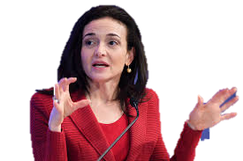
“I’m about to embarrass myself”
Every time I was called on in class, I was sure that I was about to embarrass myself. Every time I took a test, I was sure that it had gone badly. And every time I didn’t embarrass myself — or even excelled — I believed that I had fooled everyone yet again. One day soon, the jig would be up
Sheryl Sandberg, Chief Operating Officer, Facebook

Slide 14
This is imposter syndrome
https://soundgirls.org/impostor-syndrome-webinar-dec-13/

Slide 15
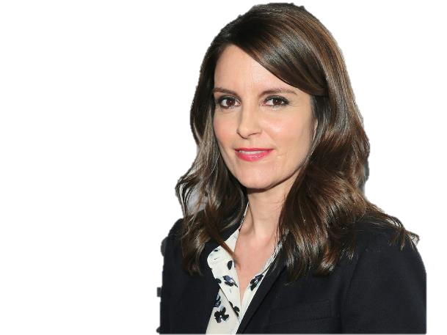
Not necessarily the whole time…
The beauty of the impostor syndrome is you vacillate between extreme egomania and a complete feeling of: “I’m a fraud! Oh God, they’re on to me! I’m a fraud!”
Tina Fey

Slide 16
Who has it?
Prevalence rates of impostor syndrome varied widely from 9 to 82%
Michelle Obama has said she still feels "impostor syndrome", adding that "it never goes away".
66% of women, 55% of men in last 12 months (HR News)
Our study found that 75% of executive women identified having experienced imposter syndrome at various points during their careers (KPMG)
“I don't think there is a woman alive, particularly working-class women, who don't experience that at some point in their lives” (Nicola Sturgeon)

Slide 17
Why does it matter? – to you?
Makes you miserable
Inhibits your aspirations
Makes you under-sell yourself
reduces others’ view of your capabilities
Reduces your willingness to speak up in meetings and on paper
reduces your influence on outcomes
reduces your opportunities to find things out
You have fewer opportunities for career advancement, new experiences

Slide 18
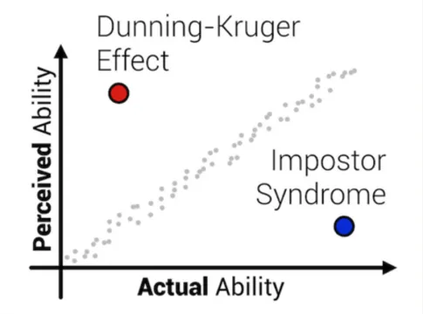
Why does it matter? – to the community
Lose the benefit of the input of some of our best people
Do not hear women’s voices as much as men’s
Leave the field open to Dunning-Kruger people
Image from Julie Pagano‘s It’s Dangerous to Go Alone: Battling the Invisible Monsters in Tech

Slide 19
Want to know more?
Enormous amounts of material out there
What is it?
Why does it occur?
Why does it matter?
How can we overcome it?
https://variablestargirl.com/2015/06/21/one-scientists-approach-to-the-imposter-syndrome/
https://www.kingsfund.org.uk/blog/2019/09/tackling-imposter-syndrome

Slide 20
Purpose of today
Introduce the ideas
Demonstrate: You are not alone
Chance to start sharing with others and thinking about how imposter syndrome is wrapped up in your own life
Not a ‘cure’ [is this even a good thing to try to do?]
Not full training
A start – to help you think about mitigating the effects on your career and your life

Slide 21
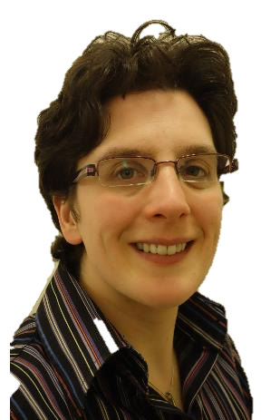
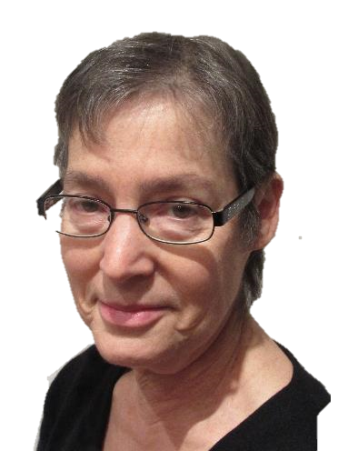
Don’t let this be you
I’m quite in awe of Ruth – can’t believe I’m working with her
Yeah yeah yeah – but I really am an imposter

Slide 22
Breakout 1:
What circumstances trigger your ‘imposter syndrome’? Do you think anything you do ever triggers ‘imposter syndrome’ in others?
Please take shared responsibility for getting the conversation going, and making sure everyone has a chance to contribute
Please agree how you are going to report back from your group to the plenary
You’ll be automatically returned to the main room at 13.40

Slide 23
Plenary 1: What triggers imposter syndrome in yourself: the list of points identified by event participants in their breakouts, and fed back to the plenary review - 1
Being asked to do something we hadn't done before
Salary negotiations – to be promoted – have to really believe in yourself and go for it – just don’t go for it if jobs have roles we haven’t done before or don’t feel qualified to do
Being put on the spot, asked a question at short notice, feel like we should know the answer, and if you don’t know the answer, feel a clot
Feel need to say yes all the time, and to feel ourselves at the forefront, have a list of what we perceive to be expected of us and have never-ending list of expectations of self, can’t cover all
Newly qualified, or no OR qualifications – compare those with other people’s – don’t have academic piece of paper
OR is broad field, is hard to feel confident about all of it, means different things to different people so feel there is an expectation that you know things that you maybe don’t. Giving talks to highlight ‘great things you’ve done’ puts pressure on

Slide 24
Plenary 1: What triggers imposter syndrome in yourself: the list of points identified by event participants in their breakouts, and fed back to the plenary review - 2
Comparing work with other people, and feeling you’re not up to it – but do we then turn table on others by showing our shiny piece of work
When some other people are extrovert, can intimidate introverts who doubt themselves. Alpha people!
Over-confidence of other people around you
Getting promoted in situ, because surrounded by colleagues who ‘really know you’ – can be difficult
Being with people you don’t know; feel more comfortable with more familiar people (opposite of the ‘promoted in situ’ point)
Being only woman in room – or being any small minority
Learning more; the more you know the more you realise you don’t know
If a project doesn’t go to plan, blame yourself rather than external factors like data. Imagine ‘if somebody else was doing this project, they would have handled differently’

Slide 25
Plenary 1: What may lead you to trigger imposter syndrome in others: the list of points identified by event participants in their breakouts, and fed back to the plenary review - 3
Giving feedback that is too negative. But focusing on the positives may make the listener feel like an imposter, because they are aware of the negatives
Might give somebody a stretching thing for development which triggers their imposter syndrome
If quotas are in place or implied, people may feel: ‘I just got job because they needed a woman’
Unfamiliarity - need to give people more time to build familiarity
If you pass on a task describing it as ‘really simple’
May overlook quiet people, approach the outgoing person reinforcing imposter syndrome in introverts

Slide 26
To help others – prewarn, introduce junior colleagues ‘so and so has a good idea’

Slide 27
Breakout 2:
What tactics do you use, or can you think of, to stop ‘imposter syndrome’ causing you problems? Are there any WORAN activities you’d like us to run, to help? What, if any, action will you commit to, now?
Please take shared responsibility for getting the conversation going, and making sure everyone has a chance to contribute
Please agree how you are going to report back from your group to the plenary
You’ll be automatically returned to the main room at 14.15

Slide 28
Plenary 2: what can we do about it? the list of points identified by event participants in their breakouts, and fed back to the plenary review - 1
Just talk to each other, to feel you’re not alone
Create healthy relationships with making mistakes, don’t hold colleagues to astronomical heights, ground yourself
Try to approach the cause, break down into smaller bits
Don’t discount your own achievements, make a list of them, read it!
Feel comfortable saying that you don’t know, ‘I’ll get back to you on that’
WORAN – hold a Failure Event! – more senior people can share their disasters and show that it’s not the end of the world
Decouple a single negative experience from ‘everything in your whole career’ – avoid spiralling down from one bad to colour the whole
Stick to the facts!

Slide 29
Plenary 2: what can we do about it? the list of points identified by event participants in their breakouts, and fed back to the plenary review - 2
WORAN – mentoring scheme – encourage more discussions
Be prepared in terms of facts and feelings when you’re going into a meeting or event
Have strong chair who will invite everybody to speak;
Help everybody feel they’re in the same boat
Promote people on basis of empathy not just technical expertise
Going into a situation where we will be judged, tell ourselves that we’re not judging ourselves, let the panel give the judgement, don’t second-guess them
WORAN - Networking event: how to present yourself, elevator pitch
If you feel overshadowed, bring frame of mind of being collaborative, not adversary

Slide 30
Plenary 2: what can we do about it? the list of points identified by event participants in their breakouts, and fed back to the plenary review - 3
Stimulate creativity and participation in your research group
Create familiarisation by practising, eg applying for job you don’t want, or role play
Learn to give positive feedback as well as negative feedback. Learn to LISTEN to positive feedback, and ask for it too
Seek out employers with a more gender-balanced team, if that is an issue
State shortcomings publicly, so you don’t feel a fraud or make others feel incompetent next to you. BUT DO NOT OVERSTATE – first of all be clear what you CAN do!
Highlighting achievements of others gives something to aim for – quash any quota-type rumours

Slide 31
Plenary 2: poll
Would you recognise imposter syndrome in yourself or others now?
Yes
No
Don’t know
Do you feel better-equipped to deal with it?
Yes
No
Do you plan to take any action to address it in the next two-three weeks?
Yes
No
Poll please

Slide 32
Closing
If you are not a member of WORAN, please join https://bit.ly/WORAN
Please complete the feedback survey
https://forms.gle/UK6qz6inQ3cFkCZ78
Many thanks to Amy, and to The OR Society
And thanks to all of you
Hope to see you on 17th March

