Slide 1

Making Better Decisions:
Operational Research
Subtitle
Venue
DD Month YYYY

Slide 2
Introduction
In this session:
What is Operational Research (OR)?
How is it used solve real-life, everyday problems?
It’s interesting, varied and a fun career using mathematics!

Slide 3

Questions
Notes:
Ask the students three questions – get them to show with a hands up if they agree. The idea of this at the end is to say that hopefully by the end of the session you’ll show them that maths is fun and useful – it is used in multiple industries / careers / sectors etc and is used by almost everyone on a daily basis.
Questions
1- Who thinks maths is used when you go on holiday?
2 - Who thinks maths is used in Sport?
3 - Who thinks maths is used when you use a Sat Nav?

Slide 4

Operational Research
Operational Research (OR) is the application of mathematical methods to tackle real-life problems associated with decision-making in businesses and other enterprises.
OR combines:
to provide the means for making more informed and better decisions.
+
A way of thinking
& communicating
Analytical
techniques
Notes:
This is a broad overview of what O.R. is

Slide 5
Origins of OR
Video
Notes:
Play the video – 3 ½ minutes long youtube video!
https://www.youtube.com/watch?v=ILWbaWrjgU4&t=5s

Slide 6
Origins of OR
World War II
  German U-Boats targeted merchant ships bound for Britain, which were loaded with important goods.
  The British Royal Navy decided to respond by deploying warships within convoys of merchant ships in order to offer vital protection.
Notes:
The field of operational research began during the Second World War, and was key to the British war effort.
One of the first successes for wartime operational researchers was investigating how to deal with the threat of U-boats. The German submarines were sinking ships loaded with important goods, attempting to cut off British supplies.
In response, the British Royal Navy adopted the convoy system, with warships accompanying merchant ships in groups to provide protection.

Slide 7
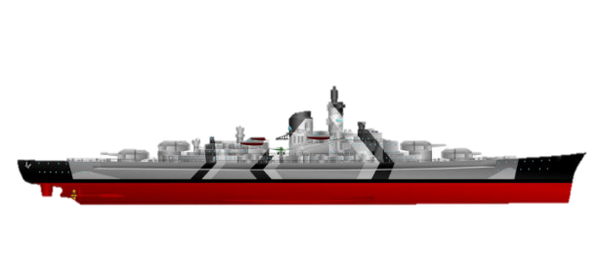
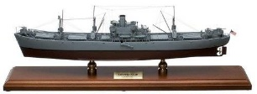


Origins of OR
  Travel faster than large convoys and may evade the threat of combat
  Slower than a small convoy but heavily armed to fight off an attack
Notes:
It was a sound strategy, but the Navy wasn’t sure how large these convoys should be.
Small convoys can travel faster and hopefully avoid combat altogether,
but larger convoys have more warships with which to fight off an attack.

Slide 8
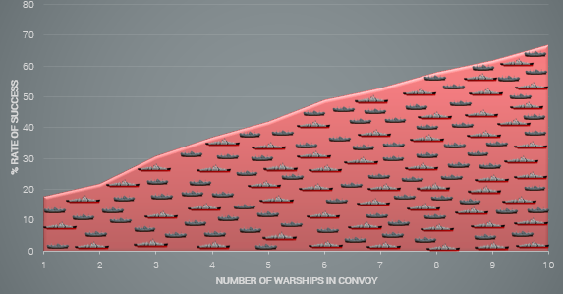
Origins of OR
Notes:
Operational researchers used statistics to analyse the results of past battles and found that it wasn’t actually the size of the convoy that mattered, but how many warships there were in each one.
As a result, the Navy switched to using a few large convoys rather than lots of little ones, saving lives and helping to win the war.
Operational researchers today still work within all branches of the military, but businesses and governments have also realised the benefits of using mathematical and scientific thinking to solve problems.

Slide 9
EVERYONE STANDING UP!
Notes:
Get everyone standing up – this is a practical exercise for the class!

Slide 10
Practical Exercise
1st person in the line, look at the person on your left. If you are taller, swap.
2nd person in the line, look at the person on your left. If you are taller, swap.
3rd person in the line, look at the person on your left. If you are taller, swap.
And so on…until you reach the end of the line.
The last person in the line should now be the tallest and can turn around.
Start again. The end of the line is the person next to someone who has turned around.
Notes:
Explain - “Bubble-Sort” is an algorithm we’re following
Explain – like bubbles in a bottle of coke – rising to the surface, the highest numbers/tallest students in this case, bubble to the top very quickly.

Slide 11

Real-life Applications of Maths
Notes:
So, we’ve successfully applied the bubble-sort algorithm to help us with the heights of 10 students – pretty easy, right?
And pretty time consuming for us - considering there were only 10 students to sort!
What if…. we were to try and sort everyone in this room?

Slide 12
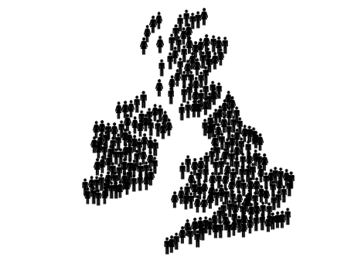
Real-life Applications of Maths
Notes:
What if…. we were to try and sort everyone in this school? For 2000 students, we’d have to make 2 million comparisons!
What about…sorting everyone in the UK?
Using the Bubble Sort algorithm, we would really struggle with long lists of data.

Slide 13
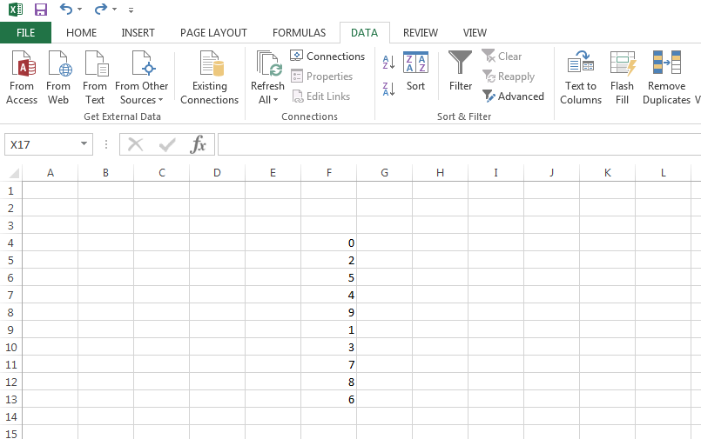
Using Technology
Notes:
OPTIONAL SLIDE – TALK ABOUT THE TECHNOLOGY
We could take advantage of technology….. For example, Microsoft Excel follows algorithms to sort arrays of data. Excel can sort larger data sets much more efficiently than humans….back in 2007, Excel could sort an array of 100,000 in just under 2 seconds and as the memory capacity of machines advances, so too will their efficiency.
Operational researchers rely on technology and software packages to support some of their approaches to solving problems which are all around us …most of us are totally unaware of the positive impact that O.R. makes to our everyday life.

Slide 14
My Job in OR
Presenter can add own notes about personal OR experience...
Include slides and information on who they work for/what they do/how they go there etc.
Notes:
Use lots of images / videos / details to highlight why your job is great and what you do!

Slide 15

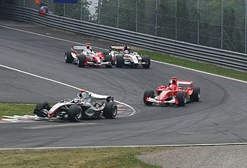
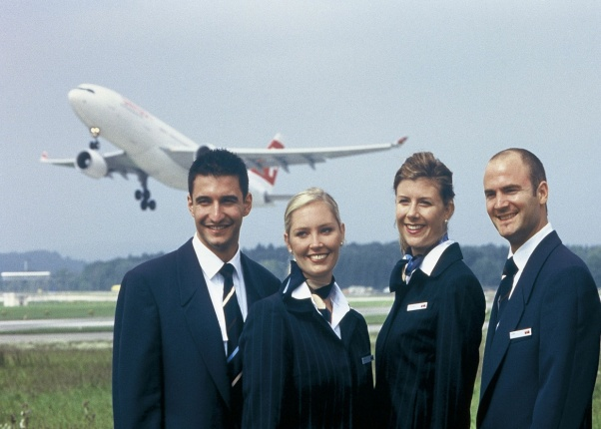
How is Maths Applied in the Real World?
Notes:
How do you think maths is used in supermarkets?
How do you think maths is used in sport?
How do you think maths is used by airlines?

Slide 16
Operational Research is:
The application of maths in the real world
OR is the maths used in supermarkets, e.g.
  Understanding people’s buying patterns
  Determining the number of staff needed on checkouts and at what times
  Calculating how many of each product to be ordered and when to be delivered
OR is the maths used in sport, e.g.
  Formula One pit stop strategy
  Scheduling football games
  Designing a stadium
OR is the maths used by airlines, e.g.
  Calculating the number of staff required at check-in & bag drop desks
  Scheduling the cabin crew
  Setting the prices of tickets to reflect changing demand

Slide 17

In detail - Supermarkets
OR is the maths inside supermarkets:
  Determining the number of staff needed on checkouts and at when / what time
  Calculating order quantities and delivery times
  Understanding people’s buying patterns
Notes:
Supermarket chains rely on teams of O.R. professionals to solve problems and make decisions such as better understanding consumer buying patterns, determining how many staff they should allocate to any given shift, and to calculate the required quantity and delivery times of their products.
If you or your parents have ever used a supermarket loyalty card, like Tesco’s Clubcard or Sainsbury’s Nectar card, then you’ve seen Operational Research in action. Loyalty cards let supermarkets track what their customers are buying, creating huge amounts of data for operational researchers to work with. They use statistics to search for patterns in the data, attempting to predict how customers will behave in the future. For example, the data might show that people buy lots of milk on a Saturday, in which case the supermarket would know to stock up on Friday evening. Most supermarkets also incorporate weather forecasting data, obtained from the weather stations nearest to each of their stores, to make sure they have plenty of burgers and sausages in for the sunny weekend BBQs and soups and casseroles for cold, rainy days.
With Operational Research, supermarkets can make sure they always have the right products on the shelves, keeping their customers happy and increasing their profits.

Slide 18
In detail - Sports
OR is the maths inside sport:
  One day cricket
  Scheduling football games
  Designing and building a new stadium
Case Study: Formula One
  The Challenge
      Determine optimal pit stop strategy
  The OR Solution
      Game theory and simulation
  The Value
      Ability to account for influential factors and increase probability of winning the race
Notes:
Sport relies heavily on O.R.: from designing and building the stadium, to scheduling the matches to be played, or to regulating fair play when external factors interfere, such as weather conditions interrupting a limited overs cricket match.
Formula One is one of the world's most high-paced sports, with drivers hurtling down the pit straight at almost 200 miles per hour in a bid to cross the finish line first. Fractions of a second can mean the difference between first and second. Such minute differences mean huge investment has been made in order to engineer a faster car. However, mathematicians trained in operational research techniques are increasingly being employed to provide the cutting edge in a different way: pit stop strategy.
It may seem like common sense to think that a car that never stops is going to finish ahead of cars that pull into the pit lane several times. However, imagine a car stops three times during the course of a race in order to change its tyres. These stops take a total of 40 seconds, but the fresh tyres get the car to the finish line 41 seconds earlier than it would have done without them. Despite stopping three times, the car has reached the finish line one second earlier, which could potentially beat its rivals to glory. So we know that pit stops can improve a car’s chances of winning, but when is the best time to pull in and how many times should a car do so during the course of a race?
Gut instinct aside, operational researchers build mathematical models which can crunch data on relative track positions, fuel consumption, tyre wear and weather conditions, along with a host of other factors. These computer models can run millions of scenarios simultaneously and find the strategies most likely to succeed. They can even say how likely they are to work. This allows team bosses to understand the relative risks associated with each strategy and decide which course to take.
These scenarios are an example of the use of game theory – the area of mathematics involved in strategic decision making. It is all a juggling act involving a trading off between different factors, something computers can do much better than humans. For example, it is all well and good finding the optimum time to come in and change your tyres, but if you re-join the track stuck behind several slower cars then you'll have to waste time finding space to overtake them. The computer models could reveal that waiting another lap, whilst slowing you down a bit due to further tyre wear, could bring you out of the pit lane free to motor on your shiny new tyres, more than making up for the delay of the extra lap.

Slide 19
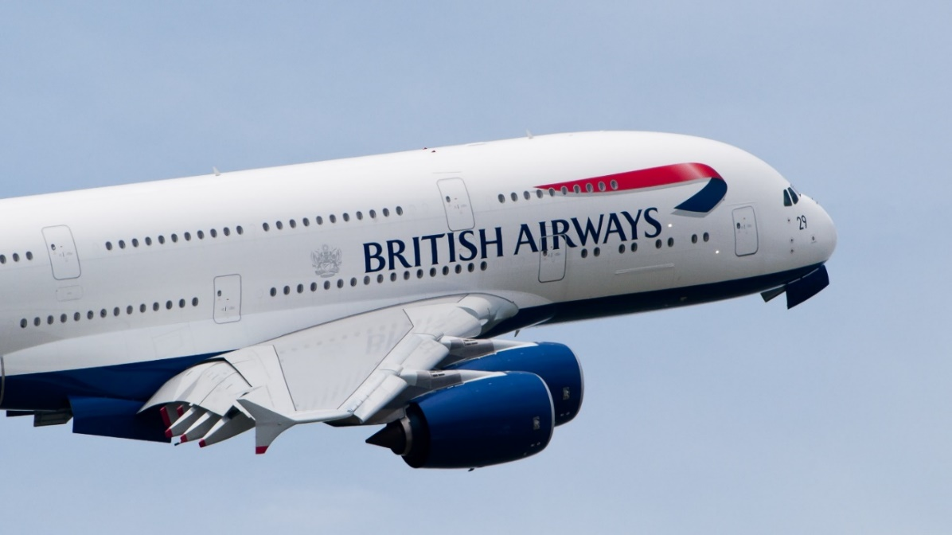
In detail - Airlines
OR is the maths inside airlines:
  Size?
  Price?
  Cost of operation?
Notes:
The group of Operational Researchers here use maths to help optimise almost everything at BA, from deciding which planes to buy, where to fly, what to charge customers, how to minimise queuing through the terminals, choosing a boarding strategy and ensuring flights can leave on time – maths is used to help improve the whole process and much more. This makes the work very varied and you can be involved in some very high profile decisions.
We use optimisation (e.g. to improve ground staff rosters), linear programming (e.g. to make optimal fleet purchase and configuration decisions), simulation (e.g. to model the flow of passengers through the terminal to make decisions about manpower and equipment) and forecasting (e.g. passenger cancellations). Personally, I use a lot of problem structuring and complex data analysis.

Slide 20
When is OR Useful?
When a decision is complex or it’s unclear what the main problem is
When it’s uncertain what the outcome of different actions will be
When you don’t know how well things are working or think they could work better
When you are worried about risks
When you need to take account of the views of different stakeholder groups
Notes:
Decision-making and problem-solving in business can be a complex, messy affair.
It may not be clear what the main problem is, what the outcome of different actions may be, or how well things are currently working.
Furthermore, there are factors such as risk, stakeholder opinions, and data to consider. O.R. can tackle all of these issues head-on….

Slide 21
When is OR Used?
Optimisation is a way to solve problems in which one seeks to achieve the best outcome.
Simulation allows you to try out different approaches by simulating events numerous times and answer the “What if…?” question.
Queuing theory is used to approximate a real queuing situation or system, so the queuing behaviour can be analysed mathematically.
Other techniques include:
Soft Systems Methodology
Heuristics
Forecasting
Multi-Criteria Methods
Data Mining
System Dynamics
Notes:
In order to do so, an Operational Researcher might draw upon one or more techniques
For example, optimisation is a method of achieving the best outcome (depending on which variable is the main priority), such as maximum profit or lowest cost with limited resources.
Simulation allows several approaches to be trialled in order to answer the “What if” questions and solve a problem, without having to apply each approach in real life…for example, within the NHS, coming up with a possible solution to a problem is great, but if it were implemented in real life to trial its efficacy, people could die. Simulating that possible solution first saves time, money, and in this instance, lives!
Queuing theory allows behaviour to be analysed mathematically in order to approximate a real queuing situation.

Slide 22
Where can OR take You?
OR is an evolving discipline because the world is ever-changing. OR departments are firmly embedded within large businesses across most industries:
  Manufacturing
  Transport
  Retailing
  Marketing
  Financial Sector
  Service Sector
  Local/Central Government

Slide 23
Where can OR take You?
OR is a profession where initiative, creativity and enthusiasm are equally as important as technical ability. There is great scope for you to make your mark and your future is in your own hands!
OR teams are involved in projects which involve a wide range of business skills and have dealings with anyone from shop floor to boardroom.
As an OR you will have the opportunity to undertake a variety of roles including:
  Analytical/consultancy
  Project management
  General management
  Lecturer/researcher
Notes:
O.R. is a profession where initiative, creativity and enthusiasm are just as important as technical ability.
For example, in Manhattan, FreshDirect need to deliver groceries to more than 10,000 people a day throughout the city, supported by Roadnet routing software.
Their success is resultant of truly innovative problem solving, such that, in dense areas of the city, FreshDirect trucks find a parking space early in the morning near their starting route target. Additional workers use the subway to get to the parked trucks before delivering grocery orders on foot. When the truck is empty, another full FreshDirect truck arrives, takes the same parking space and the deliveries continue.
Within a choice of roles and responsibilities, O.R. professionals enjoy a diverse, challenging and rewarding career where every day presents new problems to be solved, new clients to liaise with, or new opportunities to develop their business skills and mathematical techniques.

Slide 24
Interested?
Next steps…
  Maths GCSE and A Level, Further Maths may be required
  Obtain a good classification in a numerate first degree
  Join The OR Society – Student Membership is free!
  A Masters in OR is often desirable, although not always essential
  Gain work experience while studying, e.g. via a summer placement or voluntary work during studies

Slide 25
Get Involved
Connect via:
Email: schools@theorsociety.com
@ORinSchools @TheORSociety
Website: www.LearnAboutOR.co.uk or www.TheORSociety.com

