Slide 1
Structuring Strategic Thought: Cognitive Mapping & Design Rationale
Mark Westcombe & Mike Pidd
Management Science
Lancaster University
ESPRC Decision Support for Systems Engineering
Ian Sommerville, Ian Warren, Adrian Mackenzie
Computer Science, Lancaster University

Slide 2
Cognitive Mapping & Design Rationale
Cognitive Mapping
soft OR
UK OR community
IBIS
a design rationale notation
software engineering, HCI, CSCW

Slide 3
Overview
Cognitive Mapping & SODA
Design Rationale & IBIS
IBIS
technique
process
technology
methodology
Bringing CM & IBIS together

Slide 4
Cognitive Mapping
A model building technique
Used with a facilitator and process
With GDSS technology
Embedded within SODA/Journey Making framework
For problem structuring and developing strategy

Slide 5
Example slides removed for client confidentiality

Slide 6
Overview
Cognitive Mapping & SODA
Design Rationale & IBIS
IBIS
technique
process
technology
methodology
Bringing CM & IBIS together

Slide 7
IBIS: Issue-Based Information System
A model building technique
With a language driven process
Using GDSS technology
Within a framework
For structuring “wicked” design problems
Notes:
Facilitate communication across all players in design process: designers, implementers, maintainers, operators, etc)
Learning through time within project team and across other projects

Slide 8
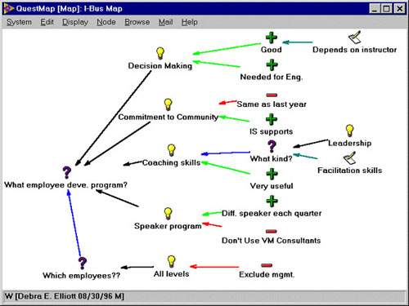

Slide 10
Overview
Cognitive Mapping & SODA
Design Rationale & IBIS
IBIS
technique
process
technology
methodology
Bringing CM & IBIS together

Slide 11
Technique
Concept nodes constrained to:
Questions: issue based
Ideas: respond to question
Arguments: ideas’ pros & cons
Represents reasons & reasoning process
Teases out the ‘what’, ‘how’ & ‘why’

Slide 12
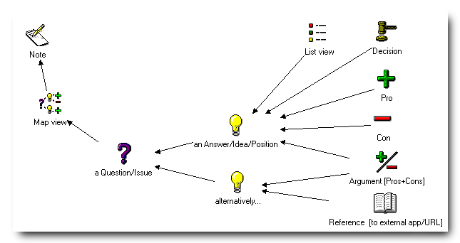

Slide 14
Overview
Cognitive Mapping & SODA
Design Rationale & IBIS
IBIS
technique
process
technology
methodology
Bringing CM & IBIS together

Slide 15
Process: A Discourse Grammar
Notation drives dialogue
Circumvent conversation potholes
“argument by repetition”
axe-grinding
blocking
rhetoric
and reflex responses

Slide 16
Process: Structuring Dialogue
Support
specifying evidence for viewpoints
making dialogue structure explicit
No facilitator
No process planning
Acquire skills through participation

Slide 17
Overview
Cognitive Mapping & SODA
Design Rationale & IBIS
IBIS
technique
process
technology
methodology
Bringing CM & IBIS together

Slide 18
Technology
Face-to-face workshops
paper based
single-user with public screen
multi-user GDSS
Distributed
local area network
web-based
Asynchronous

Slide 19
Methodology: Dialog Mapping
Audit trail of reasoning
Facilitate communication
Learning within and across projects
Improve meeting effectiveness
Shared understanding
Shared commitment
Compendium hypertext

Slide 20
IBIS Features
Incremental formalisation
Project management
Report generation
Updating
Tracking open & closed decisions

Slide 21
Overview
Cognitive Mapping & SODA
Design Rationale & IBIS
IBIS
technique
process
technology
methodology
Bringing CM & IBIS together

Slide 22
Bringing them together ...
Two modes of dialogue
SODA - Free brainstorm and find the key issues
SODA - Frame discussion within goal system
SODA - ‘Meta’ discussion, eg “why are we …”
SODA - Anonymity, voting, process driven
IBIS - Use spontaneously within meetings
IBIS - Rigorous exploration of decision space
IBIS - Long term project use

Slide 23
Overview
Cognitive Mapping & SODA
Design Rationale & IBIS
IBIS
technique
process
technology
methodology
Bringing CM & IBIS together

