Slide 1
5 compelling reasons to build quick simulations using SIMUL8
OR49
Anne Shade
Good Decision Partnership

Slide 2
Timely response
Have
a problem with a process
Need
make changes/improvements
workable solution
results quickly

Slide 3
Communication tool
SIMUL8 model - provides visual and numerical results
easy to understand
provides a focus for rational discussion in a group
allows everyone to contribute & participate
helps identify and clarify misconceptions/misunderstandings

Slide 4
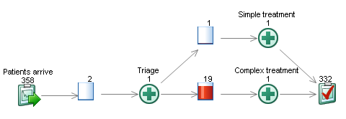
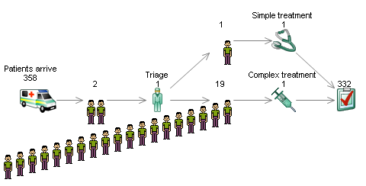

Slide 5
Appropriate scope and level of detail
High level, overview of process
big scope
little detail
use this to identify the problem areas
build further quick models
restricted scope
more detail

Slide 7
Changing focus
Following discussion, it may become clear that the focus of the model has to change
Input parameters will vary depending on the results you require
Easier to make this shift if original model was quick and simple

Slide 8
Data issues
A simulation (structure, control rules) can be built without including accurate data
guess, estimate volumes & timings
only add more accurate data for critical processes that are sensitive to change

Slide 9
Summary
SIMUL8 is a decision-making tool to help you find ways to improve processes
Quick simulations vs long term projects
Aim, wherever possible, to create quick models
Use SIMUL8 to stimulate innovative ideas for dealing with a process

