Slide 1
A METHODOLOGY TO EVALUATE THE USABILITY OF DIGITAL SOCIALIZATION IN ‘VIRTUAL’ ENGINEERING DESIGN
Amjad El-Tayeh,
Nuno Gil, Jim Freeman
Centre for Research in the Management of Projects (CRMP)
Manchester Business School
Notes:
Hello, my name is Amjad El-Tayeh.
I am in the final year of doctoral studies in Business Administration at the Operations, Innovation & Technology Management Division of the Manchester Business School.
In 2003, I earned an MSc degree in Management of Projects from the Manchester Centre for Civil & Construction Engineering at UMIST.
My principal research interests include the management of project organizations, knowledge management, and computer supported cooperative work.
I am also a qualified Architect with more than 5 years of professional practice in the Middle East.
Today I am presenting a proof-of-concept named IDRAK aimed at supporting Digital Socialization in Engineering Design Projects.
Socialization here refers to the process of converting individual tacit into group tacit knowledge without attempting a priori to codify, i.e. externalize, that knowledge (conversations, apprenticeships, meetings, and storytelling).

Slide 2
Problem Statement
Socialization (Knowledge Creation Theory)
Conversion of Individual tacit to group tacit knowledge without codifying (Nonaka 1990)
Processes: Storytelling, apprenticeship, meetings, job rotation, physical socialization (Nonaka 1990)
Challenges for Physical Socialization in project-based environments:
People work together temporarily
Individuals come from different occupational Backgrounds
Global teams mean people are increasingly NOT co-located
How to facilitate Digital Socialisation in Project-based Environments?
Notes:
Firms in project based industries:
Work together temporarily
Geographically dispersed
Remaining together from project to project is limited due to variability in product design, procurement practices, and project location.
Individuals have different occupational backgrounds
Under these conditions “Physical Socialisation” such as interdisciplinary physical meetings, informal partnering practices, and co-location is hard to accomplish.
They are time-consuming, hard to timetable, and have limited capabilities to disseminate tacit knowledge to people outside the conversation loop.
The question remains, can we facilitate Socialization using ICT?
Interstingly, project participants increasingly stay digitally networked through project extranets which faciltate the exchange of explcit knowledge.
Add a social dimension to project extranets.
Carry a cross fertilization between theoretical constructs in CSCW and knowledge management.
Examined it against the empirical findings of a case study of cross-firm socialization in a project organization.

Slide 3
Aim
Develop methodology to evaluate usability of prototypes for supporting digital socialization within geographically-dispersed, or ‘virtual,’ engineering design teams

Slide 4
Methodology
Develop IDRAK - proof-of-concept of Rich Internet Application to promote digital socialization in design
Use IDRAK to play Delta design game (Bucciarelli 1994), which simulates engineering design team undertaking project feasibility stage.
Evaluate usability of IDRAK to support work of ‘virtual’ teams
Measure usability of IDRAK in terms of satisfaction, efficiency, effectiveness
Compare Digital and Board game results

Slide 5
IDRAK: Proof-of-Concept I
IDRAK User Interface Snapshot (1)
◆ Navigation Bar  Social Proxy (passive)  Social Proxy (active)  Digital ID  Knowledge Map
Notes:
We termed IDRAK, an acronym for Internet Dialogue and Repository for Acquired Knowledge, to our proof-of-concept built based on the conceptual framework.
Single-screen made up of a bottom and top user-interface panels
The Top Panel consists of two main elements:
Navigation bar:
Users can customize bandwidth and color settings
Ring button to trigger sound alert for logged-in users
Social proxy:
‘Active’ component: logged-in users are depicted as movable, semi-transparent colored, people-like icons.
‘Passive’ component: enables users to make others better aware of their availability to dialogue through text- and color-based cues.
The Bottom Panel consists of two main elements:
One holds Instant Dialogue and Knowledge Repository
The other holds the Digital ID and Knowledge Map:
Interactive ‘yellow-pages’ with real-time search
ID displays info entered by users at registration
At registration a user must graphically plot herself into one or more communities in the knowledge map

Slide 6
IDRAK: Proof-of-Concept II
IDRAK User Interface Snapshot (2)
 Instant Dialogue  Knowledge Repository
Notes:
The Instant Dialogue and Repository enables logged-in users, regardless of the community to which they belong, to:
The Instant Dialogue:
Engage in synchronous conversations.
familiarize themselves with the parts they missed.
Each color-coded text entry is preceded by name.
Automatically displays notifications when new users log in or out, as well as a change in availability status.
‘Save’ button enables users to save all or part of a dialogue into the Repository.
Thereby allowing to document tacit knowledge within a rich context.
The Knowledge Repository:
Automatically enables the ’save’ button after a user completes the categorization task.
Browse and retrieve documented conversations, displayed according to the e-cognos ontology rules.
Asynchronously initiate a new conversation or reply to a documented conversation.
Must highlight a class and/or a documented set of dialogues, before enabling the ‘new’ and ‘reply’ buttons.

Slide 7
Validation Methodology
Delta Design:
Original board-based exercise developed at MIT
4 individuals (architect, project manager, structural engineers, mechanical engineer) must develop 2-dimensional concept
Players place triangular red- and blue- tiles on a diamond-shaped grid
Players iteratively play design output against design brief and specifications
Delta Design Game Window
Notes:
We Validated the usability of IDRAK in a laboratory setting.
Used IDRAK to play online the Delta Design exercise:
A paper board-based exercise develped at MIT
4-element design team (structural engineer, thermal engineer, project manager, and architect)
Develop a 2-dimensional conceptual design of a building to the inhabitants of the imaginary Deltoid planet.
We mimic the demands of engineering design work at the early stages of design development when collaboration needs are high.
Bespoken instantiation of IDRAK provide a suitable environment to mediate online communication across the Delta design team.
Broadly, the meaning of usability has been associated with “quality in use”.
Usability of an artifact cannot be directly measured, but can be operationalized into measurable objective and subjective attributes
It is defined as “the effectiveness, efficiency and satisfaction with which specified users can achieve goals in particular environments”
Mix and match three usability-inquiry methods to collect data.
Interview users to collect data on subjective measures for effectiveness and efficiency.
Code and analyze conversational data to measure efficiency.
Complete standard questionnaire to collect data on satisfaction.

Slide 8
Validation
On Testing day:
Set of Instructions provided ex-ante
Each user allocated one PC
Teams play for 120 min
No verbal talk allowed
Data collection methods:
12 experiments (MBA, MSc. students, Arup team)
Content coding of digital dialogues
Work Talk
Work Coordination
Social Talk
IDRAK Related
Usability questionnaire
Notes:
We Validated the usability of IDRAK in a laboratory setting.
Used IDRAK to play online the Delta Design exercise:
A paper board-based exercise develped at MIT
4-element design team (structural engineer, thermal engineer, project manager, and architect)
Develop a 2-dimensional conceptual design of a building to the inhabitants of the imaginary Deltoid planet.
We mimic the demands of engineering design work at the early stages of design development when collaboration needs are high.
Bespoken instantiation of IDRAK provide a suitable environment to mediate online communication across the Delta design team.
Broadly, the meaning of usability has been associated with “quality in use”.
Usability of an artifact cannot be directly measured, but can be operationalized into measurable objective and subjective attributes
It is defined as “the effectiveness, efficiency and satisfaction with which specified users can achieve goals in particular environments”
Mix and match three usability-inquiry methods to collect data.
Interview users to collect data on subjective measures for effectiveness and efficiency.
Code and analyze conversational data to measure efficiency.
Complete standard questionnaire to collect data on satisfaction.

Slide 9
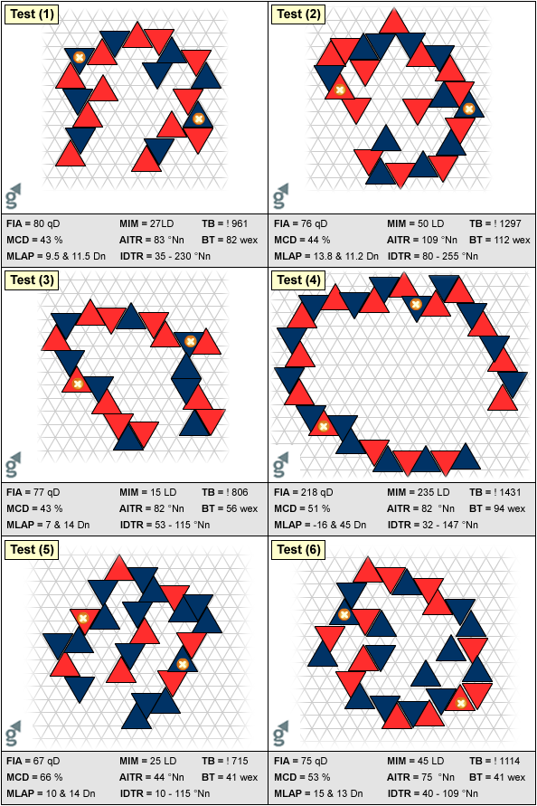
Effectiveness
Measure quality of design outcome in relation to design brief and specs
Statistically compare design output from 12 digital and 28 board experiments

Slide 10
Analysis Technique
Conduct independent samples T-tests to assess comparative performance of ‘virtual’ and co-located engineering design teams.
Relevant data plots indicate that underlying distributions conformed to assumptions of normality

Slide 11
T-test Statistics
Discipline | Design Criteria | Design Target | Descriptive Statistics
 |  |  | Board exercise (28 experiments) |  | Digital exercise (12 experiments)
 |  |  | Mean | StDev | Mean | St Dev | T-value
Architecture | Functional Internal Area (FIA) | ≥ 100 | 121.3 | 43.4 | 117.8 | 45.8 | 0.22
 | Maximum Blue Deltas (% total) (MCD) (§) | ≤ 60-70 | 54.73 | 7.97 | 52.75 | 6.89 | 0.75
Thermal Engineering | Average Internal Temperature Range (AITR) | 55-65 | 60.13 | 9.50 | 100.2 | 63.8 | -2.17*
 | Minimum Individual Delta Temperature Range (min IDTR) | 20-85 | 32.3 | 11.4 | 39.8 | 21.7 | -1.12
 | Maximum Individual Delta Temperature Range (max IDTR) | 20-85 | 80.0 | 14.0 | 181.9 | 98.1 | -3.58*
Structural Engineering | Maximum Load at Anchor Points (MLAP) | ≤20 | 15.41 | 3.58 | 25.1 | 26.6 | -1.25
 | Maximum Internal Moment (MIM) | ≤40 | 29.5 | 12.1 | 56.1 | 60.5 | -1.51
Project Management | Total Budget (TB) | ≤!1400 | 1956 | 1288 | 1089 | 514 | 3.04*
 | Building Time (BT) | Shortest | 76.2 | 41.5 | 62.8 | 23.4 | 1.27
(*) p < 0.05

Slide 12
Findings
Digital results tend to exhibit higher variability than board-based results.
Performance of ‘virtual’ engineering design teams less consistent than that of co-located teams
No statistically significant differences in mean performance of architects and structural engineers
Thermal engineers participating in virtual teams tend to perform less well than those in co-located teams
‘Virtual’ project managers can be more successful in ensuring that design outcomes meet their own key criteria (total budget and building time) than co-located project manager

Slide 13
Contributions
A conceptual framework
Grounded in empirical findings and extant theory
Proof-of-Concept (IDRAK)
Illustrates original implementation of conceptual framework in digital environment
Novel methodology to validate usability of prototypes
Evaluates usability of proof-of-concept prototypes to support digital socialization in engineering design

Slide 14
Limitations
Laboratory game simulation is not reality
Real-world is much more complex than lab setting
Engineering design involves more than four people
Decision-making involves many more variables and problems
Exercise itself only mimics demands of work at early design stage
IDRAK does not exhibit a reputation system
Only one channel of communication (IDRAK) was permitted

Slide 15
Questions
Thank You
Notes:
During the study, we recorded a total of 951 conversational Turns with a total of 9,095 words.
The conversations can be described as informal, context rich, and brief; averaging 9.56 words per turn (ranging from 1 to 38).
These characteristics also applied to other forms of workplace interactions like face-to-face and telephone.
The following content coding categories were used to measure the efficiency of IDRAK in supporting tacit knowledge-exchange:
Work Talk: Is focused on the group’s work. It includes but not limited to problem solving and quick Q&A pairs.
Work Coordination: Is directly tied with the work paractice.
Social Talk: Includes greetings, good-byes, discussion of the weather, humor, and personal types of social talk, etc.
IDRAK Related: Questions / discusions about the system.
Each content code category holds a certain amount of implicit tacit knowledge.
Content coding categories can be placed on a tacit knowledge continuum– either originating from individuals’ tacit knowledge or containing high contents of externalized tacit knowledge – with ‘work talk’ on one end and ‘social talk’ on the other.
One group member was not able to login for the first 30 minutes.
The rest of the team continued using IDRAK for social talk about UK holiday destinations, leisure activities, the weather, and humor.

