Slide 1
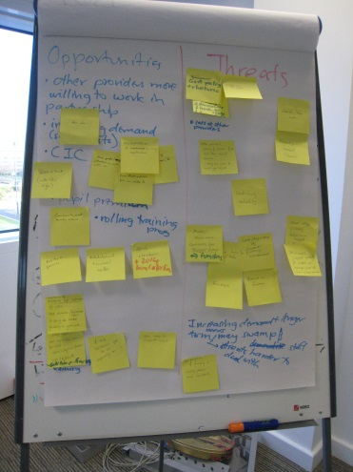
A staff team’s map of limbo
The client:
A small charity providing services to improve people’s employability, focusing particularly on disadvantaged people who are not supported by the mainstream.
The client’s problem:
To address the challenging external environment, trustees had recently broadened the charity’s Objects - requiring a change of name – and agreed a move to cheaper premises. The Executive was now grappling with these changes, as well as new funding proposals, and felt the need for clarifying the road ahead.
The solution
A facilitated workshop, involving staff and Chair of Trustees, to achieve shared clarity on what the charity is trying to achieve, what might be done to get there and what might go wrong.
The Approach
The OR Pro Bono facilitator made sure that she understood the key external issues facing the charity, and that the Chief Executive and other senior staff were happy with the proposed workshop outline.
On the day, the group explored: the charitable objects, what made them distinctive, their strengths and weaknesses as an organisation, opportunities in the environment and self-generated, threats and risks, and current and future funding and activities.
The openness of the approach, its responsiveness to the needs of the group, and the willingness of participants to contribute, meant that the workshop exposed a number of significant issues that were publicly acknowledged and shared for the first time.
The systematic nature of the approach brought out underlying assumptions, beliefs and tacit knowledge. Thus the organisation’s goals, values, and plans were clearly articulated and could be tested and shared by all.
The benefits
A ‘map of limbo’, helping staff to cope better with the change around them
A greater shared confidence in moving forward
A more positive workforce
‘There is a clearer understanding of peoples roles and funding being applied for as well. This all makes for a more positive workforce with a clearer understanding of the way forward’ – Projects and Communications Manager

