Slide 1
SWORDS: March 2015
How do you Solve a Problem like Analytics?
Stewart Robinson
Professor of Management Science, Associate Dean Research
School of Business and Economics
Loughborough University

Slide 2
Outline
What does analytics mean for OR and the OR Society?
My analytics story
What is analytics?
Analytics in society
OR and analytics
Implications for OR
The progression of OR with analytics
Notes:
Analytics is being discussed everywhere – press, media, professions, academic courses, in OR
What does is mean for OR and the OR Society
Should we change our name?

Slide 3



Acknowledgements
Michael Mortenson
Doctoral Student
Neil Doherty
Professor of Information Management
Charitable Project
Is OR in UK universities fit-for-purpose for the developing field of analytics?
Notes:
Meet Michael tomorrow afternoon at the Making an Impact workshops.

Slide 4
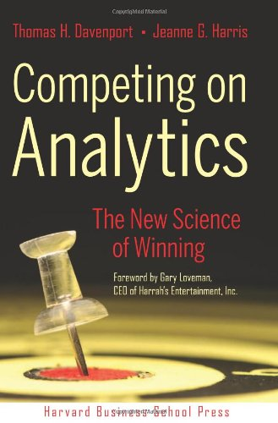


2007: a Car Park, a Dean and a Book
Notes:
MSOR numbers reducing
Associate Dean Specialist Masters – close MSOR?
Howard mentions analytics and book
Book on OR – read from post-it tabs
2009 launch of Business Analytics and Consulting programme (rebadged OR) – the first OR based analytics course in UK (and almost in the world?).
The battle
65 students in first year

Slide 5
What is Analytics?
“[T]he extensive use of data, statistical and quantitative analysis, explanatory and predictive models, and fact-based management to drive decisions and actions. The analytics may be input for human decisions or may drive fully automated decisions.” Davenport and Harris (2007).
“The scientific process of transforming data into insight for making better decisions.” INFORMS

Slide 6
What is Analytics?
Descriptive Analytics: Statistical methods designed to explore “what happened?”
Predictive Analytics: Statistical and data mining methods designed to predict “what will happen next?”
Prescriptive Analytics: Predominantly OR/MS techniques designed to answer “what should the business do next?”
Lustig et al (2010)
Notes:
“Advanced Analytics?” = Predictive + Prescriptive
MBA notes from 1999: descriptive, predictive, experimental and optimising models
Take a technique (e.g. simulation) - where does it fit?
Purposive definition – any technique fits anywhere

Slide 7

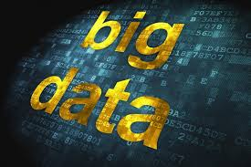


What is Analytics?
So what is new?
Volume
Velocity
Variety
Notes:
Volume
See next slide
Velocity
Real time
Variety
Numbers, text (email, social media, tweets), video

Slide 8




What is Analytics?
According to the International Data Corporation, in 2011 we created 1.8 zetabytes (or 1.8 trillion gigabytes) of information, which is enough data to fill 57.5 billion 32GB iPads.
Every minute we create:
More than 204 million email messages
Over 2 million Google search queries
48 hours of new YouTube videos
684,000 bits of content shared on Facebook
More than 100,000 tweets
Notes:
What modelling possibilities does big data present?
My OR education – dealing with limited data
In my OR practice - I thought I was lucky if I could get a sample size of 30 and could assume normality.
Does this imply a shift in OR methodology?
OR methodology – model drives the data, or should it now?
How does it impact on traditional approach to inference in statistics?

Slide 9
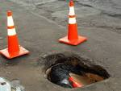
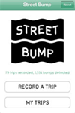

Analytics in Society
Notes:
Now a couple of illustrations of analytics in action.
Street Bump - Boston

Slide 10
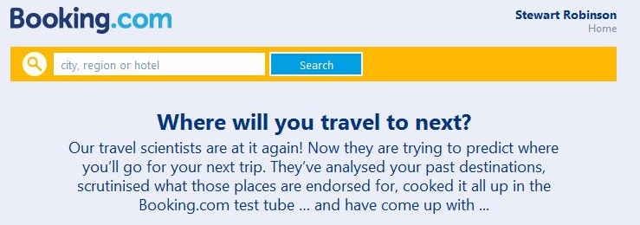
Analytics in Society

Slide 11
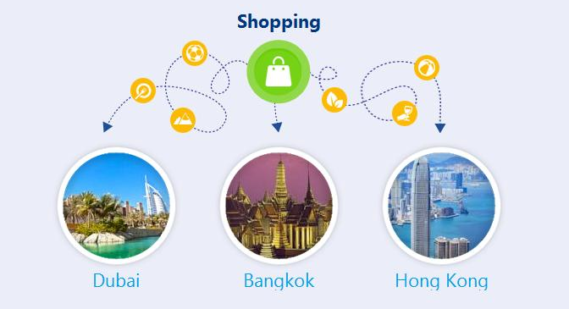
Analytics in Society

Slide 12
Analytics in Society
$105,000,000,000
size of the business analytics market in 2010 (IBM, 2010)
190,000
shortage of analytics specialists in the US alone (Manyika et al, 2010)
$225,000
starting salaries for data scientists
(Loizos, 2013)
Notes:
Analytics is huge!

Slide 13
OR and Analytics
OR
(Google Trends: operational research, operations research)
Analytics
Notes:
Acknowledge Don Kleinmuntz
OR is dwarfed by analytics ...

Slide 14
OR and Analytics
A shared concern
OR
Analytics
Operational research is the discipline of applying analytical methods to help make better decisions
OR Society
“[T]he extensive use of data, statistical and quantitative analysis, explanatory and predictive models, and fact-based management to drive decisions and actions
Davenport and Harris (2007)
≈
Notes:
... but they are related.
We have had similar debates about the relationship between OR and MIS, DSS, BI, ... in the past.
So let’s explore that relationship further.

Slide 15
OR and Analytics
A shared approach
Technology
Decision
making
Quantitative
methods
Notes:
OR and analytics utilise:
- Technology (primarily computing)
- Quantitative methods
To inform decision-making
- Decision-making not just an outcome but a process/discipline e.g. soft OR

Slide 16

OR and Analytics
A shared history
Decision
Support
Systems
Scientific
Management
Operational
Research
Analytics
Business
Intelligence
Scientific
Method
Management
Information
Systems
??
1900
1920
1940
1960
1980
2000
2020
Notes:
3 strand rope: a shared history of fusing technology, quantitative methods and decision-making:
Technology: initially manufacturing technology, but moving to first digital computers in 1940s, PCs in 1980s, internet in 1990s, social media in 2000s
Quants: SPC (1920s), LP (1940s), computer simulation (1950s), data mining (1980s), six sigma (1990s), Kaggle competitions (2010)
Decision-making: Gestalt (1910s), Herb Simon (1950s), growth of behavioural science – consumer research (1960s), Soft OR (1980s), balanced scorecard (1990s), recommendation agents on web sites e.g. Booking.com example (2000s)
Briefly describe each era
Aside: Late 1970s – end of the OR era as we moved to MIS and then to DSS. Hence, Ackoff (Future of OR is Past) in 1979. But, as we shall see, this does not mean that OR no longer exists or that it is not still important.
This all points to a single paradigm, with a series of eras.

Slide 17
OR and Analytics
A single paradigm
Technology
Decision
making
Quantitative
methods
The “Dianoetic Management Paradigm”
Dianoetic: “of or relating to thought, [especially] to discursive reasoning rather than intuition” Collins English Dictionary
Notes:
What do we call this paradigm
Is analytics a new paradigm? No, it is an era within the dianoetic management paradigm
This is not to decry the role of intuition, but to say that Dianoetics is primarily driven by a desire for evidence based decision-making.

Slide 18
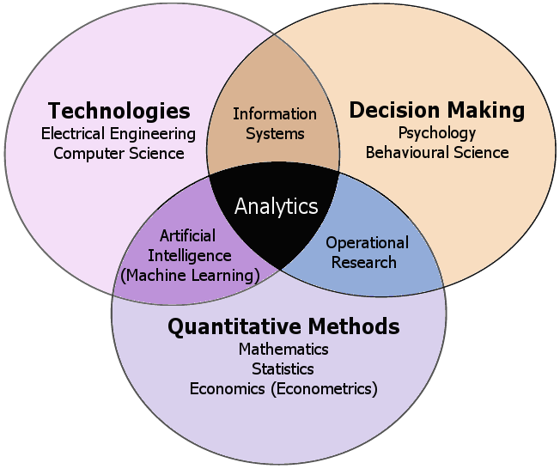
OR and Analytics
The “Dianoetic Management Paradigm”
(Mortenson, Doherty and Robinson, 2014)
Notes:
Dianoetic Management Paradigm as a set of disciplines
OR uses technology rather than develops it, so sits at the interface of QM and DM.
Soft OR covered by DM
OR = ‘Decision analytics’
So what does this mean for OR?

Slide 19
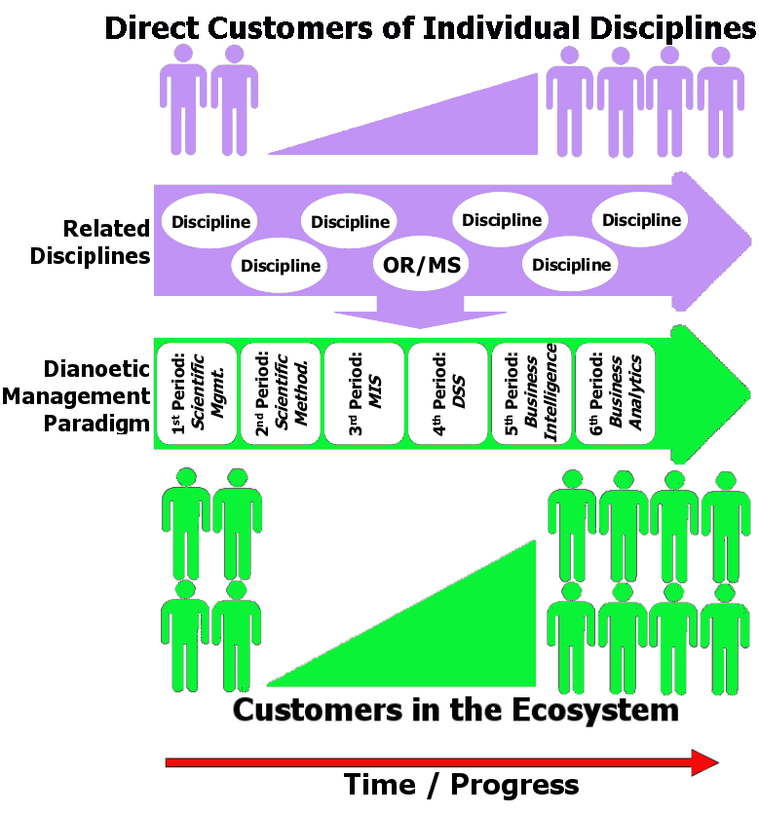
Implications for OR
(Mortenson, Doherty and Robinson, 2014)
Notes:
Ecosystem – a set of related disciplines, of which OR is one.
The ecosystem is supported by the disciplines feeding off each other, which in turn supports the disciplines
If successful, the ecosystem (its customer base) grows through time
OR has its own customers
The ecosystem (‘analytics’) has many more customers

Slide 20

Implications for OR
Response of OR
Isolationism
OR = OR
Notes:
Problems:
Cut off from the ecosystem
Do customers migrate to the ecosystem
Limited market that dies

Slide 21

Implications for OR
Response of OR
Fadism
OR = Analytics
Notes:
Problems:
Good in the short run
But, the discipline becomes too strongly associated with an era (‘analytics’) and loses its identity
What happens when the paradigm moves on?

Slide 22
Implications for OR
Response of OR
OR remains as a discipline (since the1930s) within the Dianoetic Management Paradigm
OR as a discipline can remain strong whilst connected to the Dianoetic ecosystem
Indeed, OR can grow and gain ‘customers’ by close connection to the ecosystem
But OR must adapt (to big data) to survive

Slide 23
The Progression of OR with Analytics
The Practitioner Perspective: OR Rebranded as Analytics
Head of Operational Analysis
Analytics Team Leader
Senior Analytical Strategist
Advanced Analytics & Optimisation Leader
Mathematical Optimisation and Analytics
Specialist in business modelling and analytics
VP Global Analysis, Business Intelligence and Optimisation
Finance & Risk, Infrastructure & Analytics
Decision Analysis and Modelling Group
Health & Government Analytics
Notes:
From 3 perspectives: practitioner, academic, OR Society
Many OR groups/practitioners are renaming themselves analytics – see job titles from HORF.
OK, because easy to adapt title, it is just about connecting to the ecosystem in the present
BUT:
Are we really doing anything different – working with big data?
Are we drawing in non-OR people to the OR perspective? (connecting across the ecosystem) – note a few members of HORF from ‘pure’ analytics groups

Slide 24





















The Progression of OR with Analytics
The Academic Perspective:
Courses on Analytics
Notes:
UG and PG
OR based, computing/technology based
Many more worldwide

Slide 25
The Progression of OR with Analytics
The Academic Perspective:
Analytics Research
At the end of 2013 how many articles are listed in the International Abstracts in OR with ‘analytics’ in the title or abstract?
23
... and 8 of those are in the practitioner based journal Interfaces

Slide 26
The Progression of OR with Analytics
The Academic Perspective:
Analytics Research
So where is the research on...?
Leveraging big data volumes
Utilising new data architectures
Incorporating unstructured data in models
Streaming data and real-time analytics
Visualising data
New OR methodology for big data
Notes:
Are OR academic researchers connecting to the wider ecosystem?
Note:
Calls for Turing Institute, EU digital agenda (mathematics for big data).
Analytics academic jobs and PhD studentships starting to be advertised.
Is there an opportunity for research on a new methodology for OR – data driven?

Slide 27
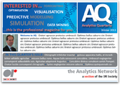

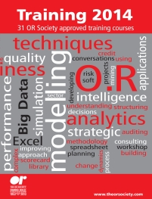
The Progression of OR with Analytics
OR Society
“Operational Research at the Heart of Analytics”
The Analytics Network
www.theorsociety.com/Pages/SpecialInterest/AnalyticsNetwork.aspx
DEVELOPMENTS IN ADVANCED ANALYTICS AND BIG DATA 2014
Notes:
Analytics network: Meetings, annual 1 day meeting, website
Analytics Working Group
BUT: are we really connecting with the wider ecosystem, or quite isolated? Some signs of broadening interest from non-OR people e.g. in analytics network and attending the one-day event

Slide 28
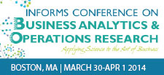
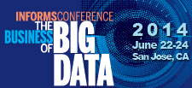
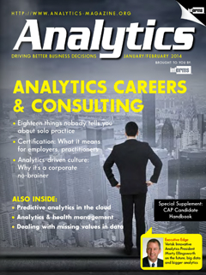
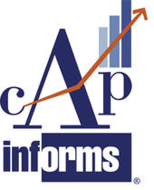

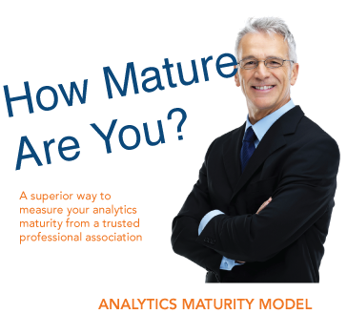
The Progression of OR with Analytics
INFORMS

Slide 29



The Progression of OR with Analytics
OR Society
How far should we go?
The Analytics
Providing more services with an analytics focus
Communicating outside of the ORS membership
Society
Notes:
I hope we are agreed that we need to connect more with the wider ecosystem (to survive ... and to thrive)
Does this mean we should become the Analytics Society? Some may say yes, but:
OR is not all of analytics
This is a fadist approach
BUT, staying as we are risks following an isolationist in our approach
What if someone launches an Analytics Society? e.g. practitioners would join, and leave ORS.
So we should adapt to and represent (decision) analytics much more strongly, connecting to the wider ecosystem and even strengthening our discipline.
How?
By providing more services with an analytics focus
Communicating outside of the ORS membership
A journey we have begun (but note that INFORMS has progressed much further)
What exactly does that mean? Discuss...

Slide 30

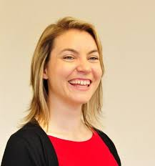
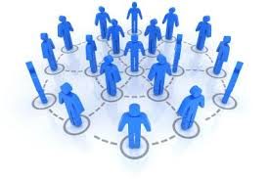
OR Society: New Developments in Analytics
The Analytics Development Group
The Journal of Analytics
Strategic Projects Manager
The OR Society Network
Notes:
What others might we implement?

Slide 31
Available from EJOR
Mortenson, Doherty and Robinson (2014)
Operational Research from Taylorism to Terabytes: A Research Agenda for the Analytics Age.
European Journal of Operational Research
Open Access: ow.ly/BuTs1

