Slide 1
Decision analysis in the renewable energy sector - Applying OR to marine renewable planning
Presenter: Prof. Dylan Jones
Centre for Operational Research and Logistics
Department of Mathematics, University of Portsmouth
Co-authors: Chandra Irawan, Michel Leseure (UoC), Djamila Ouelhadj, Xiang Song, Graham Wall

Slide 2
Contents
Potential Usage of OR for Decision Analysis in Offshore Wind
An overview of the Leanwind project
Life cycle phase, supply chain segment mapping and modelling
Port choice and layout modelling
An overview of the Channel MOR project
Strategic analysis of MRE regional potential in Southern UK / Northern France
An example from the 2OM project
Offshore wind opportunities in the UK / Northern France
Site selection model results
Conclusions

Slide 3
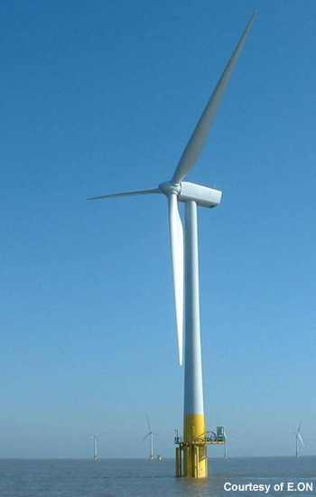
Offshore Wind Context
UK is world leader – with half of the world’s installed capacity
28 Operational projects
1465 turbines
5000MW capacity
Each turbine weighs up to 1000 tonnes
Significant and growing percentage of UK capacity
Source: Renewable UK
Notes:
Robin Rigg – Cumbria

Slide 4
Quantitative Models for Offshore Wind
Where to locate the offshore wind-farms
Multiple Objective Facility Location
Multiple Stakeholders
Strategic development of the wind-farm sector
Building a consensus amongst multiple stakeholders
Optimising the offshore wind supply chain
Multiple Objectives (Cost, Distance, Employment, Reliability)
Optimising Construction phase
Vessel Scheduling model with time and cost trade-offs
Operations and maintenance strategy optimisation
Dynamic, weather dependent, maintenance optimisation
Dismantling and renewal strategy optimisation
Multiple Objective Equipment Replacement problem

Slide 5
Quantitative models for offshore wind(2)
Multiple Objective Design of wind-farm components
Specialised heuristic algorithms
Wind Farm Layout Optimisation
Where to locate turbines and support facilities
Optimising grid interface, downstream supply chain
Optimal use of energy produced by wind farms
Dynamic pricing models
Optimal Use of Barges (100,000+ Euros/day)
Packing problem with weight constraints
Optimal port choice (construction or maintenance)
DEA/ MCDA discrete choice problem

Slide 6
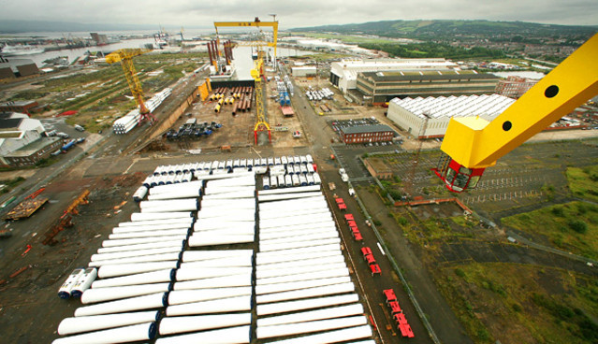
Port Optimisation
Source: Bloomberg
Challenge to ports of handling heavy, irregular shaped objects

Slide 7
Decision support for offshore wind logistics
Integrated Logistics work package of the Leanwind project
Optimisation via life cycle phase and supply chain segment
 | Installation | O&M | Decommissioning
Prior to Port | PTPIns | PTPOM | IntDis
At Port | Portlay, PortIns | PortOM | PortDis
Port to Site | VMIns | VMOM | IntDis

Slide 8
Underlying OR algorithms
Discrete choice (Port choice)
Irregular shape Packing / Layout (Port layout)
Scheduling (Vessel scheduling)
Mathematical programming (transportation)
Meta-heuristics (VNS), exact method, decomposition-based methods (for solution)

Slide 9
Proposed routings
GIS illustrated routings are generated for each life cycle phase
Optimal solutions show
Mostly minimised land transportation
Preferred transportation by sea to offshore wind support port
Different port options for supply chain configurations investigated

Slide 10
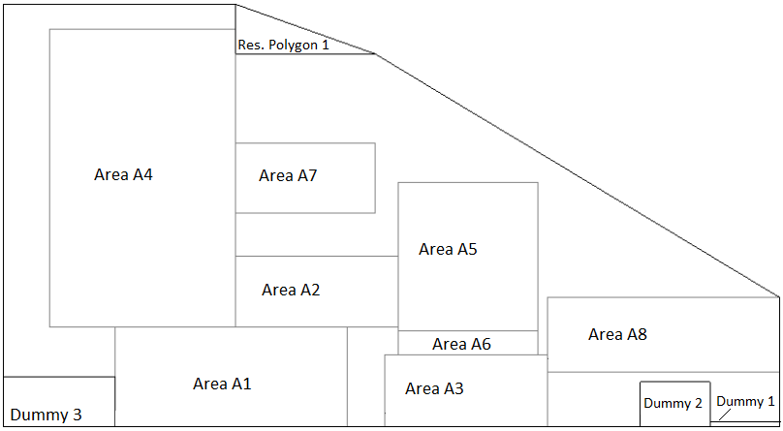
Port Layout Algorithm - Example

Slide 11
Strategic Analysis of MRE potential
Linked to the Channel MOR project.
Channel Region:
MRE types
Offshore Wind
Tidal
Wave
Workshops, survey, SWOT

Slide 12
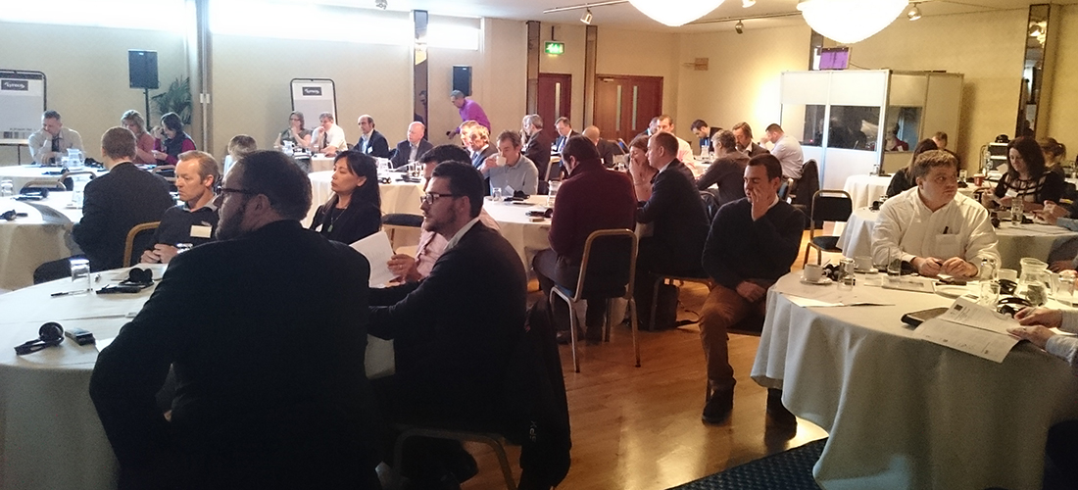
Future of Marine Renewable Energy Workshop, Portsmouth, January 2015

Slide 13
Conclusions of Analysis
Preference for offshore wind over tidal or wave
Possibly due to higher maturity levels
No clear consensus amongst survey respondents with regard to SWOT
Possible reflection of a new, developing sector
Level of inconsistency high to very high
Further reflection of a new, developing sector

Slide 14
2OM Example – Which wind farms?
Decision Owner: Crown Estate
Where to allow wind farms from a set of possible offshore locations ( if not allowed, if allowed)
Stakeholders:
Manufacturers
Operators
Governmental Authorities
Ports
Logistics Providers
Other Maritime Stakeholders: Leisure Community, Local Community, Environmentalists, Fishing Community.

Slide 15
Selection and Ranking of Sites?
Linked to the 2OM project

Slide 16
Methodology
A set of eight goal targets set
Energy production by season (more preference to heavier usage)
Cost, environmental impact, leisure and fishing impact (equal weights)
Appropriately challenging goal levels set
A 4-meta objective extended goal programming model constructed (Jones and Jimenez, 2013)
Weight sensitivity analysis (Jones, 2011) undertaken in meta objective space
Analysis of results in objective and decision space undertaken

Slide 17
Results

Slide 18
Discussion of Results
The multiple objectives trade-offs have been made apparent
Every wind farm appears in at least one solution
Every solution builds at least three wind farms
Wind farms appear with different frequency across solutions
Wind farms 1,2,4,5,9 appear frequently (near current sites)
Wind farms 6,7 appear least due to high stakeholder cost relative to energy produced
Wind farm 3 only appears in high energy generation scenarios due to large cost

Slide 19
Conclusions and Future Research
Offshore wind presents significant decision making challenges that require quantitative modelling
Decisions often made in the context of a multi-objective, multi-stakeholder dynamic environment
There are relatively little formal OR models due to the newness of the field
Similar comments apply to other renewable energy sources (wave, tidal, solar, biomass – partly)

