Slide 1
Addressing Loneliness in Rural North Yorkshire
Sarah Culkin

Slide 2
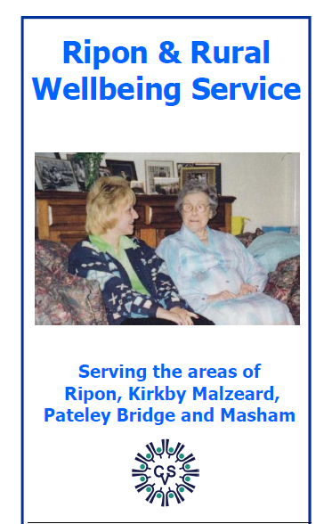
The Challenge
An organisation in North Yorkshire took over a rural visiting service for the elderly and was keen to ensure that as much benefit as possible could be provided for recipients of the service. It therefore requested a pro bono study from the OR Society to help a project team understand how a strategy for improving the service could be constructed.

Slide 5
Overview
Project initiation
Analysis
Results
What happened next

Slide 6
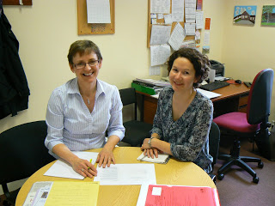
First Steps
Agree a project brief
Collect information and evidence through:
interviews with stakeholders
accompanying the project team on visits to clients
reviewing survey feedback and finance information

Slide 7
Interviews
Neighbouring organisations
CVS representatives
RRWS Staff
Clients

Slide 8
Interviews
Typical interview prompt questions:
Who are the clients? Is there a typical client?
What proportions are referred from NHS, LA, self, other?
Describe (briefly) how the service works using the example of an eligible person’s journey through the service.
e.g. How did she find out about the service, how did she get in touch, what happened next, how did they decide what his needs were, how soon did contact take place, did they check they are meeting his requirements and ask for feedback, did they check whether he needed referrals to other agencies, is the service time limited, is any record of visits kept but the service, does the customer get the opportunity to review his needs against what the service is providing, is he discharged?
What do you consider to be the main benefit of this service?
How do you know whether the service is successful, and whether this success improves year on year?
How would you improve the service? Both what is provided, and the way in which it is provided
What might impact on the service, in the future?
What would be the impacts (for customers and other organisations) if you stopped providing this service?

Slide 9
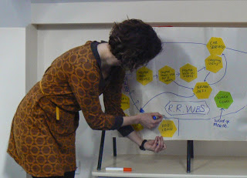
Analysis

Slide 10
Analysis
Theme | Number of mentions
Addressing loneliness is a priority- addressed by calling in for a chat | 8
Not enough marketing / service is not known about | 6
Services should partnership work more | 6
The role of the RRWS is to keep people out of care/needing carers and to promote independence | 6
Transport is important but problematic | 5
Not clear what each service does and doesn't do – there is a muddled landscape | 4
Better information sharing required when services are seeing the same client | 4
Combine transport with provision of emotional support and monitoring | 4
Use of volunteers is valuable | 4
Need a daycentre | 4
The RRWS provides information and steers clients | 4
Do not receive many referrals form the RRWS | 3
The RRWS are in competition with other services | 3
Volunteers are often retired themselves | 2
RRWS can pick up changes in health | 2
Less statutory funding means client numbers may increase | 2

Slide 11
Strategy map
http://www.publicsectorscorecard.co.uk/

Slide 12
Outcomes
As a result of the analysis the client gained a thorough understanding of the service and the wider system it is part of
A strategy map for reducing loneliness was identified and evidenced. This is used, for example, to track numbers of volunteers used, how they contribute to the numbers of visits made, and how well the service works in partnership with neighbouring organisations
The client was ‘taken on the journey’, so now understands where strategies come from
The work produced a solid foundation from which to re-model the service and apply for associated funding

Slide 13
Back at Dept. of Health….
Connecting for Change (C4C)
Causal loop system diagrams for macro evaluation
Inform own work - IA for data sharing

Slide 14
Acknowledgements
Sarah Wishart –Social Researcher
Department of Health

