Slide 1
Reflections on the relevance of systems thinking to oxfam’s management and leadership capacity
Penny Lawrence - Deputy CEO Oxfam
17 March 2017

Slide 2
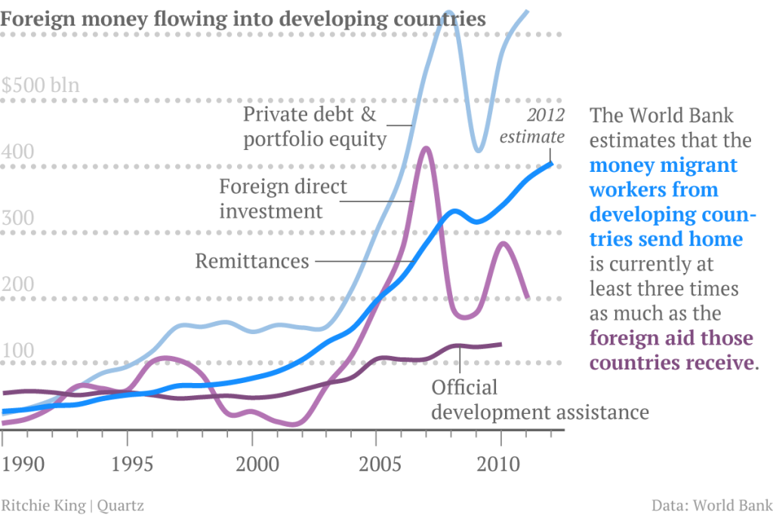
Official Aid is only part of the changing picture in our sector

Slide 3
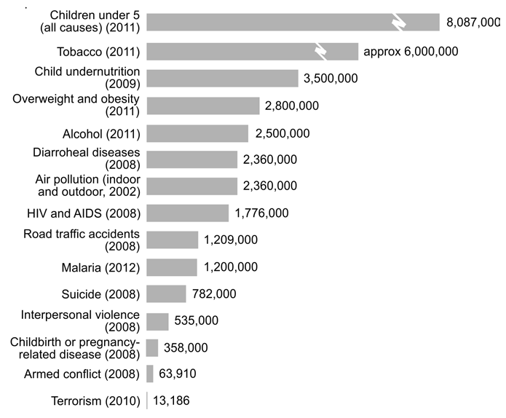
Even when it comes to mortality

Slide 4
Lots of other changes and uncertainties.....
As Poorer countries develop - Civil society organisations in Southern countries are growing, but also being attacked, esp on advocacy role
Growth of Middle Class and Private Sector in many more countries
Rise of populism more nationalist ‘UK/US first’
Declining public trust in any institutions.... charities, aid
We need to be fit for the uncertainties of the future

Slide 5
A lot of aid projects and activism look like this

Slide 6
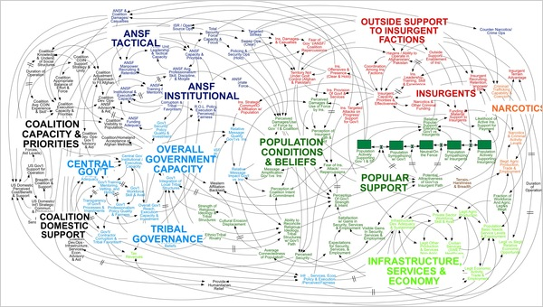
But this is the world we often work in

Slide 7
Key Features of change in systems
Critical Junctures
Large scale (wars, crises, Panama Papers)
Small scale
Path Dependence
= big problem for traditional planner approaches
Which is why we need to rethink our approach!

Slide 8
A big rethink in the aid business
Systems thinking and complexity
Adaptive Management
Theories of Change > Logframes
Disintermediation (GiveDirectly)
Localization
But lots of countervailing forces (eg Value for money results, national interest, political attack)
And the INGOs are often lagging behind

Slide 9
How do we take a supertanker White Water Rafting?

Slide 10
Some Principles and Practices
Change capital v delivery capital
How do you fund change capital?
Spin offs and Seeding the System
Subsidiarity - How far can we push power down?
Responsible Rapid Response
How does agility square with focus, loyalty to partners, responsible exit
Goal seeking, crowd sourcing
Accept many ways to get things done
How do we develop/attract entrepreneurs + systems thinkers?
How do we enable them to operate in a more traditional organisation structure ? Change incentives/the structure?

Slide 11
How we think/feel/work
We live our values - Empowered, accountable, inclusive
Curiosity – Study the history; ‘learn to dance with the system’, start with who else has done this? What have we learnt?
Humility – embrace uncertainty/ambiguity
Reflexivity – be conscious of your own role, prejudices and power
Include multiple perspectives, unusual suspects, be open to different ways of seeing the world, different ways of collaborating
Leaders provide vision, engage and develop talent, role model capabilities they espouse!

Slide 12
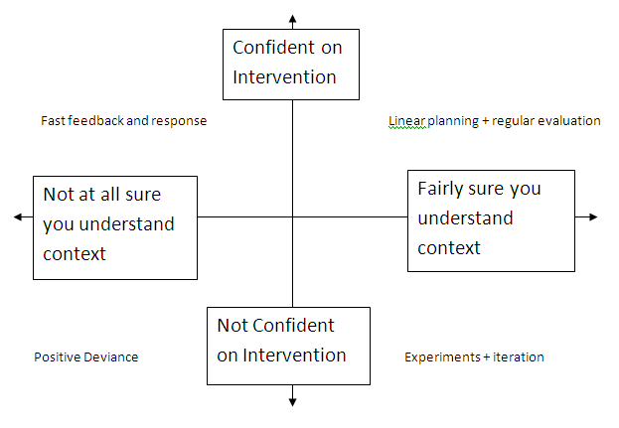
Tools to aid navigation : What kind of action?

