Slide 1
Notes:
This slide may be shown at the beginning of the presentation.

Slide 2
Verification and Validation (V&V):
Doing the Right Thing, It’s All about Good Business
SW18 Workshop
Paul Glover &
Alan Robinson
© Crown copyright (2018), Dstl. This material is licensed under the terms of the Open Government Licence except where otherwise stated. To view this licence, visit http://www.nationalarchives.gov.uk/doc/open-government-licence/version/3 or write to the Information Policy Team, The National Archives, Kew, London TW9 4DU, or email: psi@nationalarchives.gsi.gov.uk

Slide 3
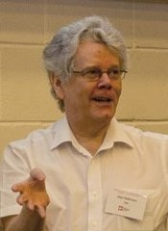
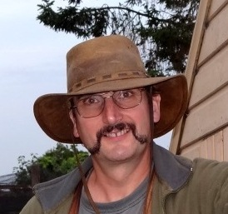
Workshop Leaders
ALAN ROBINSON has been working in Defence Operational Analysis for over 30 years. He is currently a Dstl Fellow of the Defence and Security Analysis (DSA) Division of Dstl, which is an Agency of the Ministry of Defence, advising the DSA Capability Lead on the technical quality of the work delivered by DSA Division.
PAUL GLOVER received a BSc (Hons) in Archaeological Sciences from the University of Bradford in 1985. He then completed an MSc in Information Processing at the University of York in 1986 and has been working in Defence Operational Analysis ever since. Paul is currently a principal analyst in DSA Division at Dstl, with responsibility for the quality assurance, technical development and delivery of modelling and simulation methods and techniques.

Slide 4
Verification and Validation (V&V): Doing the Right Thing, It’s All about Good Business
The purpose of the paper and associated workshop is to share perspectives on conducting appropriate V&V for simulation, so as to facilitate the delivery of ‘fit for purpose’ advice to the customer.
The paper provides an overview of UK government advice for achieving this and presents emerging perspectives on how this advice may be enhanced.
The purpose of the associated workshop is to briefly summarise the current situation and provide foci for discussion to stimulate sharing as to how this advice could best evolve, for the benefit of simulation in Operational Research (OR).

Slide 5
Contents
You and the Aqua Book: The Current Situation
  Alan
Rapid Turn-around Analysis
  Paul
Inter-working in Partnership
  Paul
The Broader Bounds of Simulation
  Paul
Wash-up
  Alan

Slide 6
Contents
You and the Aqua Book: The Current Situation
Rapid Turn-around Analysis
Inter-working in Partnership
The Broader Bounds of Simulation
Wash-up

Slide 7
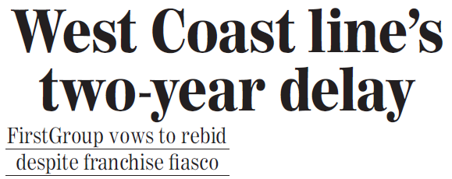
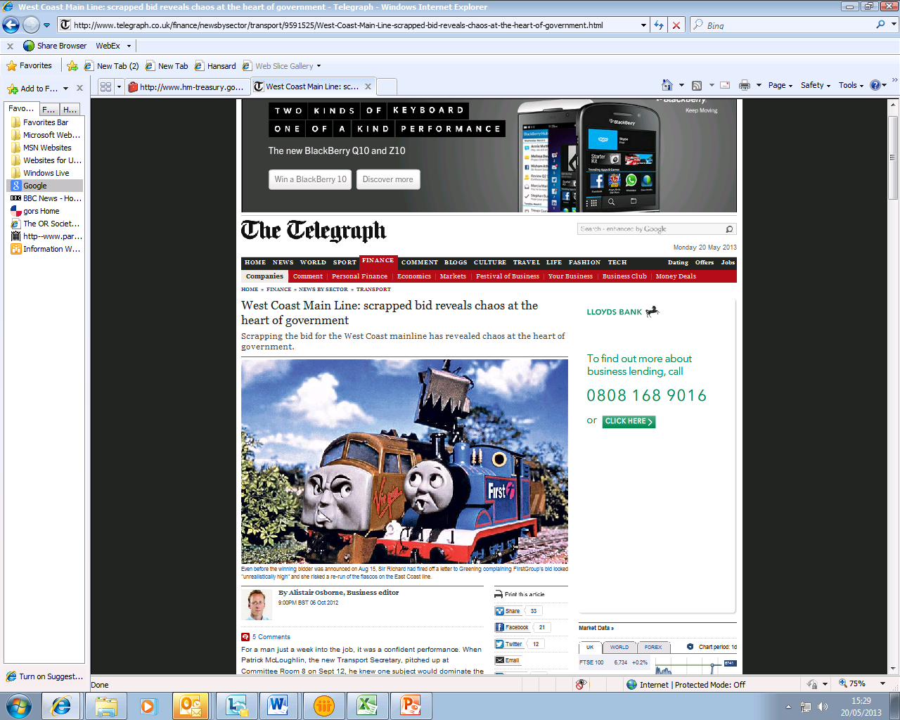
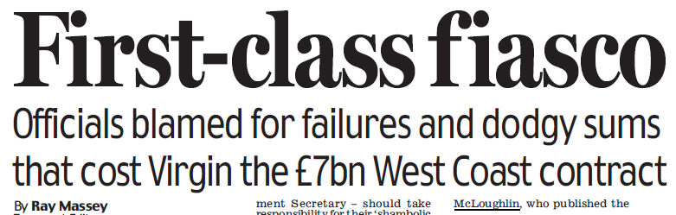
When modelling goes wrong…
It can have major impact:
  Economic
  Financial
  Legal
  Reputational
  Operational

Slide 8
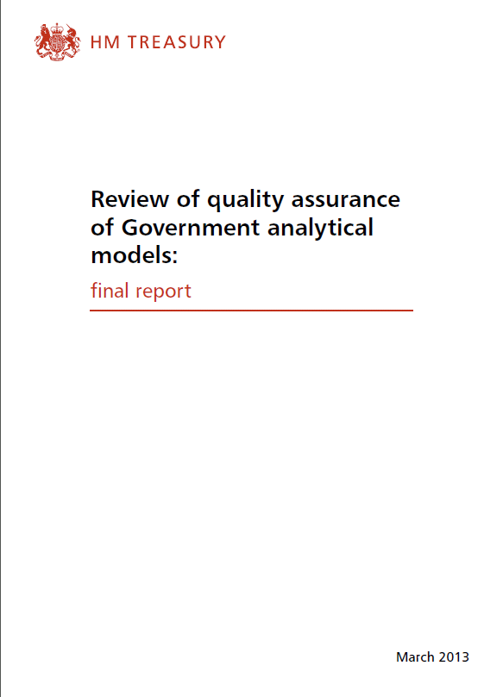
The initial Government response…
Initiate a review!

Slide 9
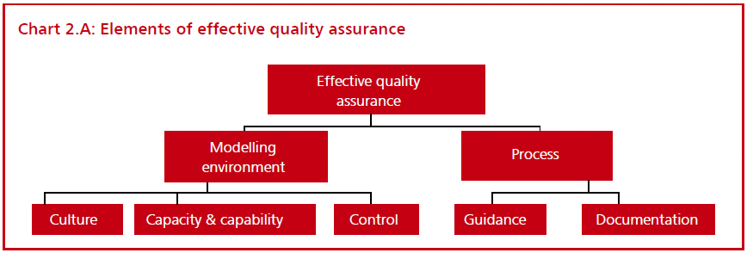
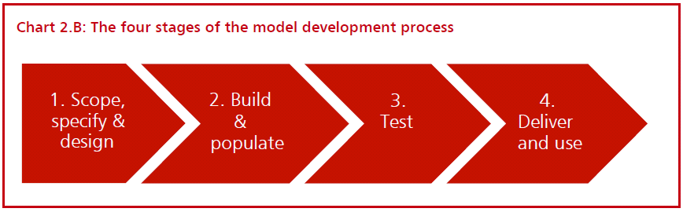
…identify key lessons…

Slide 10

… codify and share good/best practice

Slide 11
Key Aqua Book Elements
Clearly differentiated roles
  Commissioner, analyst, assurer

Slide 12
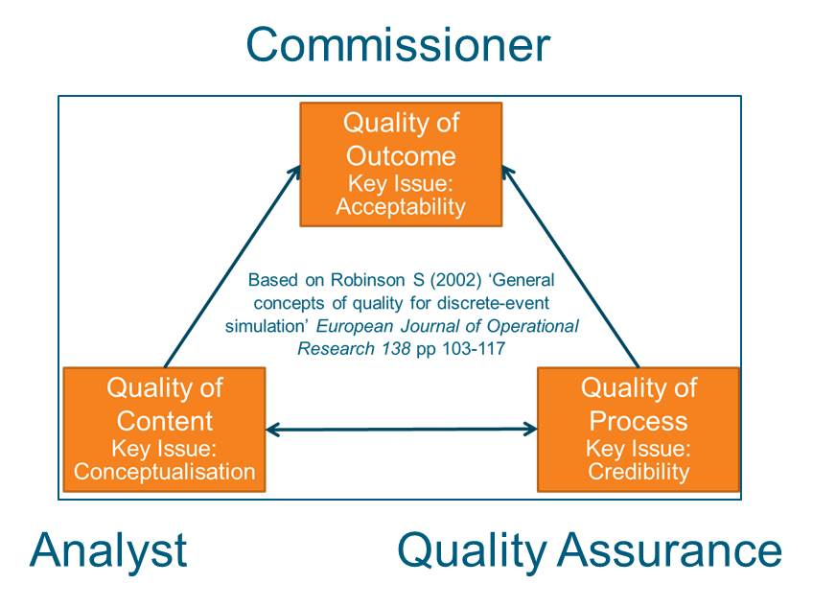

Slide 13
Key Aqua Book Elements
Clearly differentiated roles
  Commissioner, analyst, assurer
Appropriate senior ownership and responsibility
  (Model) Senior Responsible Officers

Slide 14
Key Aqua Book Elements
Clearly differentiated roles
  Commissioner, analyst, assurer
Appropriate senior ownership and responsibility
  (Model) Senior Responsible Officers
Through-life attention to Quality Assurance

Slide 15
QA and the Model Life-Cycle
Scope
Build
Test
Use
Retire
Start the QA here!
Not Here!

Slide 16
Key Aqua Book Elements
Clearly differentiated roles
  Commissioner, analyst, assurer
Appropriate senior ownership and responsibility
  (Model) Senior Responsible Officers
Through-life attention to Quality Assurance
Assurance activity proportionate to the modelling risk/significance
  Verification, validation and fitness-for-purpose

Slide 17
Quality Assurance (QA)
The model is doing things right (Verification)
The model is doing the right things (Validation)
The model is appropriate to the decision being supported (Fitness for Purpose)
Type and Scale of QA Should be Proportionate
  to the decision being supported
OFFICIAL

Slide 18
Ensuring V&V is Proportionate
Type and complexity of analysis
Highly complex analysis requires more effort to assure
Novelty of the approach
A previously untried modelling technique requires more assurance
Importance of issue
Different issues will vary in their economic and social impact
Relevance of the analysis to the decision making process
Amount of resource available for the modelling which includes the V&V
When a analysis forms only one component of a broad evidence base, less assurance is required than if the decision is heavily dependent on one model
Precision of the analysis outputs
Imprecise analysis can need different QA than precise analysis, e.g. because of inherent limitations of the analytical technique, or lack of data on assumptions
The value for money of any additional V&V must be balanced alongside the benefits and the risk appetite that exists
OFFICIAL

Slide 19
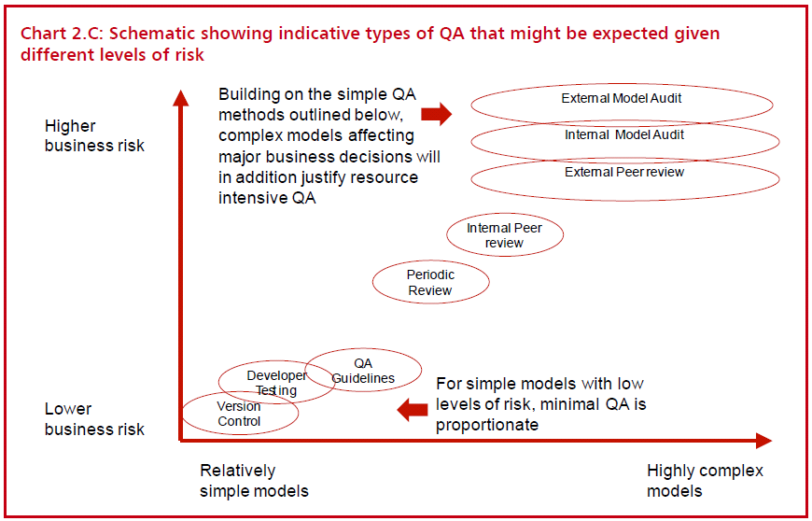
How much QA is enough?

Slide 20
Key Aqua Book Elements
Clearly differentiated roles
  Commissioner, analyst, assurer
Appropriate senior ownership and responsibility
  (Model) Senior Responsible Officers
Through-life attention to Quality Assurance
Assurance activity proportionate to the modelling risk/significance
  Verification, validation and fitness-for-purpose
Uncertainty understood and managed

Slide 21
What do Assurers need to worry about?
Are the “right” models/approaches being used / suggested for use on the study?
  Have they been suitably verified and validated, e.g peer review, using trials etc?
Are they populated with appropriate data?
Are the users sufficiently expert?
Have the right experts been consulted?
  For models, the Model Custodian and, where appropriate, the model Senior Responsible Owner.
Where risk is being held, what mitigations are in place or need to be put in place?
Is appropriate funding/time/resource in place for the modelling?
  What assumptions are being made about what will be free-at-point-of-use?

Slide 22
You and the Aqua Book:
The Current Situation
Aqua book is published and available
  https://www.gov.uk/government/publications/the-aqua-book-guidance-on-producing-quality-analysis-for-government
Some further supporting guidance is available
  Cross-government best practice forums also in place
A recent GO-Science-led “Blackett” review of modelling also commends the Aqua book
  https://www.gov.uk/government/publications/computational-modelling-blackett-review

Slide 23
Any final points about the current situation before we move on to ongoing developments?

Slide 24
Evidence Building
Maturity of
Understanding
Demonstration
Mature
Refined
Hypothesis
Fidelity of
Experimentation
Settings
Vector of Research
Preliminary
Hypothesis
Immature
High
Praxis
Trials
Discovery
Low
Modelling and Simulation
Simple
Complex
Gaming
(Based on
Dr Richard E Hayes CCRP)
Complexity (Multi-dimensional)

Slide 25
Evidence Building: Risks & Biases
(Observations on
experimental risks &
biases based
on Reiss (2017)
Maturity of
Understanding
Optimism
Bias
Demonstration
Mature
Refined
Hypothesis
Fidelity of
Experimentation
Settings
Vector of Research
Experimental
Artefact &
Optimism Bias
Preliminary
Hypothesis
Immature
High
Praxis
Experimental Artefact
Trials
Discovery
Low
Modelling and Simulation
Simple
Complex
Gaming
(Based on
Dr Richard E Hayes CCRP)
Complexity (Multi-dimensional)
Notes:
References
Reiss Prof J (2017). Against External Validity. CHESS Working Paper No. 2017-03 Durham University November 2017. See https://www.dur.ac.uk/resources/chess/CHESSK4UWP_2017_03_Reiss.pdf (accessed 13 March 2018).

Slide 26
Contents
You and the Aqua Book: The Current Situation
Rapid Turn-around Analysis
Inter-working in Partnership
The Broader Bounds of Simulation
Wash-up

Slide 27
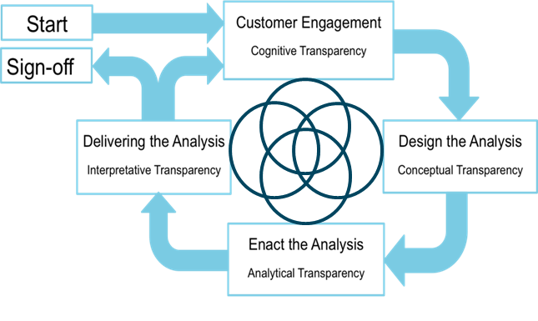
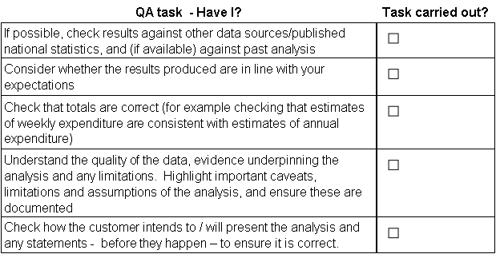
Rapid Turn-around Analysis
Tests at each stage
of Process
Validate your intended purpose
Verify that the plan fulfils the intent
Validate the detail against four lenses
Verify the intent has been fulfilled
Validate the output from this stage
Face Validity
Criterion Validity
Construct Validity
Content Validity

Slide 28
Hand-rails – Empirical and Actual
The ‘Actual’ The limit of the known
The ‘Empirical’ Those things explicitly studied
Analysis

Slide 29
Hand-rails – Warrant and Validity
The ‘Actual’ Measured in terms of Validity
The ‘Empirical’ Measured in terms of Warrant
Analysis

Slide 30
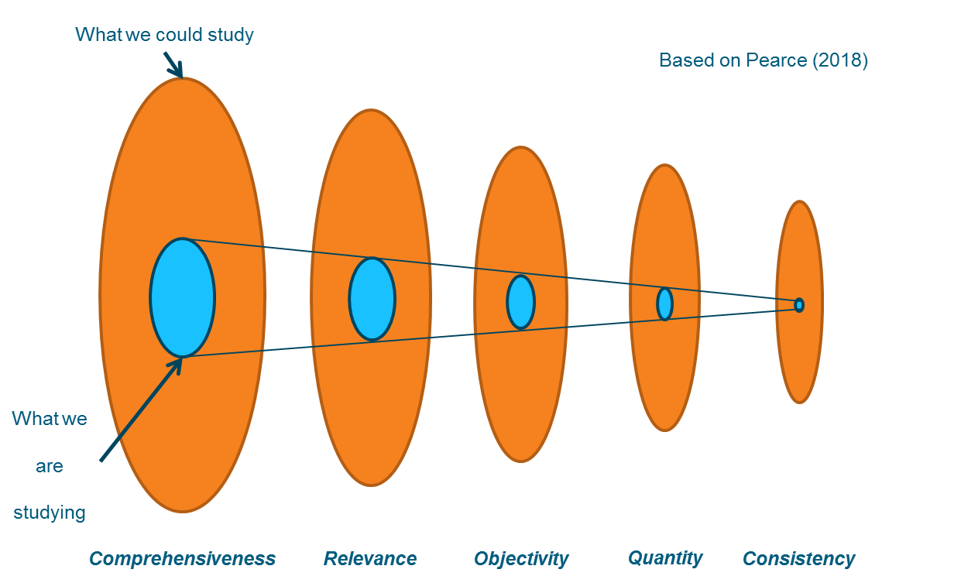
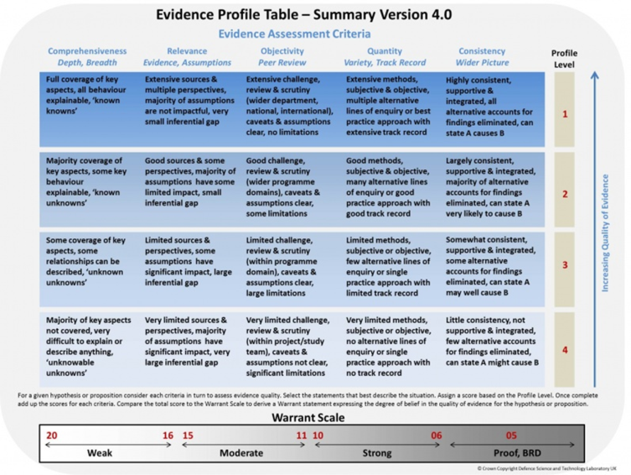
Hand-rails – Tools for Warrant
The ‘Actual’ Measured in terms of Validity
The ‘Empirical’ Measured in terms of Warrant
Analysis

Slide 31
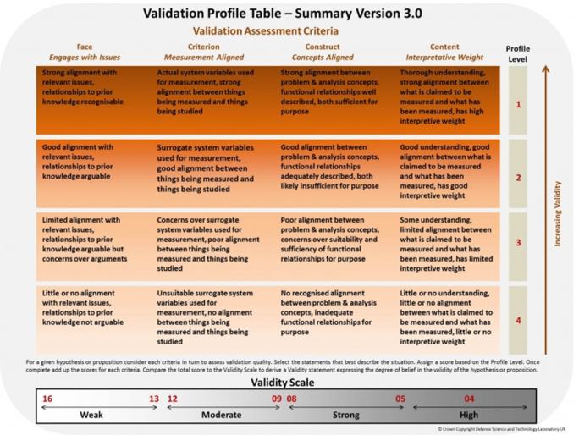
Hand-rails – Tools for Validity
The ‘Actual’ Measured in terms of Validity
Validate your intended purpose
Verify that the plan fulfils the intent
Validate the detail against four lenses
Verify the intent has been fulfilled
Validate the output from this stage
The ‘Empirical’ Measured in terms of Warrant
Face Validity
Criterion Validity
Construct Validity
Content Validity
Analysis
V&V for the Aqua Book

Slide 32
Thinking about examples of rapid turn-around analysis
How did you determine the evidence requirements for that work?
How did you infer between Empirical and Actual?
How did you assess the Uncertainty?

Slide 33
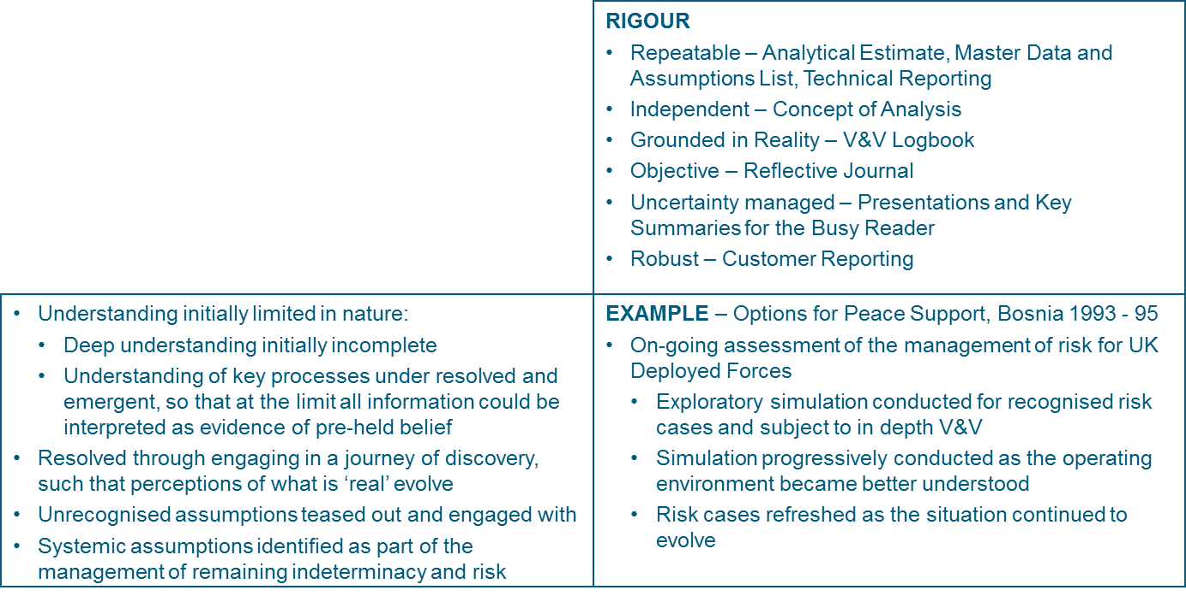
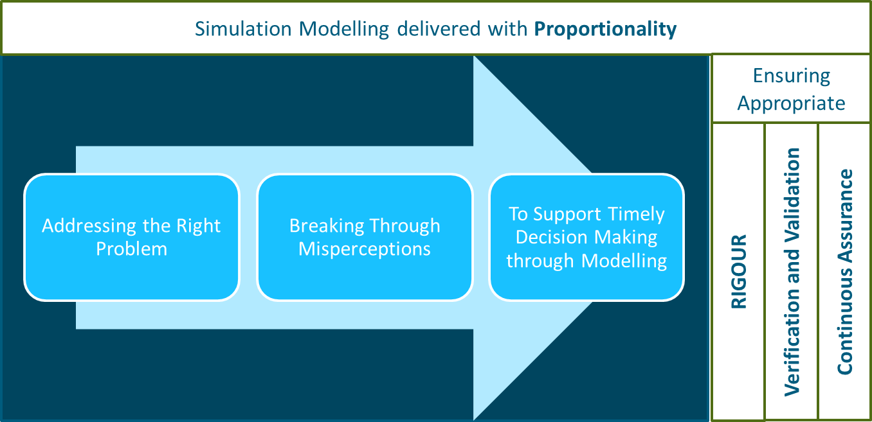
A Case Study

Slide 34
Key Learning

Slide 35
Future advice
The ‘Real’ Challenges yet to happen
The ‘Actual’ The limit of the known
The ‘Empirical’ Those things explicitly studied
Analysis

Slide 36
Contents
You and the Aqua Book: The Current Situation
Rapid Turn-around Analysis
Inter-working in Partnership
The Broader Bounds of Simulation
Wash-up

Slide 37





Inter-working in Partnership
Working with the best wherever they may be found
  Industry / Academia
  International Research Collaboration (IRC)
  Cross-Government

Slide 38
How do you plan the evidence requirements for your studies?
How do you baseline the current state of knowledge?
How do you know how much additional Evidence is needed?
How do you communicate Uncertainty?

Slide 39
Handrails
Development of the Evidence Framework Approach
    Pearce (2018)
  Provides effective ‘handrails’ for assessing evidence quality
  To ensure appropriate use of models and methods
  Exposing issues in the evaluation, assessment and understanding of evidence
  An evidence based approach produced in partnership with industry and academia
Notes:
Reference
Pearce P (2018). A Technical Overview of the Evidence Framework Approach: Practical Ways of Thinking about Evidence. CHESS Working Paper No. 2018-02 Durham University March 2018.

Slide 40


Slide 41


Slide 42
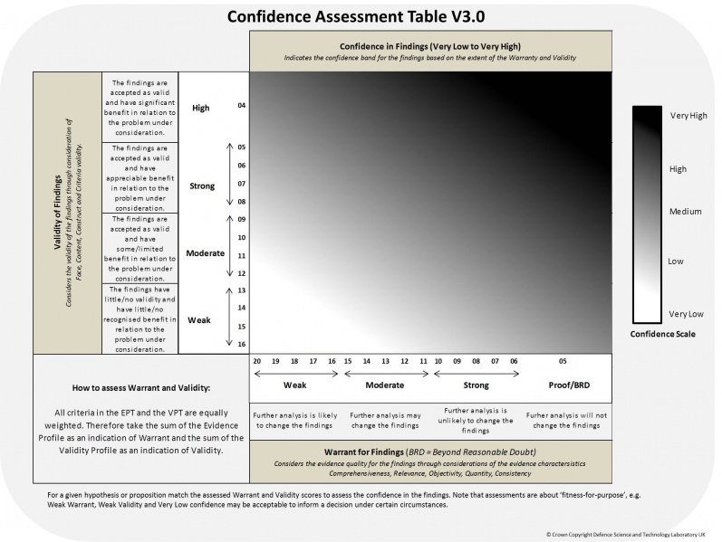

Slide 43
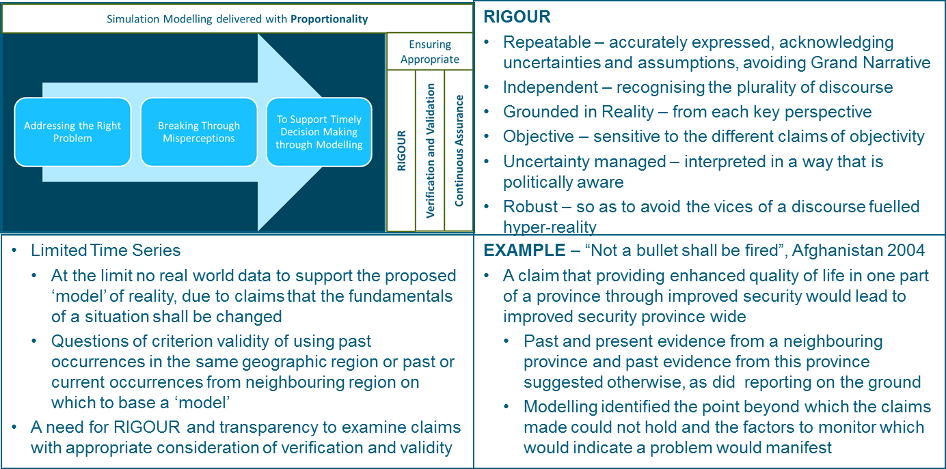
Case Study
Notes:
Reference

Slide 44
Key Learning
There must be clear value for each member of the partnership (Strang & McLeish, 2015)
  There may be particular sensitivities concerning the publishing opportunities for academics (McLeish & Strang, 2016)
There are key challenges in moving from Multi-disciplinary interchange to Interdisciplinary working
  Particularly concerning accountability and definitions (Winesberg et al, 2014) (Government Office for Science, 2018 p32 (Validating a Norovirus Model))
Notes:
References
Government Office for Science (2018). Computational Modelling: Technological Futures. See https://www.gov.uk/government/uploads/system/uploads/attachment_data/file/682579/computational-modelling-blackett-review.pdf (accessed 13 March 2018).
McLeish T, Strang V (2016). Evaluating interdisciplinary research: the elephant in the peer-reviewers’ room. Palgrave Communications Published 25 Aug 2016.
Strang Prof. V, McLeish Prof. T(2015). Evaluating Interdisciplinary Research: a practical guide. Institute of Advanced Study Durham University.
Winsberg E, Huebner B, Kukla R (2014). Accountability and values in radically collaborative research. Studies in History and Philosophy of Science 46 (2014) 16-23

Slide 45
Future Advice
Context: The Real
Comparators
None
Expert Opinion
Other Models
‘Real world’
Nomological Machine The Empirical
Perceived Context
The Actual
Assumptions Sensitivity Testing
Inference
Comprehensiveness
Hypotheses
Alternative Hypotheses
Purpose
Why?
Objectivity
Quantity
Cases
Norms
Consistency
What?
How?
Relevance

Slide 46
Contents
You and the Aqua Book: The Current Situation
Rapid Turn-around Analysis
Inter-working in Partnership
The Broader Bounds of Simulation
Wash-up

Slide 47
The Broader Bounds of Simulation
Hybrid approaches
  Simulation
    Generate dynamics
  Machine learning
    Notice change
    Assess properties
    Classify form
    Assess choices
  Artificial intelligence
    Compare options
Example applications
  Real time support
    Flight, Industry 4.0, Logistics, Maintenance, Medical, Security, Traffic
  Research support
    Agriculture, Education, Mapping Risk Spaces, Pharmaceutical, Physics

Slide 48
The Broader Bounds of Analysis
What are the implications for understanding from
  Engaging with Big Data?
  Where can Machine Learning help understanding?
  Could Deep learning further assist you?
The Cynefin Framework (Snowdon, 2014)
  Real time support
    Flight, Industry 4.0, Logistics, Maintenance, Medical, Security, Traffic
  Research support
    Agriculture, Education, Mapping Risk Spaces, Pharmaceutical, Physics
Notes:
For more information about the Cynefin framework see: https://en.wikipedia.org/wiki/Cynefin_framework

Slide 49
Hand-rails
Limits of application
  AI & Machine Learning
    Medium Complexity problems
      Requirements tend to scale exponentially
  Hybrid Approaches (AI, Machine Learning &
    Simulation)
    Complicated systems with Very Complicated Interactions
        Government Office for Science (2018)
Some Guidance: British Ecological Society (2017)
Notes:
References
British Ecological Society (2017). A Guide to Reproducible Code in Ecological Evaluation. N Cooper & P-Y Hsing (eds).
Government Office for Science (2018). Computational Modelling: Technological Futures. See https://www.gov.uk/government/uploads/system/uploads/attachment_data/file/682579/computational-modelling-blackett-review.pdf (accessed 12 March 2018)

Slide 50
Case Studies
Discovering the Higgs Boson
  Simulating
    Baseline activity
    Detector capability
    Expected decay
  Training Machine Learning to recognise Higgs Boson
  Castelvecchi (2015)
Climate change challenges for machine learning
  Simulating
    Linked atmospheric, oceanographic, topological & vegetation models
  Supported by machine Learning from local data
  Banerjee & Monteleoni (2014)
Notes:
References
Banerjee A, Monteleoni C (2014). Climate change: challenges for machine learning (NIPS tutorial). See https://www.microsoft.com/en-us/research/video/tutorial-climate-change-challenges-for-machine-learning/ (accessed 12 March 2018).
Castelvecchi D (2015). Artificial intelligence called in to tackle LHC data deluge. Nature 528, 18

Slide 51
Key Learning
Discovering the Higgs Boson
  Machine learning not Deep learning used
    Transparency of assertion vital
  Potential of Deep learning is recognised
    Transparency an issue
Climate change challenges for machine learning
  Challenges
    Deriving predictions from multiple-model ensembles
    Combining machine learning and simulation
  Learning
    Value of unsupervised learning from simulation
Notes:
References
Banerjee A, Monteleoni C (2014). Climate change: challenges for machine learning (NIPS tutorial). See https://www.microsoft.com/en-us/research/video/tutorial-climate-change-challenges-for-machine-learning/ (accessed 12 March 2018).
Castelvecchi D (2015). Artificial intelligence called in to tackle LHC data deluge. Nature 528, 18

Slide 52
Future advice - 1
The ‘Real’ Measured in terms of Insight
The ‘Actual’ Measured in terms of Validity
The ‘Empirical’ Measured in terms of Warrant
Analysis

Slide 53
Future advice - 2
The components of Insight are:
  The static potentials of the structure and function of a system
    Why the system is as it is and any additional operationally relevant potentials that it may have
  Things that a system may currently be lacking
    E.g. Systems integration issues yet to be resolved
  The anticipated performance of systems in their operational environment given current limitations on their operation
  The implications for what may additionally be needed to action the insight, such that it is humanly do-able

Slide 54
Wash-Up

Slide 55
Have we done what we promised to do?
The purpose of the workshop is to briefly summarise the current situation and provide foci for discussion to stimulate sharing as to how this advice could best evolve, for the benefit of simulation in Operational Research (OR)
Any further questions or comments?

Slide 56
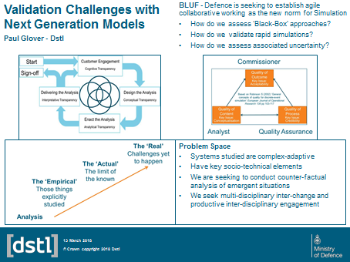
Thanks for coming!
See also Paul’s poster on V&V on Tuesday,
or catch one of us for a further chat
Paul Glover Alan Robinson
M&S Principal Fellow
DSA Division DSA Division
peglover@dstl.gov.uk aprobinson@dstl.gov.uk

Slide 57
Notes:
This slide may be shown at the end of the presentation.

