Slide 1
Analytics Network Event will start at 18:20

Slide 2
Welcome to Analytics Network

Slide 3
Before start…

Slide 4
Agenda
Bethan Mackay: Health Analytics
Musa Bilal: Productionising Machine Learning Systems
Matthew Robinson and Joanna Levitt: Applying design thinking to Analytics
Jacqui Taylor: Mapping the Future towards the Internet of Things
Next events coming up

Slide 5
Health Analytics
Applying new lenses to standard datasets

Slide 6
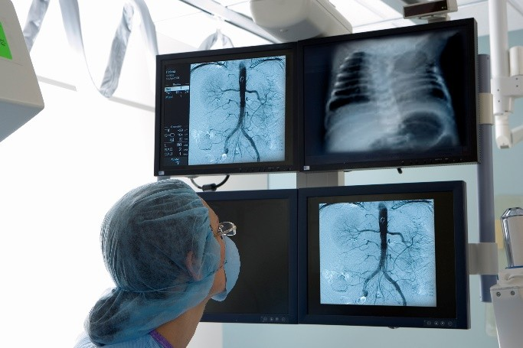
Data is collected all over a hospital for a variety of specific purposes
Ambulance response dataset
Pathology dataset
A&E attendance dataset
Theatre activity dataset
Call an ambulance
Get an x-ray
Receive blood test results
Move wards
Attend A&E
Get admitted to hospital
Have an operation
Get discharged

Slide 7
The big question
Can we use existing datasets to answer new questions and improve both the quality of decision-making and healthcare delivery overall?

Slide 8
Applying a financial lens to an operational dataset
AA25 Cerebral Degenerations or Miscellaneous Disorders of the Nervous System

Slide 9
Turning health data into a crystal ball

Slide 10
Any Questions?

Slide 11
Next events in the Analytics Network

Slide 12
We are looking for you!
If you are interested to talk or if you like to host the next event please let us know! Contact us at:
Hope Meadows on hope.meadows@theorsociety.com
Eduardo Contreras OR@eduardoc.co.uk

Slide 13
Next Events
Data Science Speakers Club, next session 21st May www.meetup.com/datasciencespeakers/
The Art and Science of Modelling, 8th June www.theorsociety.com/Pages/SpecialInterest/Simulation_Future.aspx
Annual Analytics Summit 2018, 12th June www.analytics-events.co.uk
Annual Conference OR60, 11th-13th September www.theorsociety.com/OR60
More details on www.meetup.com/AnalyticsNetwork
Notes:
Certified Analytics Professional, an exam-based analytics qualification established by INFORMS, the US equivalent of the OR Society.

Slide 14
News from the other OR Networks
Apprenticeships
Be part of a group to take forward a Level 7 (Masters Level) apprenticeship standard in OR & Analytics For more details contact Alan Robinson aprobinson@mail.dstl.gov.uk or Alistair Clark Alistair.Clark@uwe.ac.uk
Heads of OR and Analytics Forum (HORAF) A Network free to join for senior managers to network and share ideas To join contact Alan Robinson, aprobinson@mail.dstl.gov.uk or John Ranyard jranyard@cix.co.uk
Notes:
Certified Analytics Professional, an exam-based analytics qualification established by INFORMS, the US equivalent of the OR Society.

Slide 15
Thank you!

