Slide 1

Fundraising and Operational Research
Webpage: www.theorsociety.com/Probono
Blog: http://probonoOR.blogspot.co.uk/

Slide 2
Notes for the reader
This presentation is based on the one presented to the ORiTS SIG meeting on 27 September 2018
You can run it as a slide show. Most of the slides are self-explanatory. At slides 4 and 5, it helps to read the notes I have added at slide 4, as the slides themselves do not contain the full story
I have also added some section dividing slides, where this was simply said in the original presentation.

Slide 3
Contents
An OR person meets the sharp end
Some ways in which OR has helped
Some ways in which it could help

Slide 4
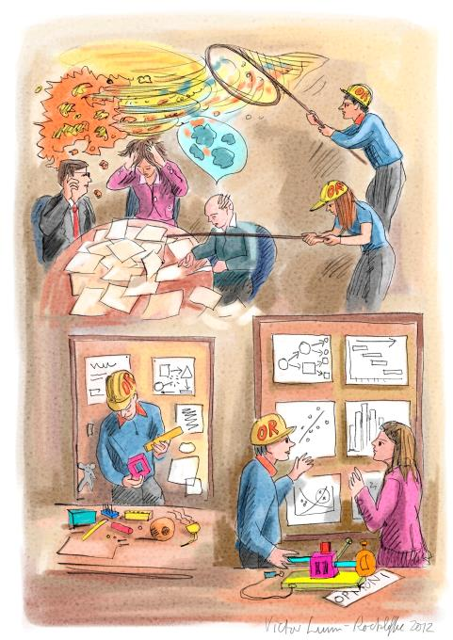
The sharp end: facing insolvency
Faced with the
tangled mess of problem situations…
…finding a way of making sense and seeing possible solutions
Notes:
Shortly after I joined the Board of Woman’s Trust, it became apparent that the finances were in dire shape. If we were to survive, we needed not just to keep an eagle eye on cash-flow, but also to convince the auditors and ourselves that we were a going concern, and for that we needed to understand ‘what-if’ –if we closed down Service X, would that be enough to save us; if we failed to get grant Y, was there anything we could do to survive?
I produced a spreadsheet model which presented a simplified version of the management accounts, that we could use to test ‘what-if’, for all our income streams, an main cost lines. Since income is related to outputs (because funders want to know what they are getting for their money), and costs are partly fixed and partlyrelated to activity levels, the model had to include these connections as well – again in simplified form.

Slide 5
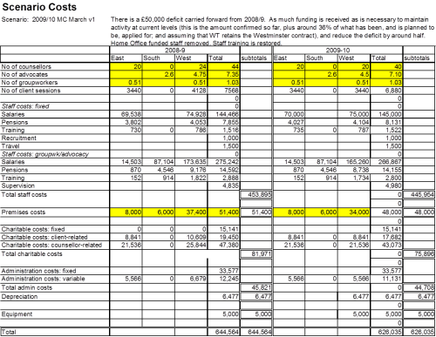
The sharp end: facing insolvency
By seeing clearly the combined consequences of different sets of events, the Trustees and Director could think realistically about how we could respond or prepare for them
Enabled us to take difficult decisions about timing of service closure, to prioritise fundraising and to lay contingency plans
This in turn enabled us to survive and continue to provide our core service in the face of a bleak and uncertain funding environment.

Slide 6
Some examples of OR helping with funding
There follows a list of examples from the last few years of Pro Bono OR

Slide 7

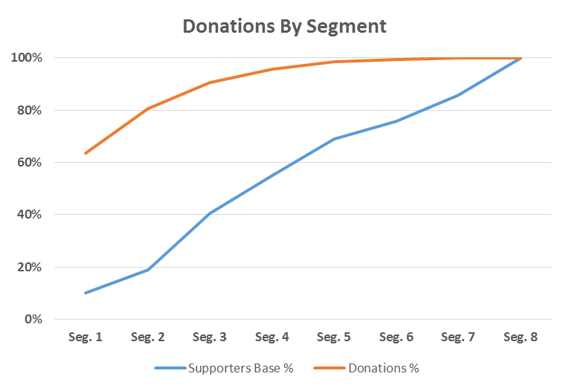
Analysing supporters and donations
Key insights about what makes each group of supporters different from each other
How to communicate effectively to each segment
An analytical framework for attitudinal segmentation
Set of rules to classify new supporters

Slide 8

Process Analysis for Continuous Improvement
External evidence to support existing improvement initiatives
New, evidence based improvement areas for consideration
Highlighted the benefits of engagement with staff and supporters in continuous improvement design and prioritisation
Skills transfer so Diabetes UK can continue to analyse and improve their existing processes
Understand
DUK Engagement
External Review
Supporter Engagement
Information Capture
Fundraising options for supporters
DUK processes
DUK and partner teams
“We are very pleased with the outputs of this project. The team provided us with a number of recommendations and actions that will undoubtedly have a positive impact on the relationships we have with our supporters.”

Slide 9
Processing donations more quickly
Validated recent process improvements
Gave senior management confidence that process was sound.
Identified principal bottlenecks and where additional resources may be needed
Recommended some practical options for improving operational layout and donation triaging
‘It has been really helpful to have an independent set of eyes look at our processes’

Slide 10
External data: making it work for you
  Greater capacity to exploit external statistics for fundraising (as well as overall planning and prioritisation, project management and evaluation, etc)
  Immediate improvement for some projects
  Staff and partners have improved knowledge about some relevant complex issues, improving their personal credibility and authority and leading to greater effectiveness and influence for the organisation as a whole

Slide 11
Getting the evidence, telling the story
Transformed arguments for funding of the group’s work, increasing its chances of securing funding
Improved evidence on what it has done and what it has funded others to do in the past and on what may have been achieved
Improved the effectiveness of its grants scheme

Slide 12

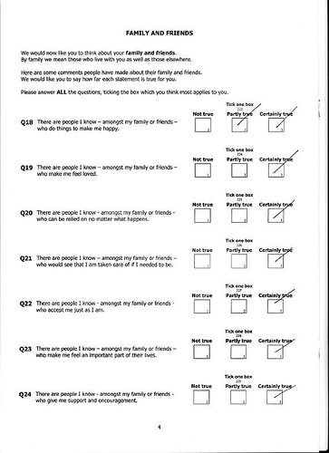
Measuring the Impact of Supported Projects
A set of metrics that give an insight into supported projects.
Specific objectives to improve the way that partner charities think about, and measure, their impact.
“This project helped us know where to start, which is always useful to know – and it’s given us data to help our fundraising & broader communications too” - CEO

Slide 13


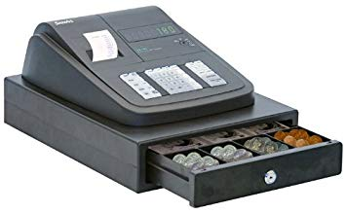
Other

Slide 14
How OR can help more generally
There follows some discussion of general areas where OR may be able to help

Slide 15
More generally…
Analyse donor data for better:
targeting, responsiveness,
fit to donor goals
Identify best location of collection sites, deployment of collectors, shops
More donations
Improve systems to collect and process donations efficiently
Larger donations
Improve outcome and impact assessment

Slide 16
…and…
Most effective use of resources
Financial forecasting to help plan, ask ‘what-if’
Tie in fundraising to wider strategy
Improve systems to collect and process donations efficiently

Slide 17
And for grantmakers…
Multi-criteria assessment to improve decision-making on individual grants
Portfolio construction to improve impact of whole set of grants
More effective grants
Improve systems to collect and process donations efficiently
Improve outcome and impact assessment

Slide 18
Thank you!

