Slide 1
Early Intervention Foundation Work on Gang and Youth Violence
Tom McBride Director of Evidence

Slide 2
Who we are

Slide 3
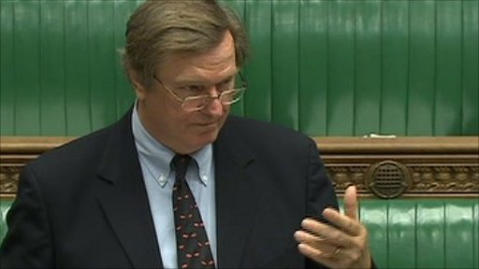
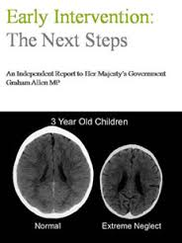
Starting the journey in 2011
Notes:
Journey began with unusual partnership between Graham and IDS – different sides of the political spectrum – both with a passion and interest in EI
Graham, founder chair of EIF – Coalition govt to report to the PM
His ground-breaking report – drawing on lots of existing knowledge
Growing research on case for early intervention drawing on research from – psychology, economics, neuroscience and social research.
Strong evidence for a number of specific programmes implemented internationally esp. in the US - Family Nurse Partnership introduced in UK
Lack of evidence for programmes in UK context
The Early Intervention Foundation created in 2013 with all-party support

Slide 4
What Works Centres – a culture of evidence

Slide 5
2018: A new five year strategy for EIF
Our vision is that all children are able to achieve their full potential
Our mission is to ensure that effective early intervention is available and is used to improve the lives of children and young people at risk of poor outcomes.
When we talk about early intervention we mean identifying and providing effective early support to children and young people who are at risk of poor outcomes.
We define effective as showing evidence of improving outcomes for children and young people.

Slide 6
Making the case
Generating evidence
Using evidence to change policy and practice
Communications
Funding
Working in partnership
Measuring our impact

Slide 10
How does early intervention work?
Studies show that early intervention is likely to have its greatest impact when targeting seven key outcomes, starting with the four primary domains of child development
Cognitive
Obesity & Physical Health
Physical
School achievement & entry into the workforce
Mental health & wellbeing
Social &
Emotional
Behavioral
Crime, violence & antisocial behaviour

Slide 11
How does early intervention work?
Studies also show that three additional outcomes are particularly important targets for early intervention
Risky Sexual Behaviour
Child Maltreatment
Substance Misuse

Slide 12
Our work

Slide 13
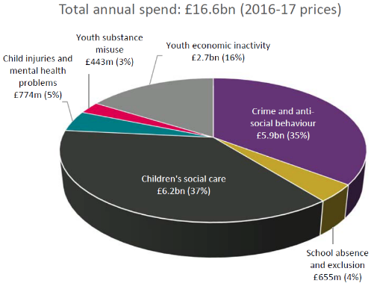
UK Late Spend: Context
“early intervention has the potential to reduce costs to the public sector before issues become entrenched and more expensive to deal with”
Annual immediate fiscal cost for children and young people (E&W)
EIF has shown that nearly £17 billion is spent each year by local and national agencies on acute and statutory services for children, young people and families in England and Wales. This is equivalent to £287 per person.
£6.4 billion is spent by local government, almost all of which is child protection and children’s social care.
¹https://www.gov.uk/government/publications/early-intervention-smart-investment-massive-savings

Slide 14
UK Late Spend: Northern Ireland Example
Comparisons of spending drivers by region

Slide 15
UK Late Spend: Northern Ireland Example
Comparisons between English Local Authorities and Northern Irish Regions
English Local Authorities and Northern Ireland Local Government Districts ranked from highest to lowest late intervention spend per head

Slide 16
‘Foundations for Life’
“Foundations for Life: What Works to Support Parent Child Interaction in the Early Years” is a groundbreaking assessment by the Early Intervention Foundation of 75 early intervention programmes aimed at improving child outcomes through positive parent child interactions in the early years.
Notes:
Represents the next stage in the Allen Review
Creating foundations for a UK evidence base for Early Intervention
Use EIF’s own ratings, approach, cost scale
Drawing on expertise of partners
Focus on relationships – parent and child and parent and parent

Slide 17
Key messages
The evidence and cost of 75 interventions were assessed. 17 interventions were identified as evidence-based.
There is already good choice of effective addressing children’s noncompliant behaviour. There is good evidence to suggest that if offered at age 3 or later, they may reduce the likelihood of persistent non-compliant behaviour. These programme are low cost.
There is less choice of programmes addressing children’s attachment security. These programmes are likely to be high cost.
There is less choice of evidence-based interventions that support children’s early learning through parent child interaction. These programmes should be offered in addition to centre-based programmes and are likely to be medium to high cost.
Attachment
Behaviour
Cognitive development

Slide 18
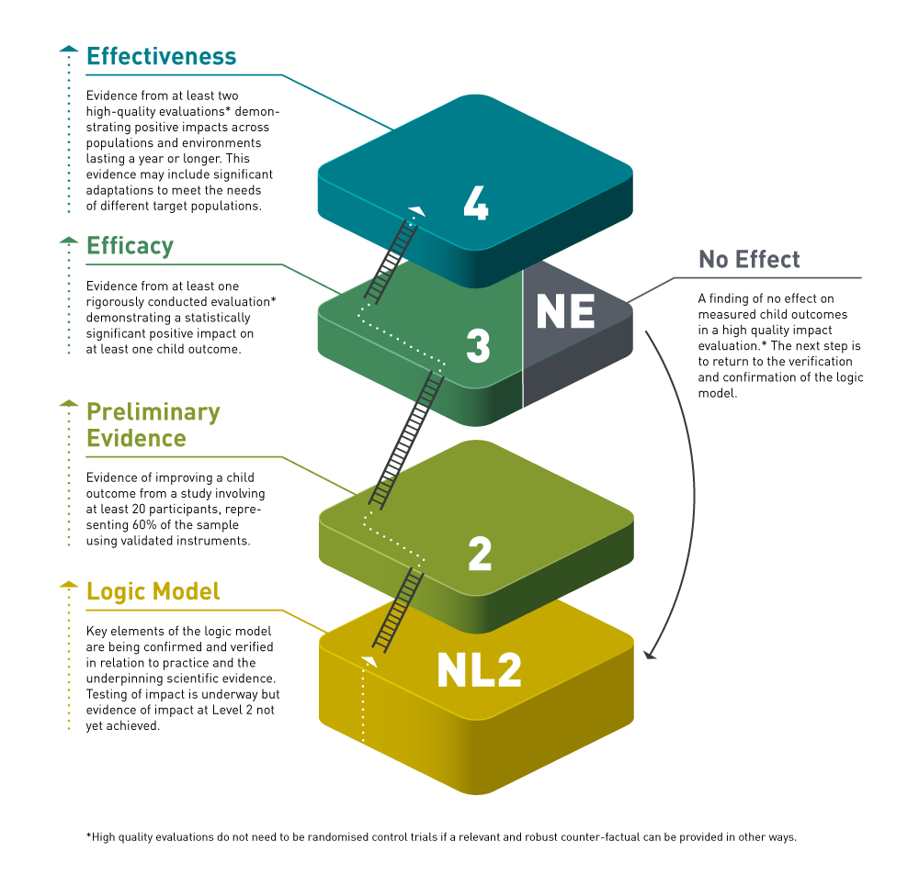
Notes:
Strength of evidence of impact is only part of the story. The rating is not the decision. Programmes can go down as well as up.

Slide 19
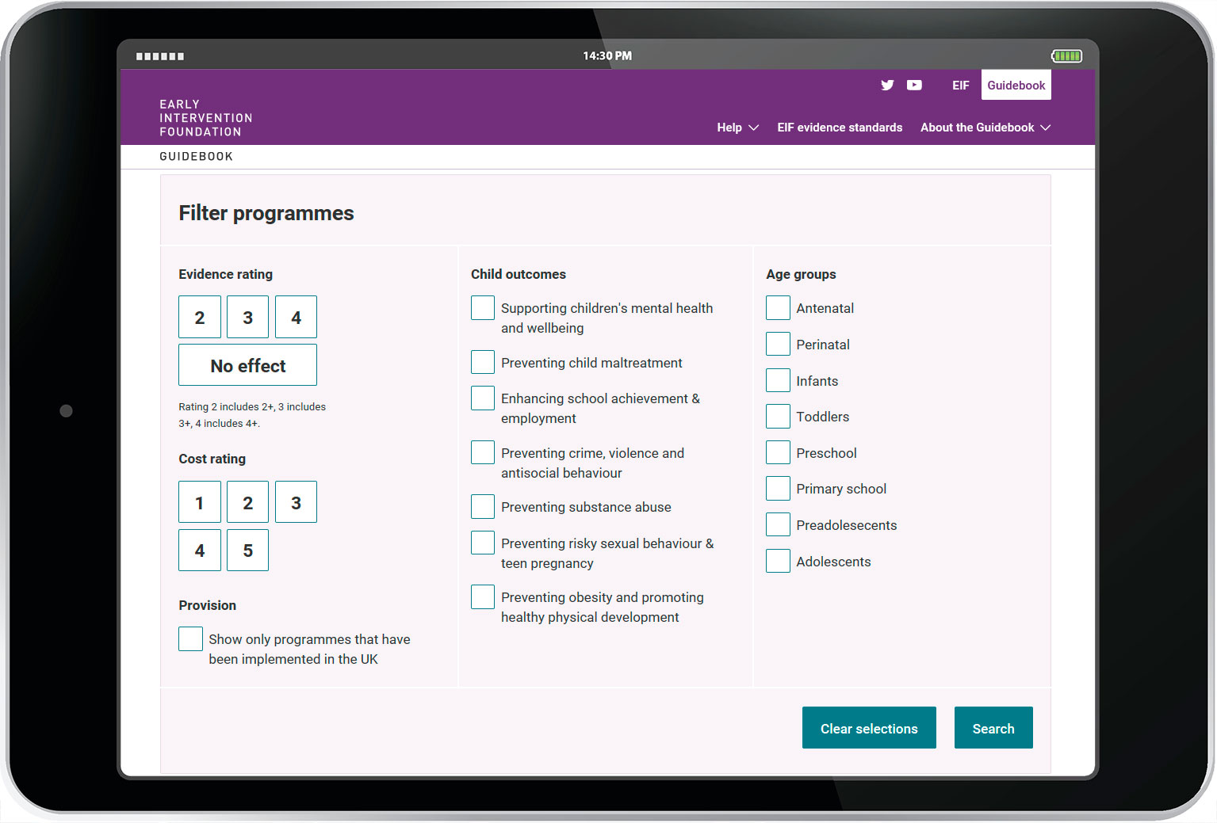
The EIF Guidebook

Slide 20
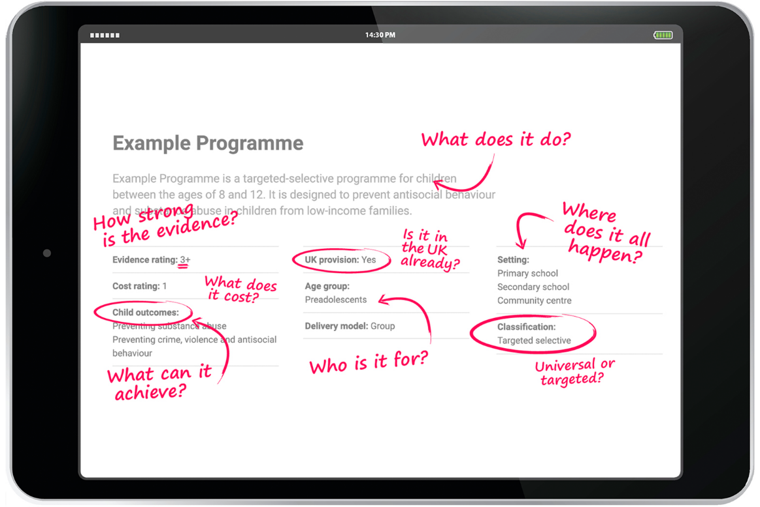
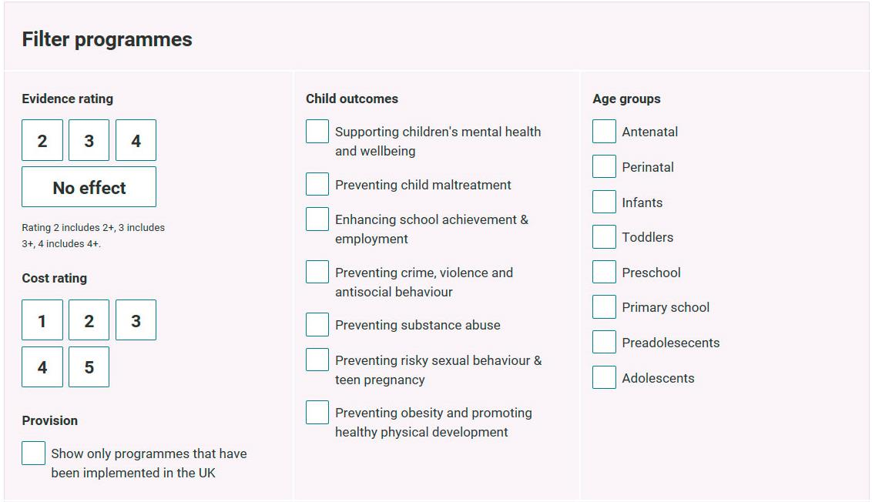
The EIF Guidebook

Slide 21
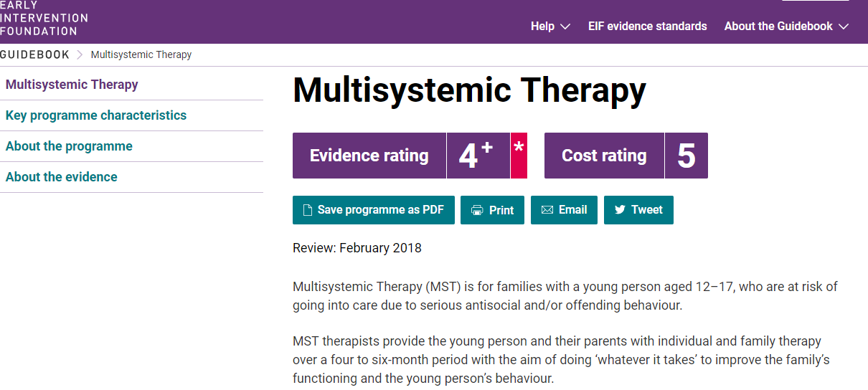

Slide 22
EIF Evidence Standards:
10. SCALE
9. ADAPT
Established
EIF Level 4
8. REFINE
7. 2nd RCT
6. 1st RCT
Initial
EIF Level 3
5. PRE/POST PILOT
Pilot
EIF Level 2
4. FEASIBILITY (Verification)
3. BLUEPRINT (Confirmation)
Confirmation/Verification NL2
2. LOGIC MODEL (Confirmation)
1. THEORY OF CHANGE (Confirmation)
Notes:
Defining your project/programme & evaluation steps. (Kirsten 10 minutes total)
10 Steps to Evaluation
How to develop a Theory of Change - easy step by step guide.
Step 1. Theory of change
Step 2. Logic Model,
Step 3. Blueprint
Step 4 Feasibility Study
Next steps: Pre/post pilot to robust outcome design.

Slide 23
The importance of early intervention
“...this small minority of violent young people is not randomly distributed and does not appear out of the blue. Some areas suffer significantly greater levels of violence than others; some individual and family risk factors repeat themselves time and time again.”
Ending Gang and Youth Violence Report
HM Government, November 2011

Slide 24
The role of social and emotional learning
“Most prominently, the search revealed a very significant body of work demonstrating the association of self-control, self-regulation (and similar concepts) in childhood with many domains of adult life, including mental health, life satisfaction and wellbeing, qualifications, income and labour market outcomes, measures of physical health, obesity, smoking, crime and mortality.”
Ending Gang and Youth Violence Report
HM Government, November 2011

Slide 25
Early signs of risk (ages 7-12)
Disrupted family
Poor supervision
Friends involved in crime or ASB
Conduct problems
High daring
Previous offending
Drug use
Aggression
Running away
Poor academic achievement (primary school)
Truancy
Learning disability
Availability of drugs
Young people in trouble in the neighbourhood
EIF report available here

Slide 26
Protective factors
Good family management
Stable family structure
Infrequent parent/child conflict
Positive/pro-social attitudes
Belief in the moral order
Low impulsivity
Academic achievement
Low economic deprivation

Slide 27
What works to prevent GYV?
Summary of findings from EIF’s 2015 literature review
WHAT WORKS?
Skills-based and family-focused programmes which aim to foster positive changes as well as prevent negative outcomes
WHAT IS PROMISING?
Mentoring and community-based interventions
WHAT IS INEFFECTIVE OR POTENTIALLY HARMFUL?
Approaches based on deterrence or discipline – ‘Boot Camps’

Slide 28
Our project in South London
That evidence-based approaches to supporting social and emotional and behavioural development can reduce the risk of children becoming involved in GYV
That schools play a vital role in children’s social and emotional and behavioural development, and that the impact of their work can be maximised by adopting a “whole school approach”
That the wider system/community can support and reinforce the work being done in schools

Slide 29
Qualitative research in South London: key findings
RESEARCH AIMS: To explore what happens at primary school level to identify and manage the risk of gang involvement and youth violence
KEY FINDINGS
Deep concern about the broader set of risks facing pupils – problems identified with emotional literacy, dealing with conflict, self-esteem
Wide disparity in support for children in schools. Some had a range of external providers, others heavily reliant on a member of staff
External providers often selected on the basis of informal recommendations, or the offer of a ‘free’ service. Provision seldom if ever evaluated.

Slide 30
Future work in South London
To map the range of services that work with schools to support children’s social and emotional skills, and examine the factors that support or undermine this
To support Wandsworth and Lambeth primary schools to adopt and implement evidence-based approaches
To support voluntary sector organisations offering out-of-school provision to develop science-based theories of change and improve the quality of their monitoring and evaluation so that they can start to build their evidence

Slide 31
www.eif.org.uk
tom.mcbride@eif.org.uk
@Tom_EIF /@theEIFoundation

