Slide 1
Every life in prison transformed.

Slide 2
Our Mission To show Christ’s love to prisoners by coming alongside them and supporting them.

Slide 3
How PF works
Prison Fellowship E&W has been active for nearly 40 years.
We have over 2,500 volunteers across England and Wales, connected in a network of Local Groups.
We are currently involved with 98% of the prisons in England and Wales (118 of 120).

Slide 4
Programmes

Slide 5
Sycamore Tree
Sycamore Tree is a course about restorative justice and victim awareness that takes place in prisons over six sessions, using the biblical restorative story of Zacchaeus.
The programme develops offenders’ understanding of the impact of their crime upon others and upon themselves.
PF volunteers, motivated by their Christian faith, deliver the programme. The Tutor always has a teaching qualification.
The programme is accredited by Gateway Qualifications and Ofqual.

Slide 6
Sycamore Tree
“It’s made me look at myself, what kind of person I am. I want to change.”
“Sycamore Tree has massively opened my eyes and I realise what pain and suffering I caused to other people. I won’t hurt people again.”

Slide 7
Sycamore Tree
An evaluation of Prison Fellowship’s Sycamore Tree Programme was undertaken by Sheffield Hallam University in 2009. The study took psychometric evaluations from 5,000 prisoners taking the course between 2005 and 2009. 13% of the overall sample were women and 17% were young offenders.
The evaluation found that:
Across the whole sample (5,000 prisoners) there were significant positive attitudinal changes that were statistically associated with completion of the programme;
The positive attitudinal changes were associated with all groups of prisoners and all institutional categories;
Both male and female prisoners demonstrated an increased awareness of the impact of their actions on victims, as well as a reduced anticipation of reoffending;
[An evaluation of the Sycamore Tree programme, August 2009, Hallam Centre for Community Justice: Sheffield Hallam University ]

Slide 8
Sycamore Tree
Overall Attitudinal Change – Whole Sample
Dimensions | Pre Scores | Post Scores | Sig. | Evidence of Change
G Score – general attitude | 36.02 | 31.46 | 0.00 | Yes
A Score – Anticipation of future offending | 11.90 | 10.77 | 0.00 | Yes
V Score – Victim empathy | 5.23 | 4.44 | 0.00 | Yes
E Score – Evaluation of crime as worthwhile | 9.37 | 7.72 | 0.00 | Yes
P Score – Problem inventory | 25.27 | 23.13 | 0.00 | Yes

Slide 9
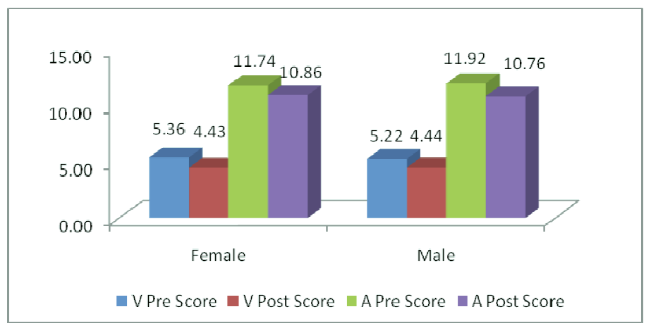
Sycamore Tree
Attitudinal shifts in V-Scale and A-Scale by Gender

Slide 10
Sycamore Tree
We recognise that the Sycamore Tree course is one tool that we can offer men and women in prison as they do the hard work of turning their lives around.
The journey of desistance is a life-long one, with many challenges and barriers to overcome, but so much of the feedback we receive shows that this course is a powerful and transformative moment on that journey for many learners.

Slide 11
Connect with us
Sign up to receive our regular newsletters and appeals by post or email, through our website.
Contact our Support Office:
020 7799 2500
info@prisonfellowship.org.uk
www.prisonfellowship.org.uk
Pfenglandwales
@PFenglandwales
PFenglandwales

