Slide 1
Using these slides
‘Slide-show’ allows the animation that shows how the argument on each slide develops
There are notes under each slide, not visible in slide show, which contain useful or important additional information
So there is no ideal way to view these slides other than a live presentation.
Please do not copy anything from these slides without permission.

Slide 2
Ethical dilemmas in everyday practice
Ruth Kaufman FORS

Slide 3


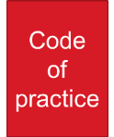

Aim of this session
Ethical practice
code
Notes:
I want to present, or remind you of, statements of ethical principles. The trouble with such statements is that when they’rewritten down it all seems obvious. We’re good people. Why wouldn’t we do this? So I also want to discuss the real-world challenges, the real world reasons why we wouldn’t or don’t do this; because if we don’t actually imagine it in practice, we are ill-equipped to turn to it in practice when the time comes.

Slide 4


Contents
Introduction to the issues
  Codes of practice
  OR literature and frameworks
3 enemies of perfect ethical practice
  Personal imperfections
  Big dilemmas – the nature of human life
  Little dilemmas – our local personal lives

Slide 5
Guidelines/codes
Certified Analytics Professional Code of ethics/conduct
Engineering Council statement of ethical principles
Promethean Oath for OR professionals
Universal ethical code for scientists (UK government)
OR Society code of conduct for Chartered Scientists
RESPECT Code of Practice for socio-economic research
EU
OR Society statement of ethical principles
7 principles of public life (UK government)
Notes:
For the first 50 years or so of O.R.’s existence there were no ethical statements. O.R. people are good people, who enter the profession to change the world for the better; why would you need them? Now: take your pick, not all aimed specifically at O.R., but many relevant to O.R. people.

Slide 6
Statement of ethical principles
“Professional Operational Researchers
work to enhance the welfare, health and safety of all
whilst paying due regard to the environment and the sustainability of resources.
They have made personal and professional commitments
to enhance the wellbeing of society
through the exploitation of knowledge
and the management of creative teams.”
OR Society Statement of Ethical Principles
First published 2011
http://www.theorsociety.com/Pages/Society/Ethical.aspx
Notes:
Whichever you pick, the main difference is in the layout and wording. If you think about going with the spirit rather than the letter of the guides, they are very similar.
I’m going to talk through the OR Society statement of ethical principles. This is a set of aspirations. It has similarities with the OR Society Code of Practice for Chartered Scientists, but the Code is shorter. That’s because the code is a requirement – failure to comply with the code is a disciplinary matter that can mean getting struck off the register of CScis – so it is limited to what can reasonably be expected all the time of everybody.

Slide 7
Four main planks
accuracy and rigour
honesty and integrity
respect for life, law and the public good
responsible leadership: listening and informing

Slide 8
Accuracy and rigour
Always act with care and competence
Only work in areas of current competence
Exercise prof skills and judgement to best of ability
Keep up to date
Help others keep up to date
Undertake appropriate CPD
Do not mislead or allow others to be misled
Present… honestly, accurately and without bias
Identify, evaluate, quantify risks
Statement of ethical principles
Code of conduct for Chartered Scientist

Slide 9
Honesty and integrity
Be alert to how work might affect others…
…respect others’ rights and reputations
Never engage in corrupt practice
Take steps to prevent corrupt practice
avoid deceptive acts
Act for employer/client in trustworthy way
Declare conflicts of interest
Reject bribery or improper influence
Statement of ethical principles
Code of conduct for Chartered Scientist

Slide 10
Respect for life, law and the public good
Ensure that
all work is lawful and justified
Minimise + justify adverse effect on society/environment
Be satisfied that all work is lawful and justified
Hold paramount health and safety of others
Do all in their power to ensure activities don’t put health and safety of others at risk
Act honourably, responsibly, lawfully
Uphold reputation, standing and dignity of the profession
Statement of ethical principles
Code of conduct for Chartered Scientist

Slide 11
Responsible leadership: listening and influencing
Be aware of issues that O.R. raises for society
Listen to aspirations and concerns of others
Have regard at all times to the public interest
Actively promote public awareness of O.R. impact and benefits
Further charitable objectives of the OR Society
Be objective and truthful when giving professional opinion
Statement of ethical principles
Code of conduct for Chartered Scientist

Slide 12
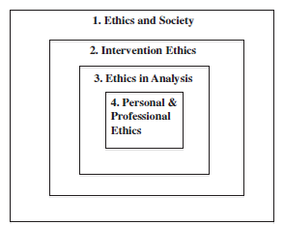
Ormerod/Ulrich framework
Is your work on the side
of good or evil?
Is process fair? aims, scope, stakeholder voice, method choice, implementation
Are your models valid?
Do they address values adequately? Do you follow best practice (modelling, presenting, documenting…)
Do you behave ethically?
Notes:
That’s what’s in the code. There is also a very interesting literature on ethics, which provide a number of ways of looking at what we do. I commend to you the literature review by Ormerod and Ulrich, which has this breakdown.

Slide 13
Ethics: no-no or dilemma
Is your work on the side
of good or evil?
Optimising child trafficking routes
Optimising bombing convoys
Is process fair? aims, scope, stakeholder voice, method choice, implementation
Modelling to justify foregone conclusion
Confidential analysis to support downsizing
Are your models valid?
Do they address values adequately? Do you follow best practice (modelling, presenting, documenting…)
Presenting uncheckable outputs
Presenting imperfect analysis
Keeping quiet about someone else’s poor practice
Do you behave ethically?
Fiddling results
Notes:
There are some things which are definitely unethical. And there are some where there is genuine dilemma about what is best in specific circumstances.

Slide 14
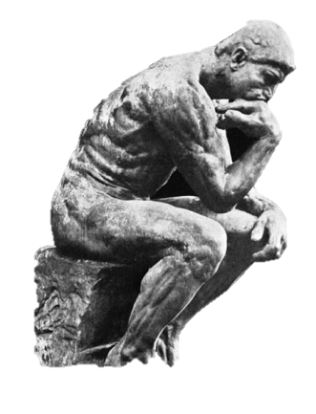

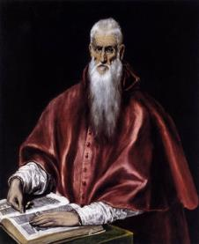
Ethics in practice
Perfect ethical behaviour
Yes-Yes
Day-to-day practice
Ethical dilemmas
Notes:
So moving on to ethics in practice:

Slide 15

Enemies of ethical practice
Perfect ethical behaviour
Yes-Yes
Day-to-day practice
Ethical dilemmas

Slide 16
Personal imperfections
Laziness
Thoughtlessness
Ignorance
Arrogance
Controlling
Cowardice
Putting own interest first
Other, please specify
Time management
Pragmatism
Notes:
Examples I have seen in my career. Some of them come from my personal practice. Most of them don’t.
Laziness. A spreadsheet without a checksum column. An under-documented model. Models, data and documentation that are not filed systematically. Not checking with other stakeholders, or previous literature. Mostly things that are boring – other stuff is more fun to do. Perhaps better classed as ‘lack of diligence’
Thoughtlessness Leaping to conclusions on data – correlation v causality, trends. Not thinking about the implications of data source, collection methods etc for validity and meaning of data. Accepting stated aims without thinking of alternatives, or what might be going on under the surface. Deciding on a method without thinking about alternatives and their consequences. Not thinking through analytical methods, not thinking through analytical findings, not thinking through implications. Another version of laziness – intellectual laziness. “Cognitive closure”
Ignorance Not knowing what you don’t know, which can result in invalid statistical analysis, invalid modelling, inadequate data, inadequate stakeholder participation, wrong assumptions. Ignorance is more of a problem when coupled with arrogance – confident that you know enough. And laziness – can’t be bothered to find out.
Arrogance Not challenging own ignorance. Not checking own results. Assuming counter-intuitive findings are due to interesting systems behaviour instead of your own errors
Controlling Presenting your process and results as if they were the only possible approach and outcome, in order to force the clients hand. Taking the ‘expert’ role in order to silence other voices
Cowardice Failure to confront clients who want to make improper use of the models. Avoiding stakeholders who might challenge the project. Tempering the presentation of results to avoid provoking clients.
Putting own interest first Over-selling results so you look good. Choosing a method that suits you, so you can hold onto the work, instead of finding the best approach for the client. Using the results of one project to on-sell another. Not sharing results you don’t like. Not confessing to errors found after results have been presented. Not confessing to inexperience in case the client chooses somebody better.
I’ve deliberately presented these in harsh terms. But actually, almost everybody succumbs to at least one of these now and then. And it is remarkable how much of it you can rationalise as legitimate compromise.

Slide 17
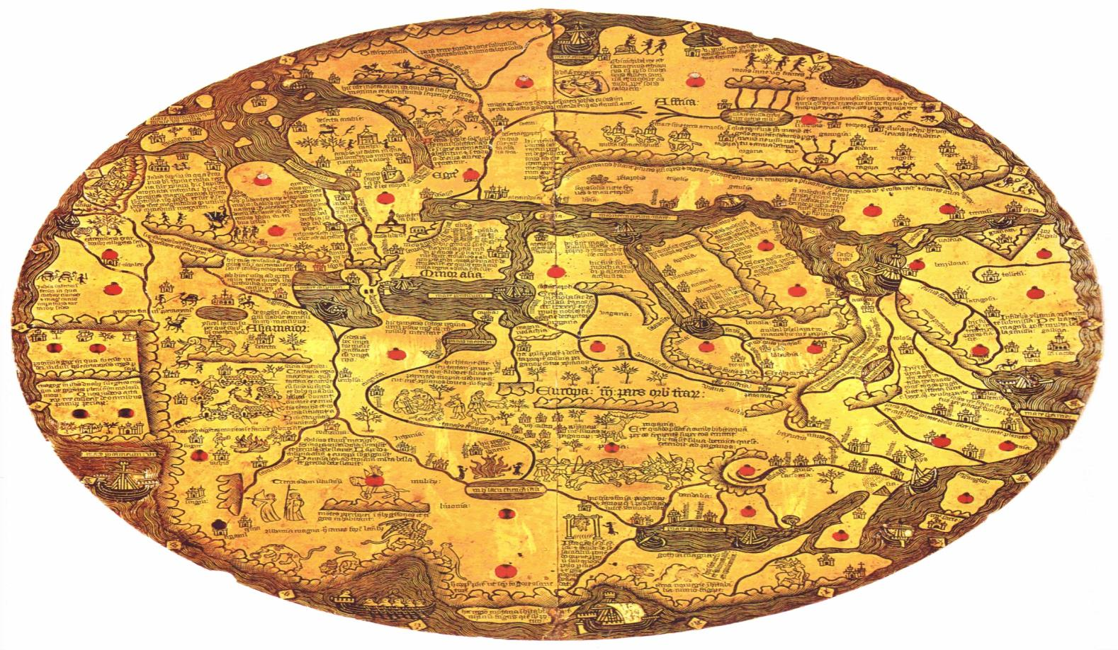
Sources of ethical dilemmas
your
little
world
the
big
world

Slide 18

The big world: sources of dilemma
Two incompatible ‘Goods’
“Public interest” – which public, whose interest
Power imbalances
Absence of power
Long-term v short-term
Who speaks for those with no voice?
Doubt and uncertainty
Notes:
These are the issues you will tend to find in the literature. They are the Big Questions that crop up across our lives. I’m not going to say much more about these, except to point out that many of the participative problem-structuring methods, and the community OR initiative grew out of the need to address these issues

Slide 19
Your little world: sources of dilemma
Obligations:
  contractual,
  managerial,
  representational
Time – your own
Time, money and good will – your clients’
Organisational culture
Relationships: loyalty, dependency, respect
Notes:
The next set of enemies is the connected, social and professional world we operate in.
Contractual obligations: consultants or in-house practitioners Is your work on the side of good or evil? For most practitioners, you make a one-off decision on this when you join your employer. If you think they are evil, don’t join! But if you think they work on the whole on the side of good, you sign a contract with them, which doesn’t have a let-out – for external consultants, if your consultancy deems a company or project within its ethical guidelines, you will find it hard to refuse; and in-house, similarly. Civil servants sign up knowingly to do their best whatever party is in power, which some may think of as a pact with the devil – but it is a pact. In the private sector [dividends/prices; redundancies; risk management].
Managerial obligations: If you are leading a team, they become stakeholders in your decision-making. They may have different views on ethical practice from you – how much should you constrain each other? If you challenge a client for improper use of the modelling, will it be the team that bears the brunt of subsequent withdrawal of work? If you want somebody to have developmental experience, how far should you also be second-guessing and intervening in their work with the client; and if you don’t, is the client getting a second-class service
Representational obligations: If you are representing your team, or your organisation, or your profession, how far can you put your personal values forward
Time You only have a limited amount of time. You must decide where to draw the line between quick-and-dirty and as good as technically possible. How good is good enough? If you do more than good enough, are you in effect ‘stealing’ from the client, by providing a gold-plated service she doesn’t need. This is true of model design, of parameter choice, of data collection and validation, of consultation…
Your client has only a limited amount of time. How much of it do you use consulting her? Detailing all the caveats? Ensuring she understands? It might be ideal always to have an expert; but the cost, the waiting time, the additional briefing needed for an outside, may be too much. It might be ideal to get further training for yourself, but the cost and the delay may not be affordable. If you take up other peoples’ time consulting them or getting information from them to further your client’s project, you are forcing them to respond to your client’s priorities instead of their own, and that is using up your client’s good will – how much of it can you use up? All these factors can cut back on data collection, understanding the context, stakeholder input, communication, testing, validation and general project quality and good practice.
Organisational culture May be to have lots of training or very little. Lots of reflection and review or get on with the next job. Lots of consultation or very little. Lots of consideration about alternatives or very little. Writing up for the wider community or for those who come after you, or very little. If you go against organisational culture, you may also damage relationships, damage people’s willingness to work with you, damage the chances that they will see you as one of the team
Relationships I must speak for most practitioners when I say that good relationships are crucial to successful projects. Every one of us is working with other people, and our relationships are a mix of good practice, social behaviour and emotion. Good practice to respect them and their needs; natural to have some dependency; emotional ties of loyalty. So when your client, or your manager, says: do not explore that scenario because it will distract us from my focus; do not include that finding in your final report because it will lead people to doubt the rightness of the decision; do not speak to that stakeholder because their opinion is irrelevant; how much do you argue with them? How far are you willing to go above their head, or behind their back? Everyone you work with has all the imperfections that I described earlier. Everyone you work with is making judgement calls about all the same sorts of ethical issues – big world and little world – that you are. At what point does their borderline-unethical practice cross over the line and lead you to break that relationship. At what point does your disagreement with their judgement call lead you to disrespect their judgement and undermine them, or worse, to break that relationship altogether.
And if the cost of breaking the relationship is no longer working with or for them, is that cost worth the benefit?

Slide 20


The answers?
Notes:
Beyond the scope of this talk.

Slide 21
Recommended further reading
Operational Research and Ethics: a literature review
R J Ormerod, W. Ulrich, European Journal of Operational Research 228 (2013) 291-307
Why good practice of OR is not enough—Ethical challenges for the OR practitioner F. Rauschmayer, I.Kavathatzopoulos, P.L.Kunsch, M.LeMenestrel, Omega 37 (2009) 1089-1099
Ethics beyond the model: How social dynamics can interfere with ethical practice in operational research/management science John Brocklesby, Omega 37 (2009) 1073-1082
https://www.informs.org/ORMS-Today/ORMS-Today-Current-Issue/Issues-in-Education

Slide 22
In conclusion: OR ethics is like OR
Plenty of problems to be addressed
[Plenty of] guidance on how to go about it
[Plenty of] potential solutions
The hard thing is implementation

Slide 23
Intentionally blank

Slide 24
Brocklesby
Social dynamics
Time pressure
Personal
emotions
Inexperience with method
Exclusion of alternative views, values, requirements
Failure to consider ‘who is the client’
Too-early consensus on the story-line
Deciding too soon on the method
Using a method without being fully expert
Mistaken belief that analysis is uncontroversial
Failure to place insights in wider context

Slide 25
Respect for your client
With regard to problem formulation (relations 1–2 and 5–6), “It is good practice not to accept the client's problem statement as the problem to be addressed” in order not to bias the results. Objectives of all important stakeholders should be included. All possible options should be con- sidered, and the OR practitioner should “withhold personal judgments and withstand political pressures”, even when difficult. Due to prevailing uncertainty, “it is good practice to develop several plausible scenarios”.

Slide 26
What might this mean in practice
Statement of intent:
  Too vague?
  Obstacles?
  Exceptions?
Test it:
  Universality
  Focus
  Helpful in real situations?
Refine eg:
  Degrees of separation
  Clashes with organisational culture
  Reporting others

Slide 27
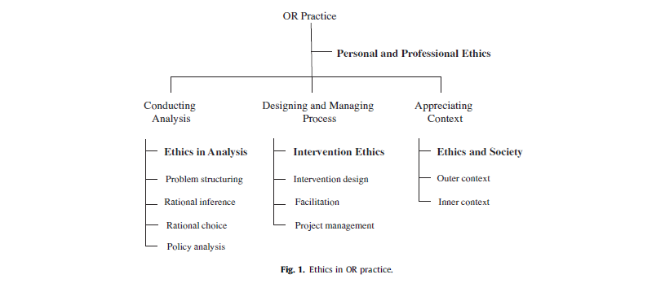

Slide 28
whole generation of OR/SA/MS analysts, educated since The Report (Guidelines) was published, do not even know of its existence and, worse, are not even aware of some of the ethical difficulties which they are likely to have to face: the temptation to curry favorwith a client, the quag- mires of the adversary process, the blurred distinctions between science and Operations Research. [Machol quoted in Gass]

Slide 29
Oath of prometheus
As an OR researcher, I request the largest freedom to collaborate with my colleagues and to investigate without any limits all ideas, all techniques and all methods in any field. However, I shall always keep in mind that the results of my research could possibly be used for Human purposes.
As an OR teacher, I commit myself: to transmit honestly my knowledge and my know- how; to respect my colleagues and to collaborate with them in a spirit of dialogue; to discuss with my students the consequences of the possible decisions proposed by the OR models.
As a decision-maker, I commit myself to takeinto account not only my own objectives but also the social, economic and ecological dimensions of the problems.
As a consultant OR ananalyst, I commit myself to convince the decision-makers to adopt a fair ethical behaviour and to assist them to meet their goals within the limits of sustainable development. I will feel myself free to refuse to provide information or tools, which to my opinion, could bring into danger the social welfare of mankind and the ecological future of Earth.

Slide 30
Why be ethical
“O.R. people are…nice”
Us
OR Society General Council member, at discussion on values
“Volkswagen Engineer Gets Prison in Diesel Cheating Case”
Them
New York Times, 25 August 2017
Notes:
http://www.reuters.com/article/us-volkswagen-emissions-sentencing-idUSKCN1B51YP?utm_campaign=trueAnthem:+Trending+Content&utm_content=59a05e9b04d301050bce8161&utm_medium=trueAnthem&utm_source=twitter

