Slide 1
How to get the most out of your model
Quality Assurance for Non-Analysts

Slide 2
Agenda
Objectives for the next hour
Introductions
What is a model?
Why should we care about process?
Getting from an idea to an answer
Your role as the customer
Quality Assurance

Slide 3
Objectives for the next hour
Your role in the process
How to be a good “customer”
And….Why is this important
Steps to get the best out of a modelling project
Principles of analytical quality assurance

Slide 4
Introductions
Who am I ?
Why am I here?
What modelling have I done?

Slide 5
What is a model?

Slide 6
What is a model?
Inputs
Modelling
Outputs
Insights
Models represent simplified versions of real systems and can be used to forecast figures, understand a phenomenon or evaluate a number of options.
Examples of models:
Simulating a new shop floor process
Sales forecasts
Depot and store location
“A model’s first quality is to cut out irrelevance and to simplify.”
Notes:
Quote by Prof. Patrick Rivett

Slide 7
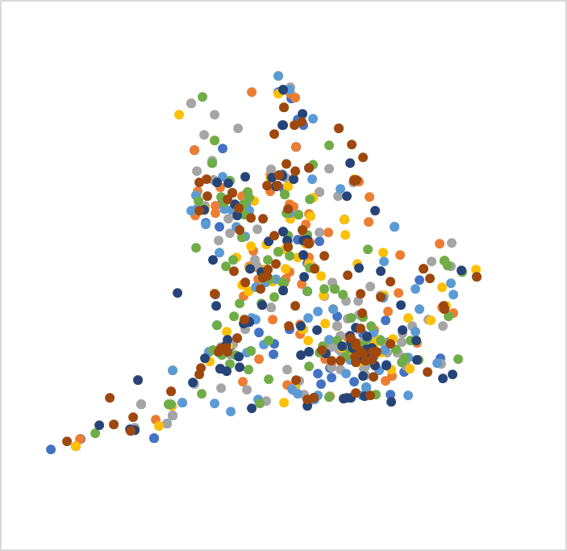
“ModBall” League – An example
Before
The sport of ModBall has been played since Victorian times & has a National Federation that manage and run regional leagues.
Clubs have joined leagues according to their whim and many clubs travel long distances to play in their leagues
The National Federation want to:
Reorganise the league boundaries
Reduce the distances travelled by clubs
Make sure that the standards of the divisions are compatible
Take into account the number of players
etc. etc.
You have to commission a model meet these requirements and satisfy the very very prickly committee
After!

Slide 8
The Model
Calculations
Assumptions
Inputs
Outputs
Travel time
Club details
Allocate clubs to leagues
Travel times
Maps
Maps
Travel
Preferences

Slide 9
How do we get there?
Mathematical
Space
Real World
Translation

Slide 10
The process

Slide 11
Getting from the idea to an “answer”
Translation
Understand the problem
Determining assumptions
Formulate the problem
Solve the model
Interpretation of results
Validation of model results
Implementation
Mathematical Space
Real World
How do we ensure the quality of the modelling stages before implementation?
BAD
Notes:
Adapted from Paul Harrison’s diagram “OR Method: The Scientific Method”

Slide 12
The Modelling Cycle
Scope & specify
Test
& sign off
Use
Populate (with data)
Design & Build
Review
The process to the left is idealised.
In reality there is significant iteration between all stages.
Quality assurance affects all stages of the cycle.
Document and communicate

Slide 13
New projects beware…
New areas of interest …
often lack relevant data or data is poor quality
therefore you need to make assumptions
BUT…..
small changes to some assumptions might have large effects
dealt with by:
collecting data
sensitivity analysis
Uncertainty is complex and not easily communicated – finding a balance is important to reduce misinterpretation of results.

Slide 14
A word on interpretation
Headlines
Simple messages. Few caveats.
Summary of model results includes comments, more easily communicated
Detailed model including results and working. Heavily caveated, not easily communicated.
Complexity and precision
Ease of understanding
Board
Management
Team
Customer
Analyst

Slide 15
You as the customer

Slide 16
Understanding models and modellers
Notes:
Role of SRO is different in different projects
SRO is not usually an analyst. Often have lead (or only) analyst but SRO still has responsibilities to:
Make sure modelling appropriate
QA is done properly
Limitations / assumptions understood and modelling used correctly

Slide 17
A caricature of the modelling process: The customer's story
It’s very frustrating…
All I want to know is, what is the best plan from for our bottom line? But the analyst won’t simply tell me this, even when I have carefully explained the problem and its surrounding considerations. I have to tell them precisely what options to consider and explain what they mean. What if we miss one?
Even when we’ve agreed which options to model…
I am asked to agree to a large set of assumptions about the future. Fuel prices, passenger volumes, international trends: you name it, I don’t know it and need to give an answer. Don’t we have one company view on this? Isn’t this the job of analysts?
I am always nervous…
If we have to make so many assumptions, surely any answer that the model gives must be highly contingent? How can I trust the answer? The numbers change so often…
And that brings up another thing…
If I make the assumptions clear, I will might come under under lots of criticism from colleagues who hold different assumptions; but, if I don’t share the assumptions, I will come under criticism for hiding something. I am caught between a rock and a hard place. The board wants clear, bold, and definitive explanations for the policies we have chosen; but the analyst is always hedging their answer with so many evasions and caveats that I can’t write a clear narrative.
Notes:
Delivery? Ask questions - do you recognise this caricature? Does it resonate with you? How do you deal with it?
A simplified version along the following lines:

Slide 18
A caricature of the modelling process: The analyst’s story
It’s very frustrating…
Modelling is hard – a mix of science and judgement. I need time to work out how to answer the question, but they never give me time. At the beginning of the process they don’t even know what the question is; and by the time they’ve figured out a question I can actually answer, it’s too late to do a thorough analysis.
Even if I did get time…
My customer doesn’t seem to understand that the world isn’t perfectly predictable. I don’t know what future prices are going to be and the model will only be as good as our assumptions. They want me to make definitive statements of fact but it’s surely obvious that I can never do that.
I am always nervous…
My customer seems to be basing their entire plan on my model. How can they trust it so much? What if someone finds a mistake? I hate it when deadlines are approaching but we keep going round and round making changes – the chance of error is too great for comfort.
And that brings up another thing…
My customer keeps changing the terms of reference of the problem after I thought we had agreed it; imposing ‘political constraints’, and otherwise constraining the solution in ways that require ‘off-model’ analysis. What’s the point of modelling if we’re going to do this?
Notes:
Delivery? Ask questions - do you recognise this caricature? Does it resonate with you? How do you deal with it?
A simplified version along the following lines:

Slide 19
Questions to ask your “modeller”
At project start
During development
When using model outputs
Questions to ensure the model is being set up appropriately with the best available information, and to have early sight of potential issues, e.g.:
What sort of outputs might I expect to get?
How useful will they be?
What are the key features of the modelling approach?
Why has this been chosen rather than alternatives?
Is it feasible / realistic to model at all?
Do you have the right resources for the job? (Both time and type / skills)
What will the key limitations be (e.g. data gaps, limitations of approach etc.)?
What are the key assumptions? How uncertain are they?
Are there links with other work that we should be aware of / be consistent with?
What could go wrong? How will we QA this?
Notes:
Here we can also discuss knowledge management e.g. at the beginning – making sure other suitable don’t already exist, or where we should be checking for consistency/drawing comparisons. At the end, making sure that knowledge gained is captured and will be used appropriately in the future.
Briefly talk about policy / modelling life cycle? Critical elements for QA are: choosing technique, checking it’s coded correctly, do outputs make sense etc.
Joining project mid-way through
- this supports the need for effective succession planning and knowledge transfer.
- SROs might want to review progress so far and assumptions used to date, and may need reassurance on the goals.

Slide 20
Questions to ask your “modeller”
At project start
During development
When using model outputs
Questions to monitor model progress (including QA), identify emerging issues and understand / assess early outputs, e.g.:
What is the model telling me?
Do the outputs make sense? Do people believe them? If not why not?
How do results compare with other estimates/ actual figures? Why do they differ?
What assumptions most affect results (policy assumptions and modelling assumptions)?
How is the model being assured? Who by? Why was this approach chosen?
Are plans in place for maintaining the model and ensuring it remains fit for purpose?
Notes:
Here we can also discuss knowledge management e.g. at the beginning – making sure other suitable don’t already exist, or where we should be checking for consistency/drawing comparisons. At the end, making sure that knowledge gained is captured and will be used appropriately in the future.
Briefly talk about policy / modelling life cycle? Critical elements for QA are: choosing technique, checking it’s coded correctly, do outputs make sense etc.
Joining project mid-way through
- this supports the need for effective succession planning and knowledge transfer.
- SROs might want to review progress so far and assumptions used to date, and may need reassurance on the goals.

Slide 21
Questions to ask your “modeller”
At project start
During development
When using model outputs
Questions to ensure outputs will be communicated appropriately, e.g.:
What are the outputs? Do you understand what causes them? Does anything surprise you?
What is the range of possible outcomes? How likely are they? What are the reasons for the variation?
What can we learn from this model about the real world?
How have outputs been assured? Who by?
Has the purpose of the model changed or been extended since the last QA was performed?
Are there any deeper uncertainties, whose impact cannot be evaluated?
Notes:
Here we can also discuss knowledge management e.g. at the beginning – making sure other suitable don’t already exist, or where we should be checking for consistency/drawing comparisons. At the end, making sure that knowledge gained is captured and will be used appropriately in the future.
Briefly talk about policy / modelling life cycle? Critical elements for QA are: choosing technique, checking it’s coded correctly, do outputs make sense etc.
Joining project mid-way through
- this supports the need for effective succession planning and knowledge transfer.
- SROs might want to review progress so far and assumptions used to date, and may need reassurance on the goals.

Slide 22
Quality Assurance

Slide 23
What is Quality?
Quality Assurance (QA) describes the processes in place that ensure models are delivered to the specification required by the customer.
Quality Control (QC) are the discrete tests and procedures carried out which provide assurance to a model.
Quality is not only about finding errors (QC) but to ensure, as much as is possible, that those errors aren’t made in the first place (QA) and, if they do occur, they can be found before they propagate (QA and QC).
Quality covers the whole model cycle, the decisions made on the way and the people involved with the process – not just the data and formulae in the model.

Slide 24
The Five Pillars of Quality Assurance
Documentation
Good documentation minimises the risk of knowledge loss or misuse of the model
Structure & Clarity
Models with a good structure and minimised complexity have shorter familiarisation times and errors are less likely to occur.
Verification
Verifying a model gives confidence that there are no errors in its execution.
Validation
Data & Assumptions
Models are designed to answer questions. Validation measures how well they do that.
Understanding the quality of input data decreases the risk of relying on outputs where the quality is uncertain.

Slide 25
An “off the shelf” approach to QA
The Aqua Book: guidance on producing quality analysis for government
BEIS Modelling Quality Assurance tools and guidance
QA Score
Documentation
Structure & Clarity
Validation
Verification
Data & Assumptions
Model Report for documentation
Assumptions log for data and assumption
Excel Model Template for structure

Slide 26
Why should we care about process?

Slide 27
The Growing Importance of Modelling
BEIS is a department with a large and growing analytical capability. There is a good chance that you may have to make a decision informed by the outputs of a model.
Good quality assurance practices ensure that you are given the best available information to make a rational decision based on evidence.
A model is not an end in itself. A model is simply a tool to help intelligent people make better decisions.
As non-analytical professionals, you could be the people making those decisions

Slide 28
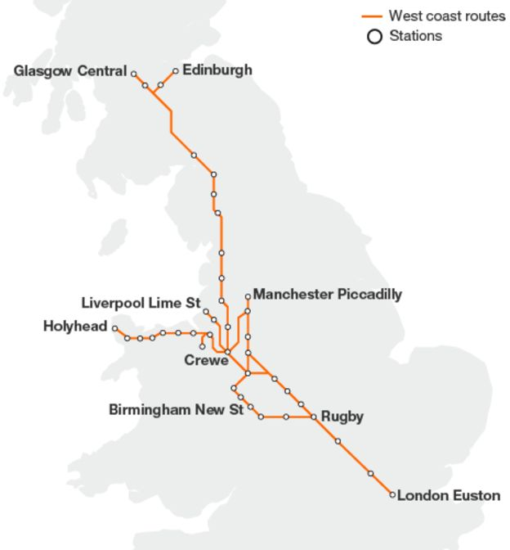
Motive West Coast Mainline
15 August 2012 – Franchise award to FirstGroup - challenged by Virgin through High Court
3 October 2012 - Award scrapped - Virgin continue running the route during rerun

Slide 29
Motive West Coast Mainline
‘The errors exposed by our investigation are deeply concerning. They show a lack of good process and a lack of proper quality assurance… 'completely unacceptable mistakes‘
‘I am determined to identify exactly what went wrong and why, and to put these things right so that we never find ourselves in this position again.’
Philip Rutnam
Permanent Secretary at the Department for Transport
Notes:
Size of Risk Bond to be paid by the bidder
“One of the flaws was that the economic assumptions were only checked at a late stage , when the transport department calculated the size of the risk bond to be paid by the bidder.- £200m vs £600m John Stokdyk 10 Oct 2012 AccountingWeb.co.uk
Cost 40M£ refund to bidders.
Criticisms of forecasting and risk models
Mistakes were made in the way in which inflation and passenger numbers were taken into account and how much money bidders were then asked to guarantee as a result.
At the hear of the bid process were spreadsheet projections of ticket sales, passenger numbers and investment plans from each bidder.

Slide 30
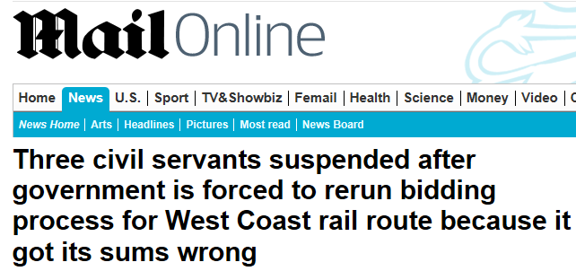
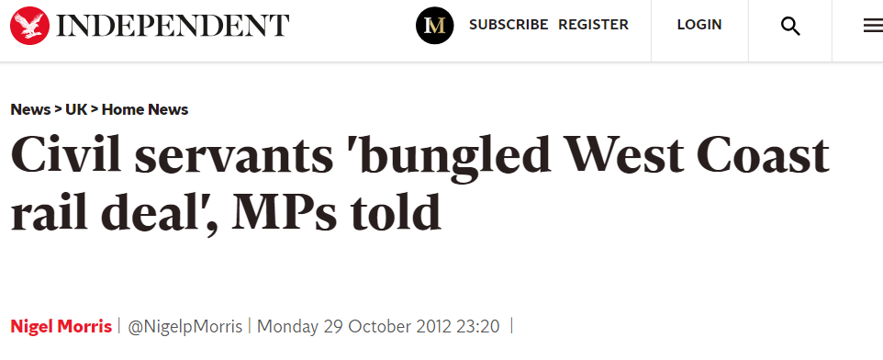
Motive

Slide 31
Questions?

