Slide 1
Risk, change and dependence on others
How BAE Systems uses modelling to address these challenges in ensuring value for money across the enterprise
Suzanne Harrison, Director CORDA, BAE Systems

Slide 2

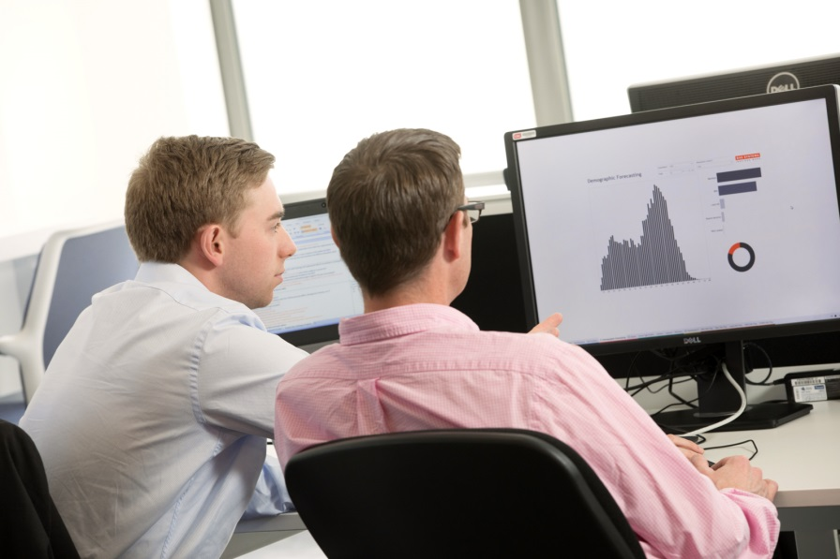
If only you could look into the future…
How will we perform?
How much will it cost?
Computational Modelling
What if things change?
What are the risks? And how can we mitigate them?

Slide 3
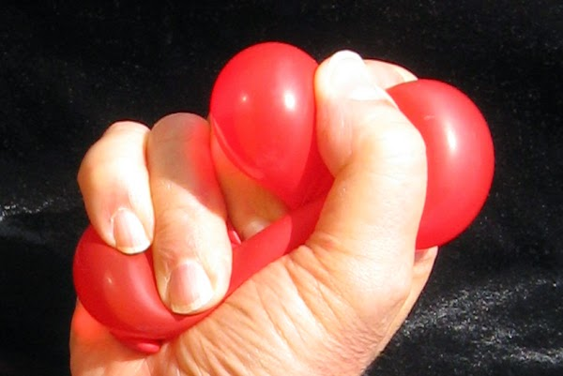
Many problems will quickly become complex…if you make a change in your solution, how will it impact the wider enterprise?

Slide 4
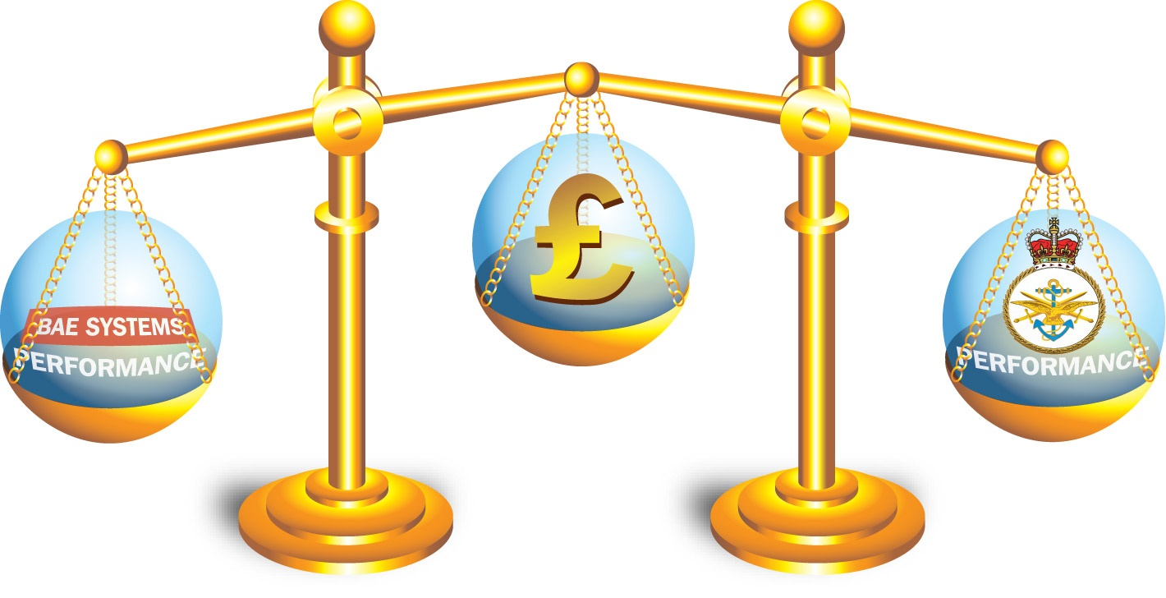
Everything requires a balancing act … Integrating performance and cost / revenue modelling is key to understanding the whole solution

Slide 5
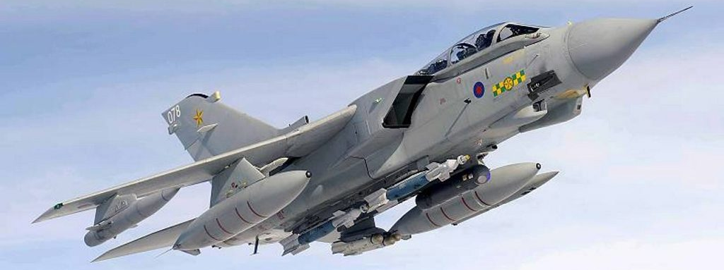
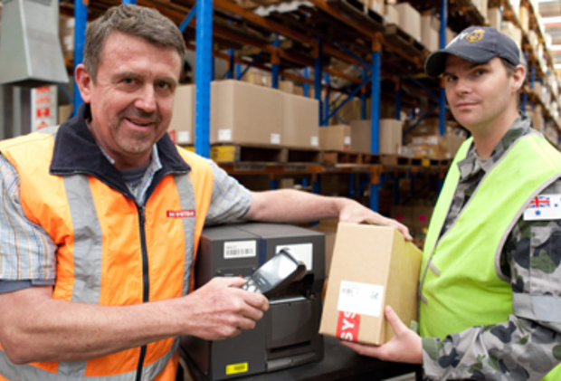
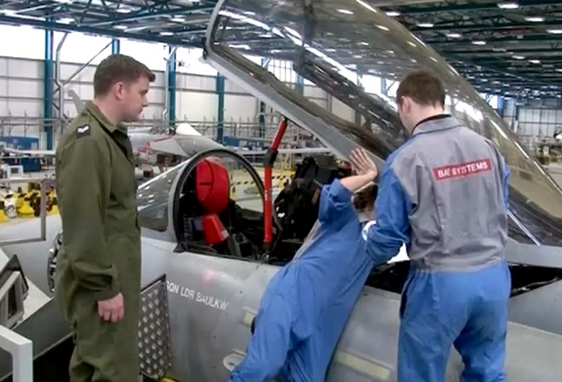
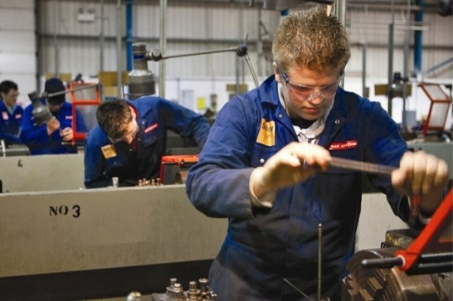
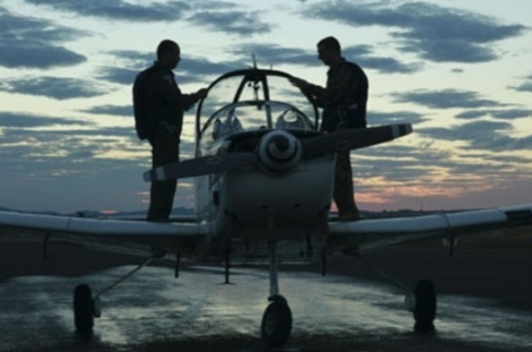
Industry’s role became more complex…

Slide 6
By modelling the whole enterprise we can understand the impact of taking on more responsibility and the associated risks / opportunities
The Past
Today & the Future
Provider & Decider
Decider
Equipment Operation
Equipment Operation
Maintenance
Maintenance
Supply
Customer
Supply
Customer
Industry
Industry
Engineering
Engineering
Training
Training
Provider of
Support
Provider of Services

Slide 7
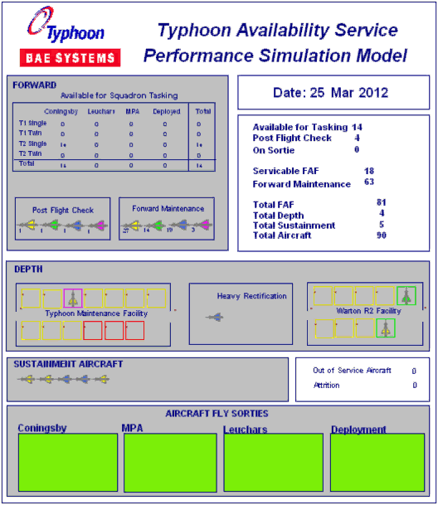
Example 1: Predicting how a service will perform…

Slide 8
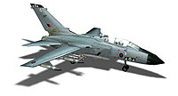
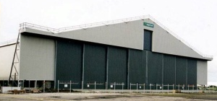

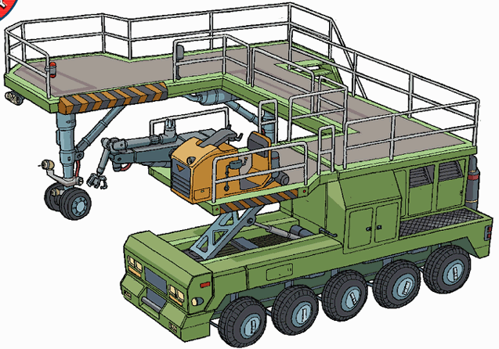
Example 2 – Managing an upgrade programme to time and cost and communicating the results
How many maintenance tracks are required?
How many Test rigs are required?
What will be the throughput rate?
Where are the bottlenecks?
What level of resourcing will be required?
What is the impact of delays in the system?
On-equipment
maintenance
Facilities
Support
equipment
Manpower

Slide 9
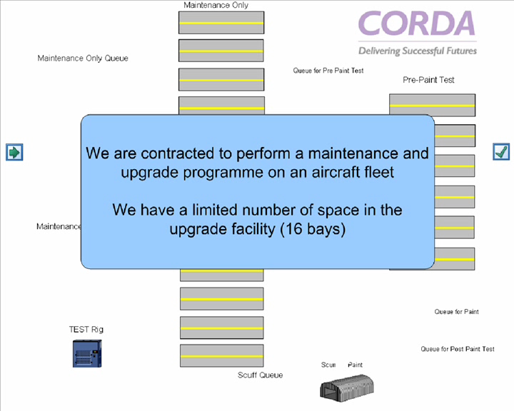

Slide 10

Mythbusting about Computational Modelling
“I’m not ready for modelling yet”
It’s never too early to start…the earlier the better
“We have no data”
You can still understand the key levers and drivers
“Modelling is only worthwhile for large organisations”
Everyone would benefit from more rigour in their decision making
“It’s going to take time and I already know the answer”
There may be multiple answers, risks to understand and will help with communicating

Slide 11
Thank you

